Slide 1
Do you believe that great athletes are born that way? Why or why not?

Slide 2
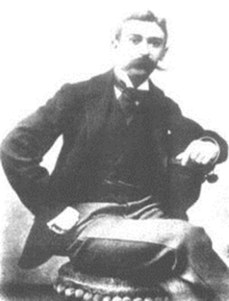
Evolution and the Birth of the Modern Olympics
I. Rebirth of the Olympics attributed to Pierre de Coubertin (1863-1937)
Early on dedicated life to social peace and domestic harmony
Haunted by memories of French defeat in Franco-Prussian War to Germany
Blames French physical inferiority to Germans for defeat
Germans participate in nationalistic form of gymnastics called turnen. Goal was to unify German people and drive French from land.
Coubertin studies German physical education and finds that Germans are more physically fit than French and wants to do something about it to ensure French safety.

Slide 3
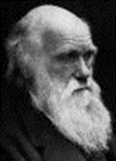
Birth Of Modern Olympic Games
II. Scientific basis for Coubertin
1859 Darwin’s Origin of Species
Life is difficult and in competition those best adapted will survive
Not determined by anyone (natural selection) some just have it
Those with positive variations survive
Questions religion and idea that we as humans have no control of environment
This theory would essentially give French no control over future

Slide 4
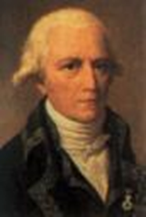
Birth Of Modern Olympic Games
B. 1809 Jean-Baptiste Lamarck
1. French feel inferior physically to European counterparts and if they buy Darwin then there is nothing they can do about the situation
2. Lamarck theory gives them hope that they can do something
3. Directed Adaptation allows people to adapt to environment
I. Organisms during their lifetimes acquire traits and characteristics they pass onto their offspring (giraffe)

Slide 5
Birth Of Modern Olympic Games
Coubertin visits England and United States sees they have gone mad for sports
English and American version of sport of higher “moral character” than German so brings that model home to France, but is met with Anglophobic attitudes.
1890 Coubertin forms the USFA to organize French sports
Viewed a mini-version of Olympics in England and begins plans for international games
Realizes that Christian zeal ended ancient games, so Coubertin and others feel modern games should be purged of all forms of paganism and goal should be to foster peace, happiness and harmony.

Slide 6
Birth Of Modern Olympic Games
1892 Coubertin makes formal announcement of plan to revive Olympic Games
Sparks conversations of amateurism (Coubertin didn’t care, but English do)
1. No material benefit from any sport
B. In America AAU President James Sullivan disliked idea
C. Received support in Britain from Amateur Athletic Association
1894 Coubertin forms the International Olympic Committee (IOC) and states that committee must be politically independent
First games to be played in Athens in 1896
Appoint Greek Demetrios Bekelas as first president of IOC
Decided to create new race that would be held in commemoration of Battle of Marathon 490 bc
Bikelas not met with much support by Greek government or the athletes in many countries. (For example Germany was happy with turnen and against competition)

Slide 7
Birth Of Modern Olympic Games
1896 Olympic Games
Games pulled together by a shoestring (Greeks do refurbish buildings)
USA, Britain, France, Italy, Spain, Sweden, Russia, Belgium, Greece show at first games
Russia (few athletes, modern sports not known)
Britain (6 athletes make trip, one vacationing Brit joins team)
Germany (Willibald Gebhardt convinces 10 gymnasts to leave Turnerschaft to join three other athletes)
USA sends 13 athletes, all volunteers from elite backgrounds, no women
Robert Garrett-captain of Princeton track team, dad pays for his and 3 friends trip
Boston Athletic Association sponsors 5 athletes
James Connolly-27 year old Harvard runner drops out after dean tells him no
Gardner Williams-U.S. swim champ
John and Summer Paine-Marksmen

Slide 8
Birth Of Modern Olympic Games
E. French send 3 athletes
Events/Success
Thomas Burke wins 100m 12.0 sec (wr 10.75) and 400m in 54.2 (wr 48s)
Robert Garrett wins discus 36’9.75” over Greek champ also wins shot put
Ellery Clark wins long jump 20’10” and high jump
James Connolly wins triple jump, Thomas Curtis wins 110m hurdles, William Hoyt wins pole vault
German Weingartner wins most medals with 7
Overall U.S. wins most track and field events but does bad in swimming and marathon
Marathon was highlight with Greek Spiridon Louys winning (Greek Pride)
Most dropped out, 13/17 competitors Greek

