Slide 1
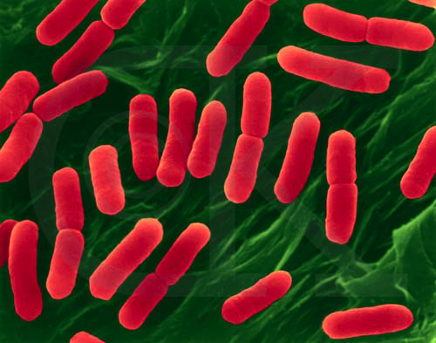
Chapter 13
Bacterial Genetics

Slide 2
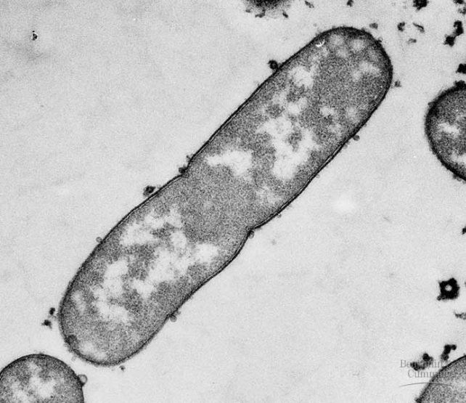
Why study bacterial genetics?
Its an easy place to start
  history
  we know more about it
    systems better understood
  simpler genome
  good model for control of genes
    build concepts from there to eukaryotes
  bacterial genetic systems are exploited in biotechnology

Slide 3
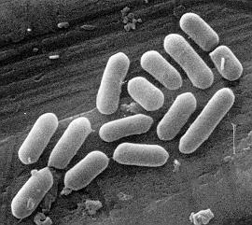
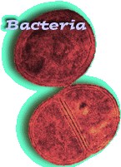
Bacteria
Bacteria review
  one-celled organisms
  prokaryotes
  reproduce by mitosis
    binary fission
  rapid growth
    generation every ~20 minutes
    10⁸ (100 million) colony overnight!
  dominant form of life on Earth
  incredibly diverse

Slide 4
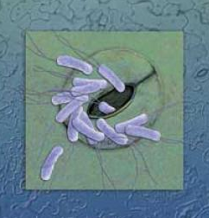
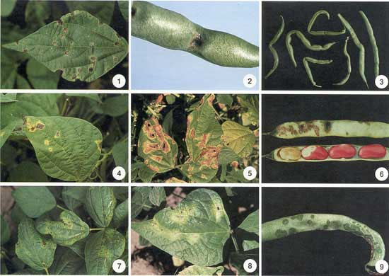
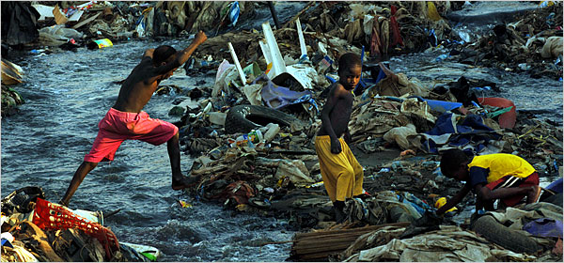
Bacteria as Pathogens
Disease-causing microbes
  plant diseases
    wilts, fruit rot, blights
  animal diseases
    tooth decay, ulcers
    anthrax, botulism
    plague, leprosy, “flesh-eating” disease
    STDs: gonorrhea, chlamydia
    typhoid, cholera
    TB, pneumonia
    lyme disease

Slide 5
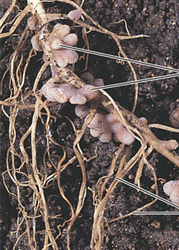
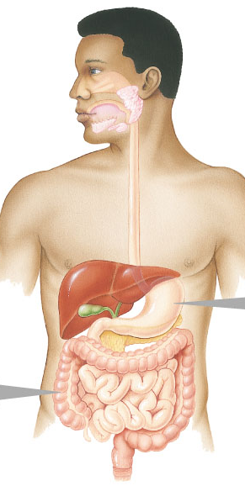
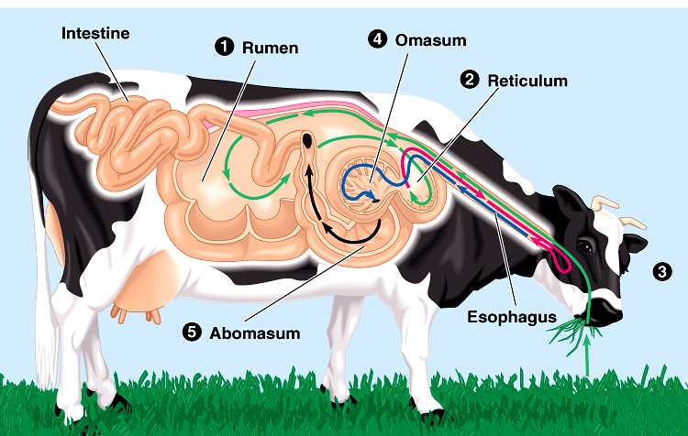
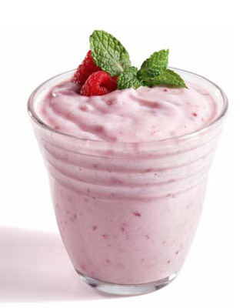
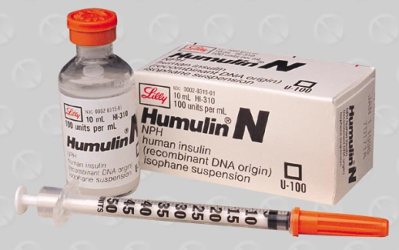
Bacteria as Beneficial (& necessary)
Life on Earth is dependent on bacteria
  decomposers
    recycling of nutrients from dead to living
  nitrogen fixation
    only organisms that can fix N from atmosphere
      needed for synthesis of proteins & nucleic acids
      plant root nodules
  help in digestion (E. coli)
    digest cellulose for herbivores
      cellulase enzyme
    produce vitamins K & B₁₂ for humans
  produce foods & medicines
    from yogurt to insulin
Notes:
AP Movie—Ch 26: Bacteria

Slide 6
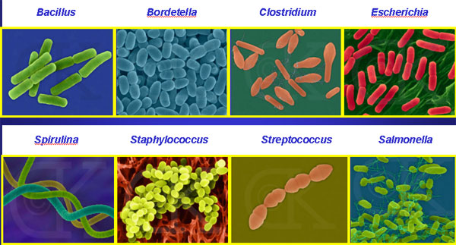
Bacterial Diversity
rods and spirals and spheres… Oh My!
Notes:
Rods
Spheres
Spirals

Slide 7
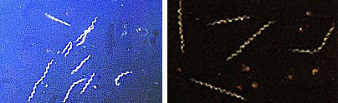
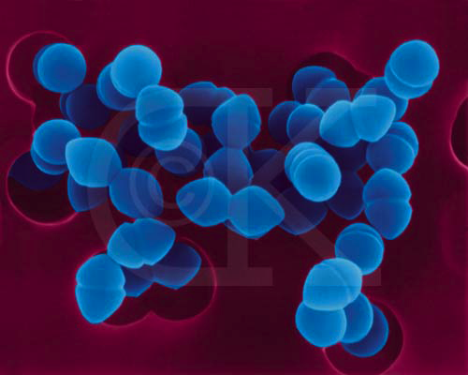
Bacterial Diversity
Borrelia burgdorferi
Lyme disease
Treponema pallidum
Syphillis
Escherichia coli O157:H7
Hemorrhagic E. coli
Enterococcus faecium
skin infections
Notes:
AP Link—Ch 13: Giant Microbes

Slide 8
Bacterial Genome
Single circular chromosome
  haploid
  naked DNA
    no histone proteins
  ~4 million base pairs
    ~4300 genes
    1/1000 DNA in eukaryote
Notes:
Genome = all the DNA of an organism
Eukaryotes
• 1000 times more DNA
• only 10 times more genes
- introns, spacers, inefficiency

Slide 9
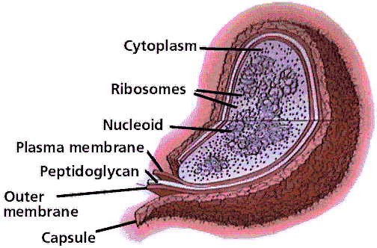
No Nucleus!
No nuclear membrane—prokaryotic!
  chromosome in cytoplasm
  transcription & translation are coupled together
    no processing of mRNA
  no introns
  but ‘Central Dogma’
  still applies
    use same
    genetic code

Slide 10
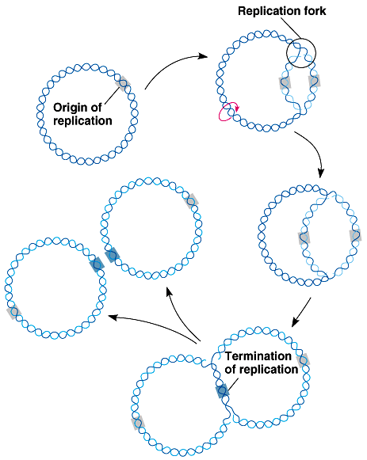
Binary Fission
Replication of bacterial chromosome
Asexual reproduction
  offspring genetically identical to parent
  where does variation come from?
Notes:
AP Link—Ch 13: Prokaryotic DNA Replication

Slide 11
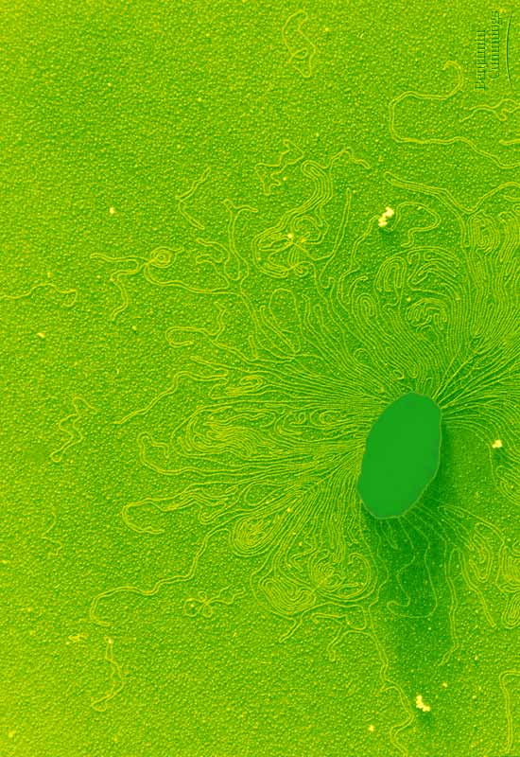
Variation in Bacteria
Sources of variation:
  spontaneous mutation
  transformation
    plasmids
    DNA fragments
  transduction
  conjugation
bacteria shedding DNA

Slide 12
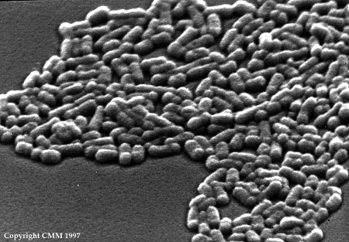
Spontaneous Mutation
Spontaneous mutation is a
significant source of variation
in rapidly reproducing species
Example: E. coli
  human colon (large intestines)
  2 x 10¹⁰ (billion) new E. coli each day!
  spontaneous mutations
    for 1 gene, only ~1 mutation in 10 million replications
    each day, ~2,000 bacteria develop mutation in that gene
    but consider all 4300 genes, then:
    4300 x 2000 = 9 million mutations per day per human host!

Slide 13
Transformation
Bacteria are opportunists
  pick up naked foreign DNA wherever it may be hanging out
    have surface transport proteins that are specialized for the uptake of naked DNA
  import bits of chromosomes from other bacteria
  incorporate the DNA bits into their own chromosome
    express new gene
    form of recombination
Notes:
While E. coli lacks this specialized mechanism, it can be induced to take up small pieces of DNA if cultured in a medium with a relatively high concentration of calcium ions.
In biotechnology, this technique has been used to introduce foreign DNA into E. coli.

Slide 14
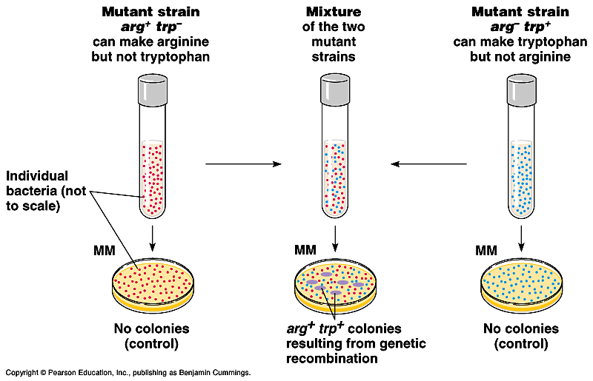
Swapping DNA
Genetic recombination by trading DNA
1
3
2
arg+
trp-
arg-
trp+
minimal
media

Slide 15
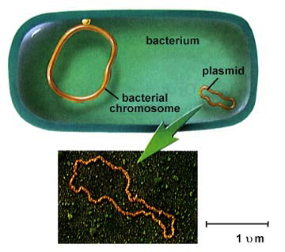

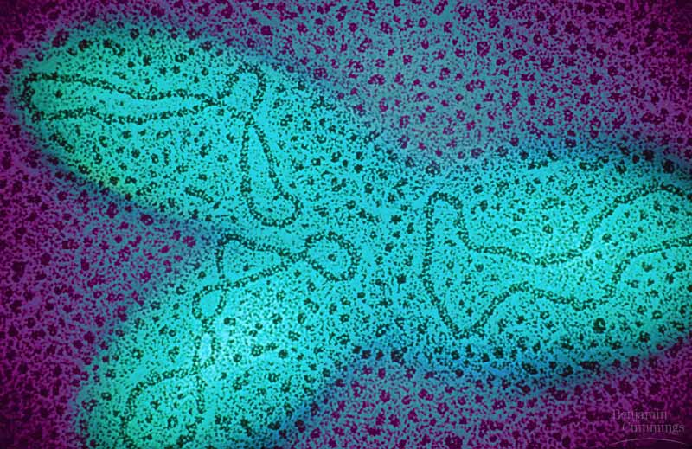
Plasmids
Trust me…
this will be
important!

Slide 16
Plasmids
Plasmids
  small supplemental circles of DNA
    5000 - 20,000 base pairs
    self-replicating
  carry extra genes
    2-30 genes
  can be exchanged between bacteria
    bacterial sex!!
    rapid evolution
    antibiotic resistance
  can be imported
  from environment
Notes:
Mini-chromosomes

Slide 17
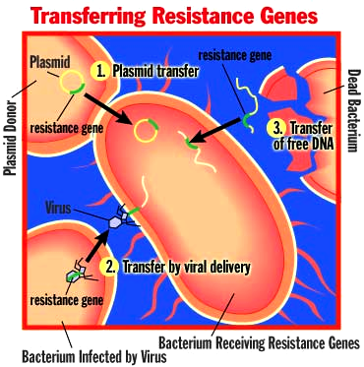
Plasmids & Antibiotic Resistance
Resistance is futile?
  1st recognized in
  1950s in Japan
  bacterial dysentery
  not responding to antibiotics
  worldwide problem now
    resistant genes are on plasmids that are swapped between bacteria

Slide 18
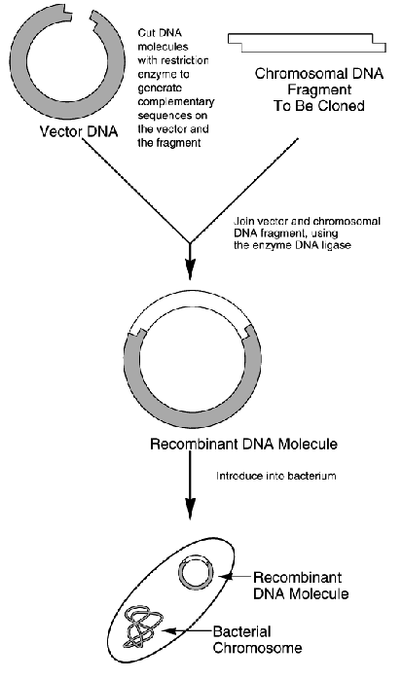
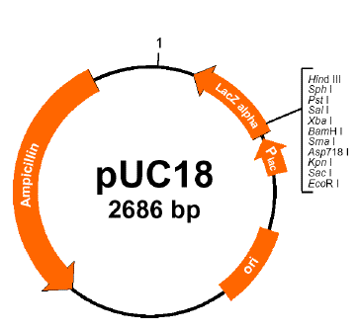
Biotechnology
Used to insert new genes into bacteria
  example: pUC18
    engineered plasmid used in biotech
antibiotic resistance gene on plasmid is used as a selective agent

Slide 19
Transduction
Phage viruses (or some other vector) carry bacterial genes from one host to another.

Slide 20
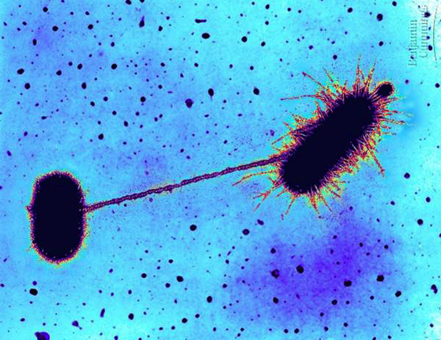
Conjugation
Direct transfer of DNA between 2 bacterial cells that are temporarily joined
  results from presence of F plasmid with F factor
    F for “fertility” DNA
  E. coli “male” extends sex pilli, attaches to female bacterium
  cytoplasmic bridge allows transfer of DNA
Notes:
AP Link—Ch 13: Bacterial Conjugation
AP Movie—Ch 13: Conjugation

Slide 21
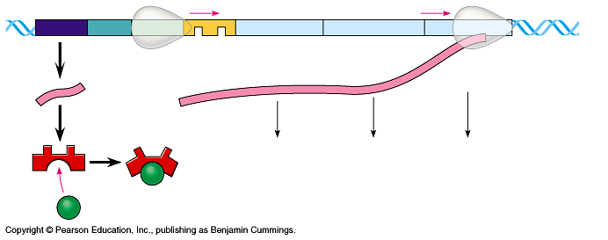
Bacterial Genetics
Regulation of Gene Expression

Slide 22
Bacterial Metabolism
Bacteria need to respond quickly to changes in their environment
  if have enough of a product,
  need to stop production
    why? waste of energy to produce more
    how? stop production of synthesis enzymes
  if find new food/energy source,
  need to utilize it quickly
    why? metabolism, growth, reproduction
    how? start production of digestive enzymes

Slide 23
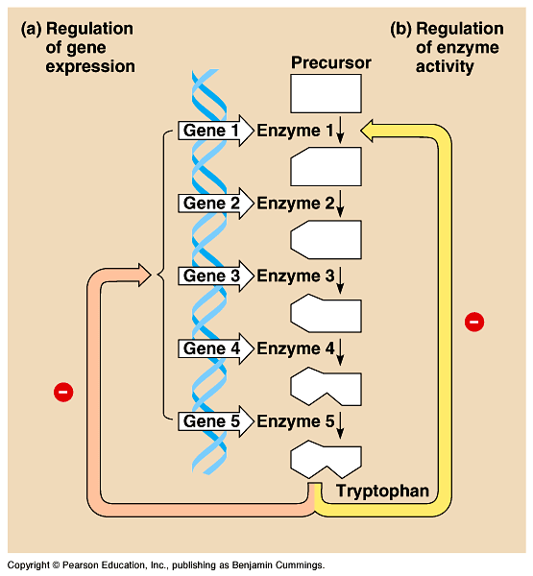
Reminder: Regulation of Metabolism
Feedback inhibition
  product acts
  as an allosteric inhibitor of
  1st enzyme in tryptophan pathway
-
= inhibition

Slide 24
Another Way to Regulate Metabolism
Gene regulation
  block transcription of genes for all enzymes in tryptophan pathway
    saves energy by
    not wasting it on unnecessary protein synthesis
-
= inhibition

Slide 25
Gene Regulation in Bacteria
Control of gene expression enables individual bacteria to adjust their metabolism to environmental change
Cells vary amount of specific enzymes by regulating gene transcription
  turn genes on or turn genes off
    ex. if you have enough tryptophan in your cell then you don’t need to make enzymes used to build tryptophan
      waste of energy
      turn off genes which codes for enzymes
Notes:
Remember:
rapid growth
generation every ~20 minutes
10⁸ (100 million) colony overnight!
Anybody that can put more energy to growth & reproduction takes over the toilet.
An individual bacterium, locked into the genome that it has inherited, can cope with environmental fluctuations by exerting metabolic control.
First, cells vary the number of specific enzyme molecules by regulating gene expression.
Second, cells adjust the activity of enzymes already present (for example, by feedback inhibition).

Slide 26
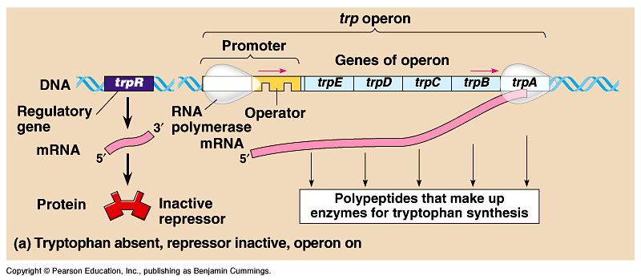
So how can genes be turned off?
First step in protein production?
  transcription
  stop RNA polymerase!
Repressor protein
  binds to DNA near promoter region blocking RNA polymerase
    binds to operator site on DNA
    blocks transcription

Slide 27
Genes Grouped Together
Operon
  genes grouped together with related functions
    ex. enzymes in a synthesis pathway
  promoter = RNA polymerase binding site
    single promoter controls transcription of all genes in operon
    transcribed as 1 unit & a single mRNA is made
  operator = DNA binding site of regulator protein

Slide 28
Repressor Protein Model
Operon:
The operator, promoter & genes they control
serve as a model for gene regulation
RNA
polymerase
RNA
polymerase
repressor
gene1
gene2
gene3
gene4
TATA
DNA
Repressor protein turns off gene by blocking RNA polymerase binding site.
promoter
operator
repressor
repressor protein

Slide 29
Repressible Operon: Tryptophan
Synthesis Pathway Model
When excess tryptophan is present, binds to tryp repressor protein & triggers repressor to bind to DNA.
  (blocks [represses] transcription)
RNA
polymerase
RNA
polymerase
repressor
gene1
gene2
gene3
gene4
TATA
DNA
repressor
repressor protein
promoter
operator
tryptophan (a corepressor)
tryptophan – repressor protein
complex
repressor
conformational change in repressor protein!

Slide 30
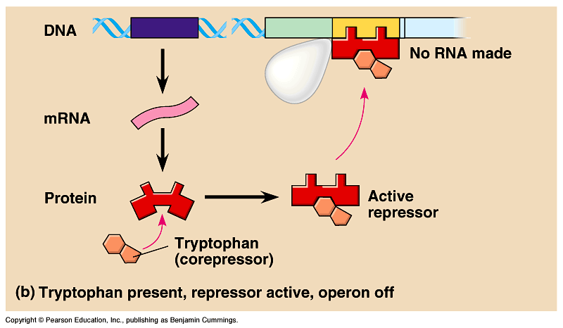
Tryptophan Operon
What happens when tryptophan is present?
Don’t need to make tryptophan-building enzymes!
Tryptophan binds allosterically to regulatory protein.
Notes:
Left AP Link—Ch 13: trp Operon (TSOB)
Right AP Link—Ch 13: trp Operon (McGraw Hill)

Slide 31
Inducible Operon: Lactose
Digestive pathway model
When lactose is present, binds to
lac repressor protein & triggers repressor to release DNA
  (induces transcription)
RNA
polymerase
RNA
polymerase
repressor
gene1
gene2
gene3
gene4
TATA
repressor
DNA
repressor
repressor protein
promoter
operator
lactose
lactose – repressor protein
complex
repressor
conformational change in repressor protein!

Slide 32
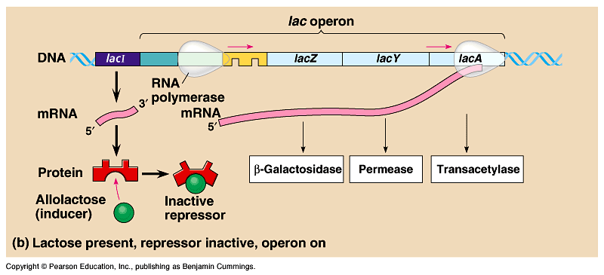
Lactose Operon
What happens when lactose is present?
Need to make lactose-digesting enzymes!
Lactose binds allosterically to regulatory protein.
Notes:
Left AP Link—Ch 13: lac Operon (TSOB)
Right AP Link—Ch 13: lac Operon (McGraw Hill)

Slide 33
Operon Summary
Repressible operon
  usually functions in anabolic pathways
    synthesizing end products
  when end product is present in excess,
  cell allocates resources to other uses
Inducible operon
  usually functions in catabolic pathways
    digesting nutrients to simpler molecules
  produce enzymes only when nutrient is available
    cell avoids making proteins that have nothing to do, cell allocates resources to other uses

Slide 34
Jacob & Monod: lac Operon
1961 | 1965
Francois Jacob & Jacques Monod
  first to describe operon system
  coined the phrase “operon”
Jacques Monod
Francois Jacob

Slide 35
Any Questions??

