Slide 1
Planning and Conducting Scientific Investigations

Slide 2
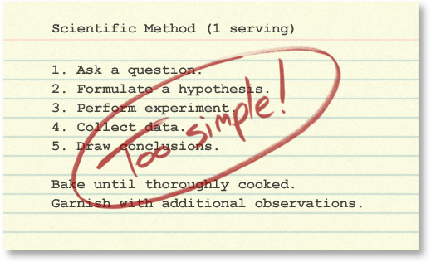
The Scientific Method

Slide 3
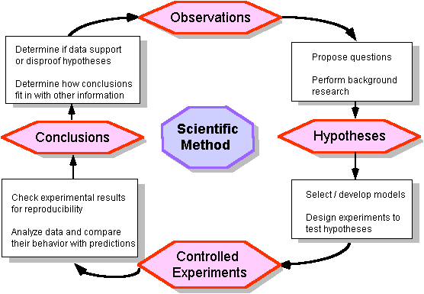
Better:

Slide 4
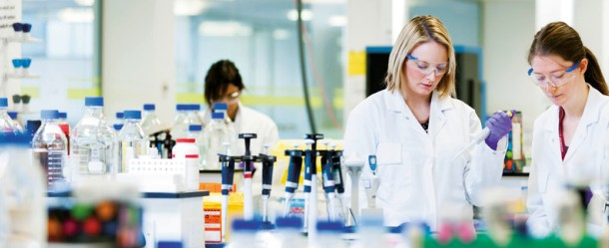
In reality, the scientific process is non-linear. Investigations often involve repeating the same steps many times to account for new information and ideas.
Notes:
http://undsci.berkeley.edu/article/howscienceworks_01

Slide 5
A non-linear process of scientific inquiry
Best:
Notes:
© 2012 The University of California Museum of Paleontology, Berkeley, and the Regents of the University of California • www.understandingscience.org
http://undsci.berkeley.edu/article/scienceflowchart

Slide 6
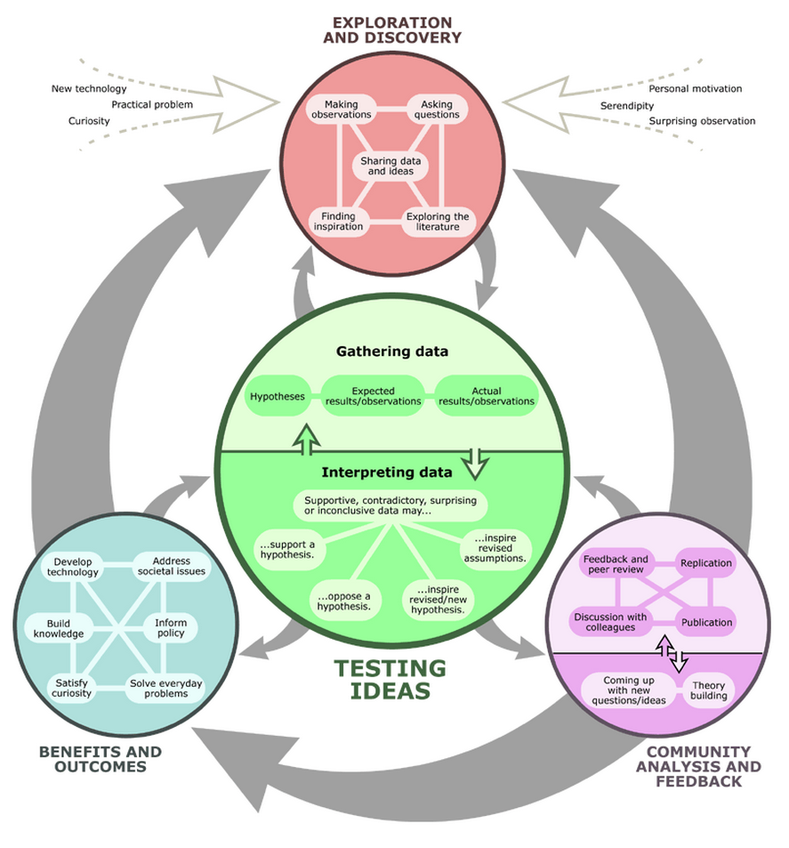

Slide 7
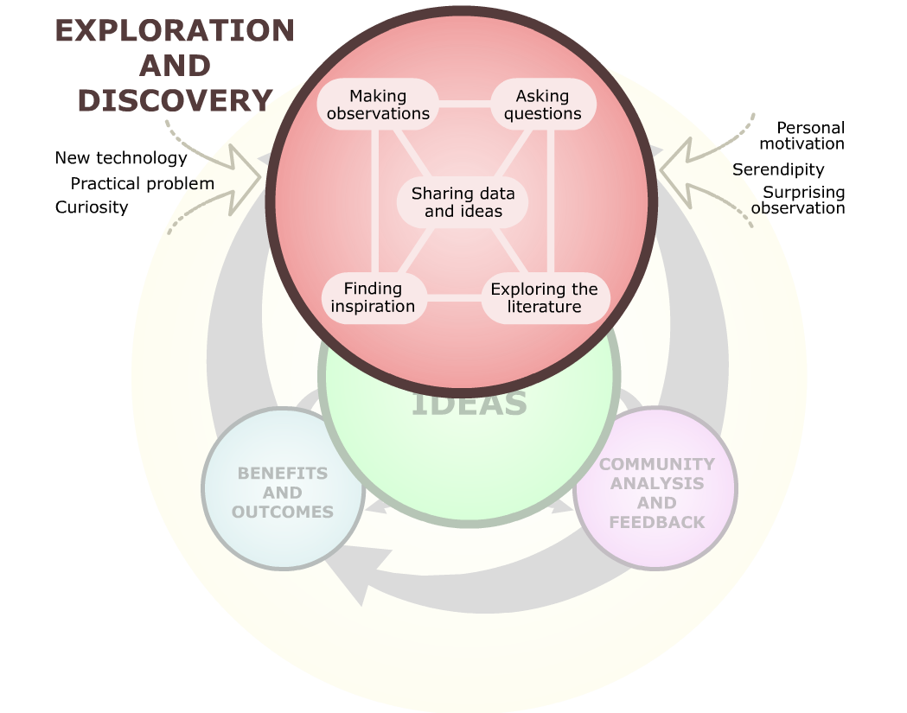
Notes:
© 2012 The University of California Museum of Paleontology, Berkeley, and the Regents of the University of California • www.understandingscience.org
http://undsci.berkeley.edu/article/scienceflowchart

Slide 8
Exploration and Discovery involves:
Making observations
Asking questions
Sharing data and ideas
Finding inspiration
Exploring the literature

Slide 9
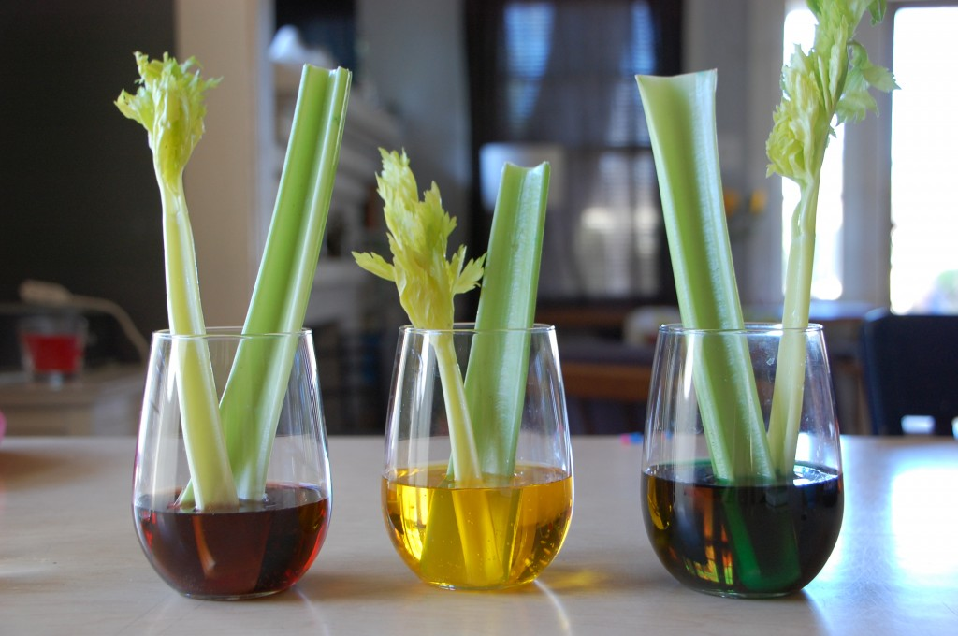
Good scientific questions:
lead to further discussion.
lead to further investigation.
include measurable values.
lead to fact finding.
identify the independent and dependent variables.

Slide 10
Is this a good scientific question: “Is more fertilizer better for plants?” As a class, figure out how this question could be improved.
Use with Worksheet to Accompany “Planning and Conducting Scientific Investigations” PowerPoint

Slide 11
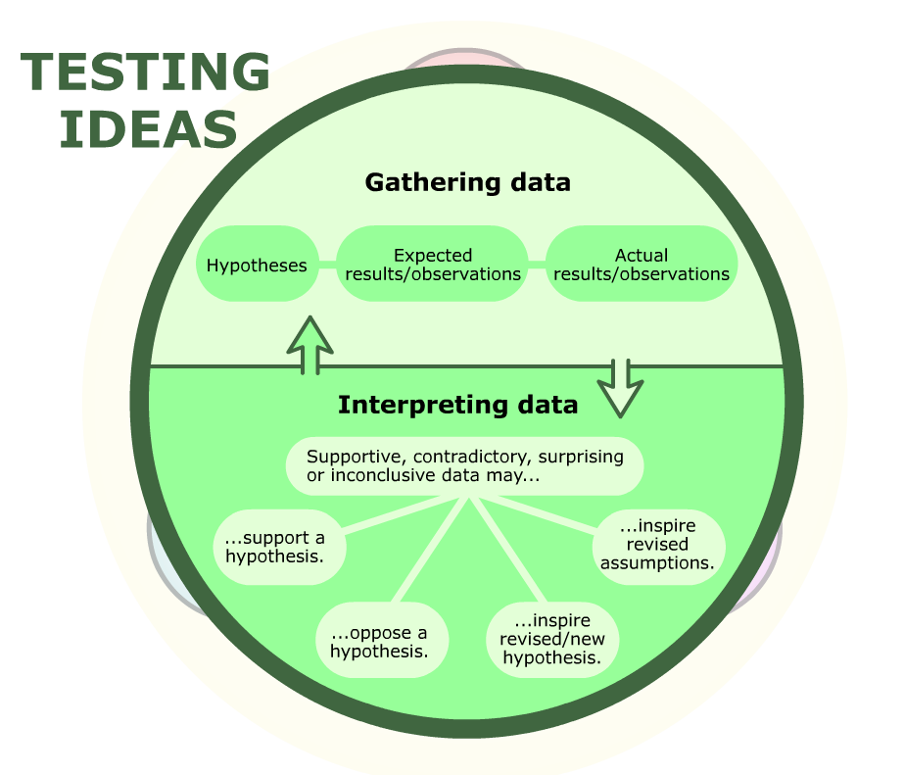
Notes:
© 2012 The University of California Museum of Paleontology, Berkeley, and the Regents of the University of California • www.understandingscience.org
http://undsci.berkeley.edu/article/scienceflowchart

Slide 12
Testing Ideas involves:
Gathering Data
Interpreting Data
Forming a testable hypothesis
Deciding expected results/observations
Discovering actual results/observations
Data can:
Support a hypothesis
Oppose a hypothesis
Inspire a new/revised hypothesis
Inspire revised assumptions

Slide 13
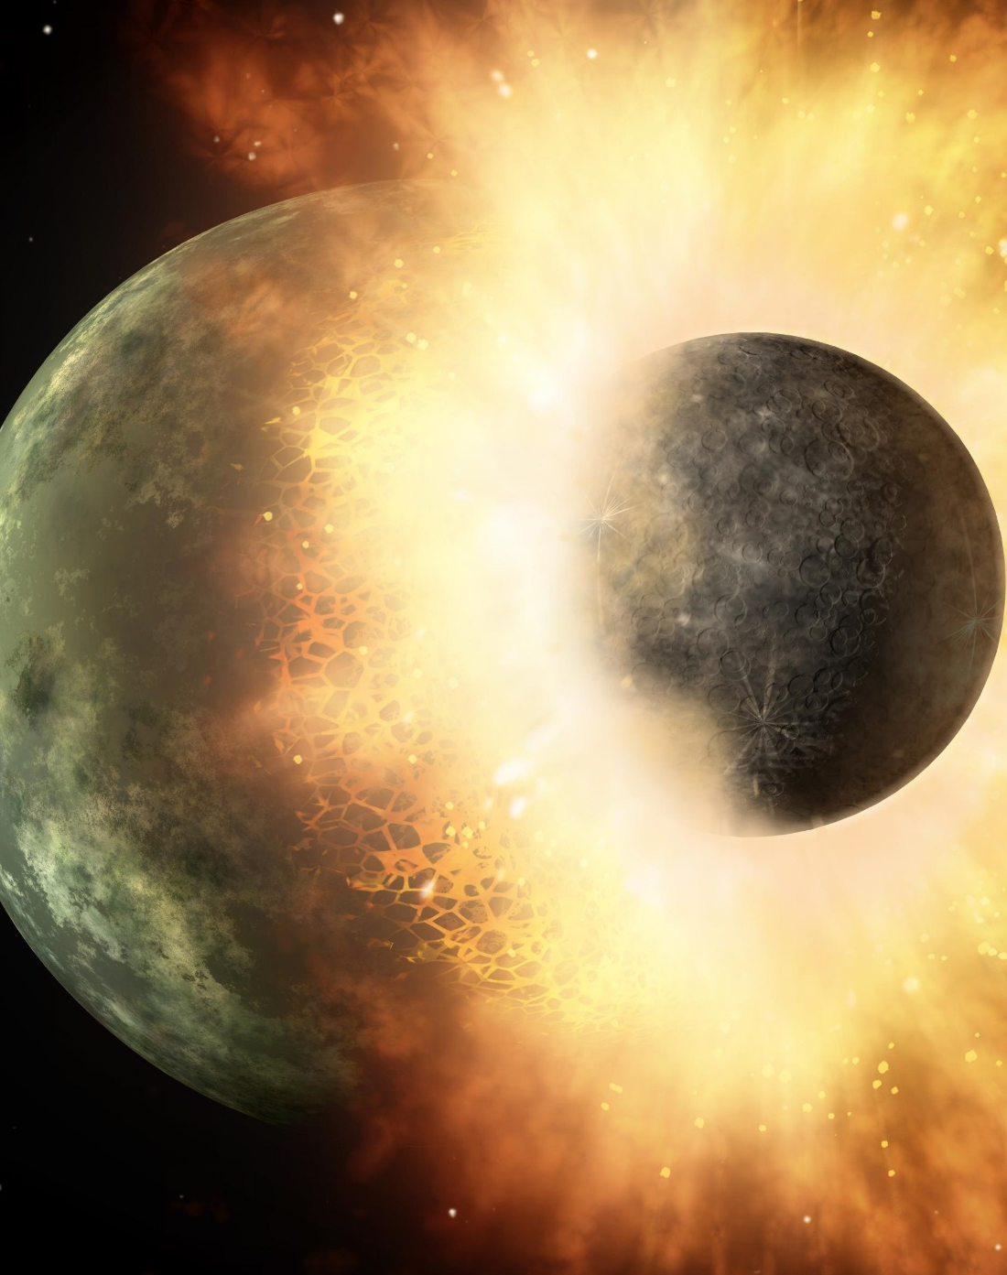
A good hypothesis:
is a statement, not a question.
is plausible.
is testable.
is falsifiable.
is as general as possible.
defines measurable variables.
is written in the form of “if…then”.
Is consistent with data already obtained.

Slide 14
As a class, develop a good hypothesis for the question you previously revised: “Is more fertilizer better for plants?”
Use with Worksheet to Accompany “Planning and Conducting Scientific Investigations” PowerPoint

Slide 15
Characteristics of a True Experiment:
Random assignment to groups
Control of extraneous variables
Manipulation of the independent variable
Quantitative measurement of outcomes
Comparison of participant groups
Contains a control group

Slide 16
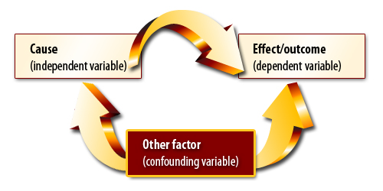
Experimental Variables:
Independent variable: variable that is being tested (manipulated by researcher)
Dependent variable: variable that is being measured (the data that is recorded)
Confounding variables: other variables that must be identified and controlled so as not to confound results.

Slide 17
Types of Data:
Quantitative Data
– numerical results
measurable; can perform statistical analysis
Qualitative Data
– non-numerical results
results can be subjective
cannot statistically analyze

Slide 18
As a class identify the variables in your fertilizer experiment:
Independent variable:
Dependent variable:
Confounding variables:
Use with Worksheet to Accompany “Planning and Conducting Scientific Investigations” PowerPoint

Slide 19
The parts of an experiment:
The control group:
The group(s) that do not receive the treatment (the independent variable)
The experimental group:
The group(s) that receive the treatment (the independent variable)
Control
Group:
Experimental
Group:
Levels of the experimental group
Amount of fertilizer:
No fertilizer
Varying amounts of fertilizer

Slide 20
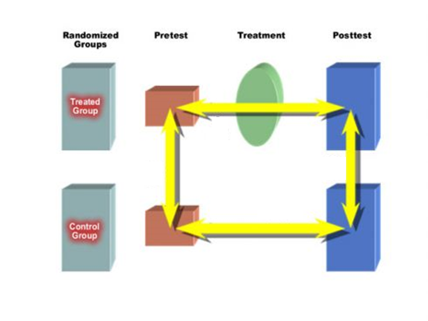
Test groups should be of a large size or the experiment should be performed several times to eliminate getting results by chance (anecdotal evidence).

Slide 21
As a class, design your experiment. Assign plants to either the experimental group or control group. Identify the levels of your treatment group (experimental group).
 | Control Group | Levels of Treatment Group:
Amount of Fertilizer: | ________ | _______ _______ _______ ______ ________
Use with Worksheet to Accompany “Planning and Conducting Scientific Investigations” PowerPoint

Slide 22
After the experiment, the results are analyzed and a conclusion is made.
The hypothesis is either accepted or rejected based on the evidence.
Nothing is ever “proved”.

Slide 23
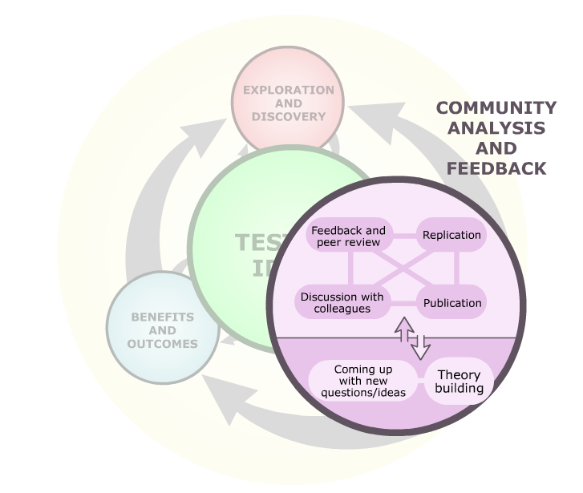
Notes:
© 2012 The University of California Museum of Paleontology, Berkeley, and the Regents of the University of California • www.understandingscience.org
http://undsci.berkeley.edu/article/scienceflowchart

Slide 24
Community Analysis and Feedback involves:
Scientific Community
Effect on Researchers
Discussion with colleagues
Publication
Feedback and peer review
Replication of research by others in the community
Coming up with new questions/ideas
Theory building

Slide 25
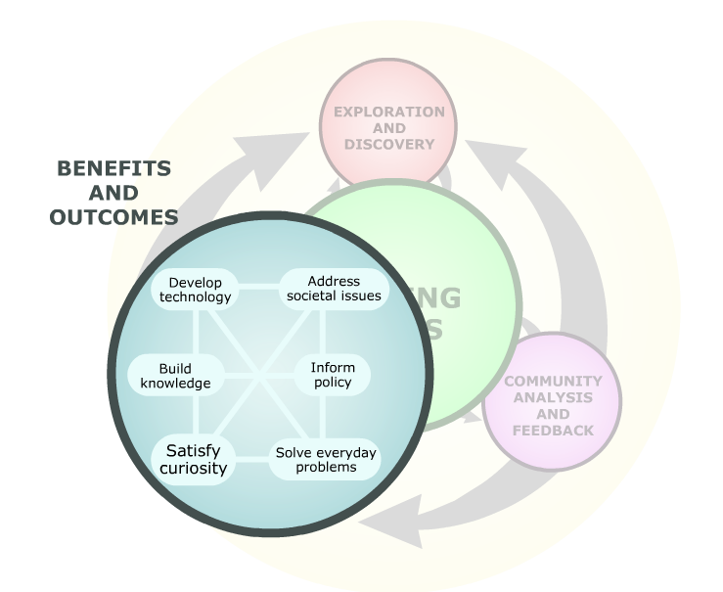
Notes:
© 2012 The University of California Museum of Paleontology, Berkeley, and the Regents of the University of California • www.understandingscience.org
http://undsci.berkeley.edu/article/scienceflowchart

Slide 26
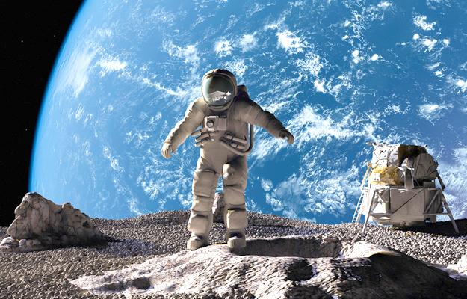
Benefits and Outcomes of Scientific Research include:
Build knowledge
Satisfy curiosity
Develop new technology
Address societal issues
Inform policy
Solve everyday problems

Slide 27
Correlational Studies
Have no control group
“Correlation cannot imply causation”
A correlational study cannot determine that the results were actually caused by the independent variable and not another, confounding third variable.
Positive Correlation
Negative Correlation
No
Correlation

Slide 28
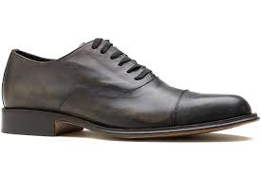
Example of a real-life correlation:
“Shoe size is strongly correlated with reading ability.”
Possible Interpretations:
Having bigger feet increases your reading ability.
Reading increases your foot size.
There is a third variable that is affecting the correlation. Example: Age.

Slide 29
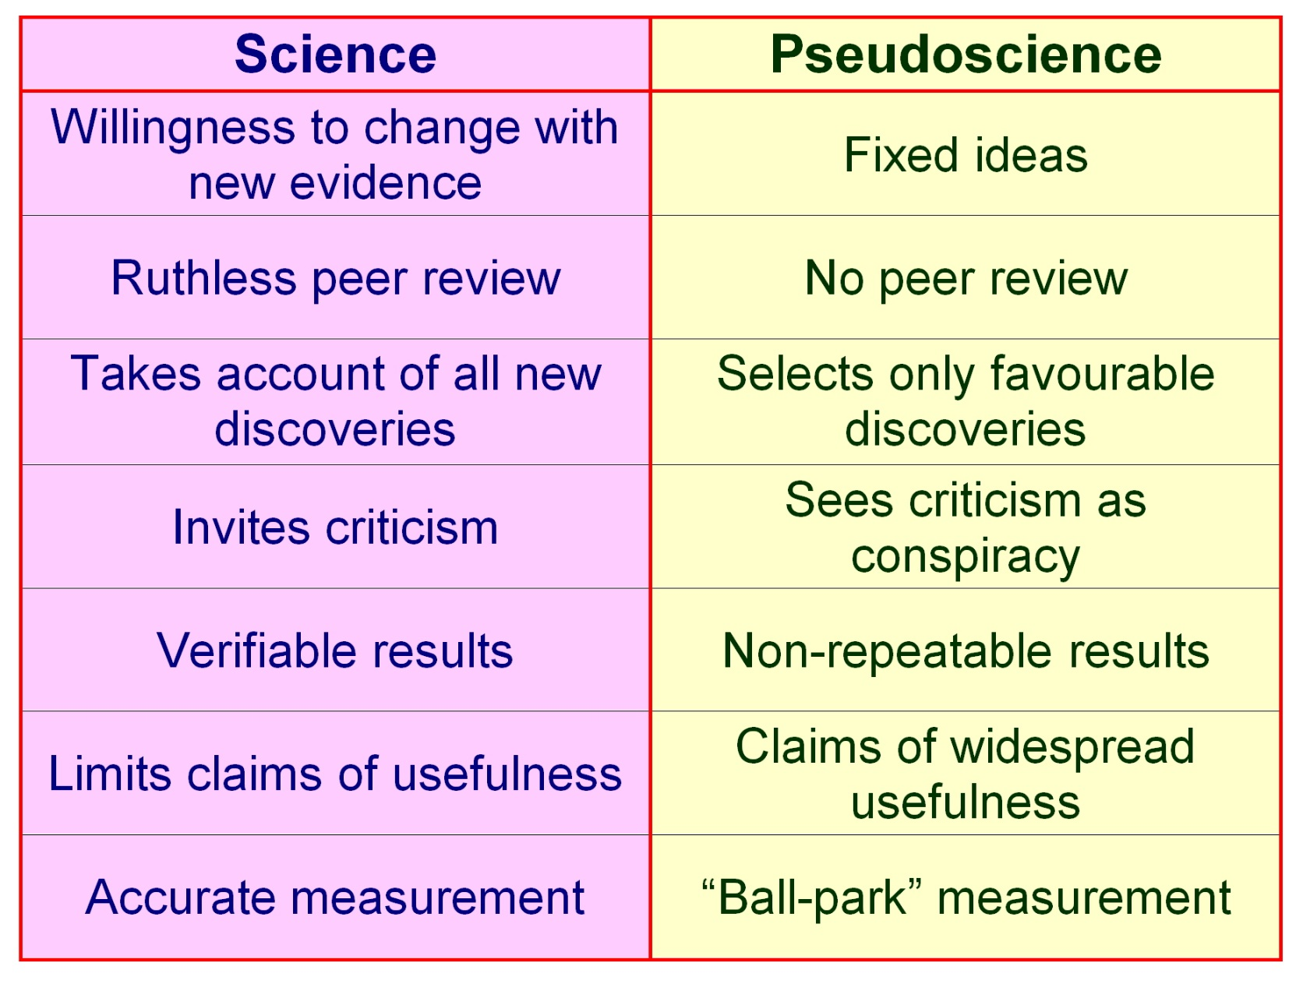
Beware of Pseudoscience

Slide 30
References:
http://undsci.berkeley.edu/article/0_0_0/whatisscience_01

