Slide 2
America & Imperialism
The Spanish-American War
1898

Slide 3
Objectives
Identify events that escalated to conflict between the U.S. and Spain
Discuss the course and results of the Spanish-American War

Slide 4
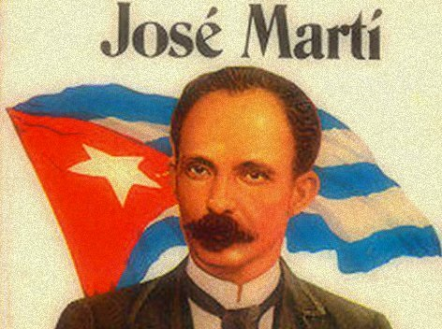
The Path to War
Cuban Rebellion
José Martí
Enlivened Americans about the plight of Cubans under Spanish rule. Cuba Libre!

Slide 5
The Path to War
War Fever
Yellow Journalism - Exaggerated reporting accounts to increase readership
The De Lôme Letter
Spanish minister to the U.S. called President McKinley weak
The U.S.S. Maine Explodes
260 men were killed
Newspapers laid the blame on Spain

Slide 6
Yellow Journalism Example

Slide 7
U.S.S. Maine
before & after

Slide 8
The Spanish-American War, 1898
War Erupted
Spain was willing to negotiate, but the American people were not.
Why?
“Remember the Maine!”
“Yee-haw!”
“Remember the Alamo!”
“Taxation without representation is tyranny!”

Slide 10
The Spanish-American War, 1898
War Erupted
The Caribbean
Naval blockade of Cuba
Teddy Roosevelt’s Rough Riders captured San Juan Hill
The Philippines
George Dewey defeated Spanish fleet
Filipino rebels led by Emilio Aguinaldo supported U.S. forces

Slide 12
The Treaty of Paris, 1898
Secretary of State John Hay called it a “Splendid Little War” (only 15 weeks long)
Spain granted Cuba its independence
- The U.S. also acquired Guam and Puerto Rico
Spain gave the U.S. the Philippines for $20 million

Slide 13
Cuba
Teller Resolution (1898)
- U.S. not to annex Cuba
Platt Amendment (1901)
Demanded political, economic, & military concessions
No treaties
No debt
U.S. can intervene
Guantanamo Bay
- Cuba became a U.S. protectorate (?)
Protectorate – a country whose affairs are partially controlled by a stronger power

Slide 14
Puerto Rico
Foraker Act (1900)
Ended military rule
Civilian control government

Slide 15
Foreign Policy
“America has no permanent friends or enemies, only INTERESTS.”
Henry Kissinger

