Slide 1
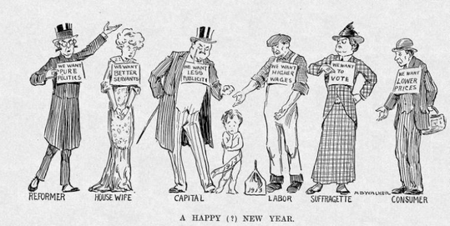
Greetings
Think About It
“History, although sometimes made up of the few acts of the great, is more often shaped by the many acts of the small.” - Mark Twain

Slide 2
Objectives
Analyze efforts to reform government and elections.
Build a concept map to visualize the government and election reforms presented .

Slide 3
State & Election Reforms
BEFORE
party bosses selected almost all candidates for office
political machines controlled city, county, and state legislatures
AFTER
states adopted the secret ballot, the initiative, the referendum, the recall, and direct primary

Slide 4
State & Election Reforms
Initiative – a bill originated by the people rather than lawmakers
Example: There ought to be a law for…
Referendum – an acceptance or rejection vote on an initiative by voters
Example: Whether to legalize medical marijuana.

Slide 5
State and Election Reforms
Recall – a petition and election to remove elected officials before the end of their terms
Example: California Governor Gray Davis
Direct Primary – voters choose candidates for public office through popular election
Example: John Katko

Slide 6
Direct Election of Senators
Prior to 1913,
each state’s legislature chose its own U.S. senators
put more power in the hands of party bosses and corporation heads
The Seventeenth Amendment (1912)
made direct election of senators a national law
senators became more responsive to the public

Slide 7
Build a Concept Map
Instruction: Organize the reforms presented using a concept map and concisely describe each reform in your own words.
(50 points)
Secret ballot
U.S. Senators
Election reforms Initiative
Direct primary Referendum
Recall Seventeenth Amendment

Slide 8
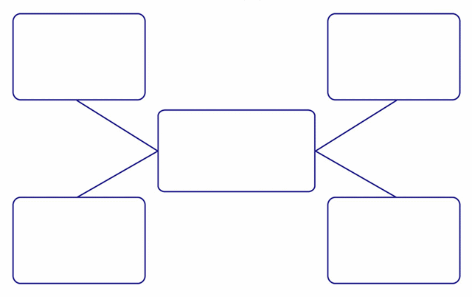
Concept Map Example

