Slide 1
When is enough, enough? In other words, what does it take for you to get angry enough about something that you decide to do something about it?

Slide 2
The American Revolution
Objectives:
Understand the reasons the British started enforcing tax laws
Identify and explain the Colonists reactions to the British taxation

Slide 3
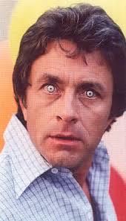
Impact of the French and Indian War
Although Great Britain gained vast amounts of land, their debt doubled.
GB looked to the Colonies to recoup their losses
“Was for your protection.”
Parliament decides to enforce tax laws already in place and institute new ones
So long, Salutary Neglect
“Don’t make me angry. You wouldn’t like me when I’m angry.”

Slide 4
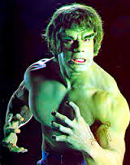
Act, this.
Sugar Act: tax on molasses, was actually lower than before, but was now strictly enforced.
Quartering Act: allowed British soldiers to stay in Colonists houses’. They were required to provide food and supplies.
Stamp Act: tax on all printed goods.

Slide 5
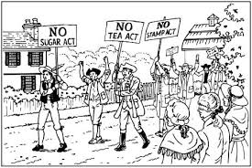
Taxation without Representation
Colonist did not disagree with the idea of taxes. They knew they were inevitable.
However, the idea that a Parliament across the ocean could impact their livelihood without them having a say angered them.
Felt their liberties slipping away.

Slide 6
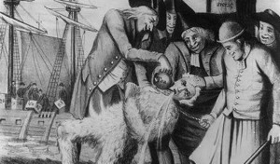
The Colonists React
The Colonists manifested their displeasure with Britain in three ways:
Intellectual protests
Economic boycotts
Violent intimidation

Slide 7
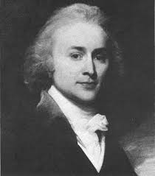
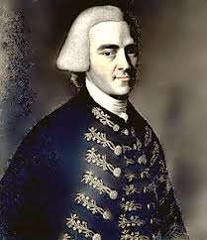
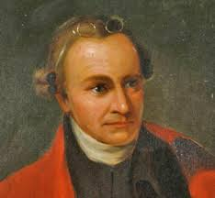
Patriot Leaders Emerge
Sons of Liberty: an association of Patriots, or those opposing British Taxes
John Adams
John Hancock
Patrick Henry

Slide 8
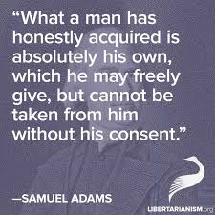
Violence!
As a result of The Townsend Acts, a new round of taxes, protests increased, especially in Boston
Britain cracked down
Ships seized
Troops occupied Boston (4,000)

Slide 9
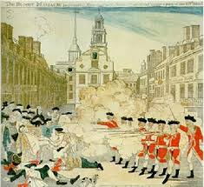
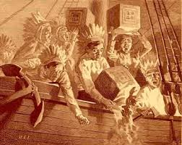
The Horror!
Boston Massacre
British soldiers fire into an angry mob, killing five
Builds Colonial unity
British drop all taxes except for tea
Boston Tea Party: Patriots dump tea into Boston Harbor to protest tax on tea.

Slide 10
Britain Responds
The Intolerable Acts
Closed the port of Boston
Quartering of soldiers
First Continental Congress
Boycott British goods
America begins to unite
War seems inevitable

Slide 11
Lexington and Concord
British troops sent to arrest John Adams and John Hancock and seize Patriot weapons
Shots are fired, 8 Colonists are dead
British troops skirmish with militia in Concord
British retreat to Boston, but are harassed all the way back. 200 soldiers are killed
Second Continental Congress
Unified war effort; George Washington, commander
Send “Olive Branch Petition” to King George (REJECTED)

Slide 12
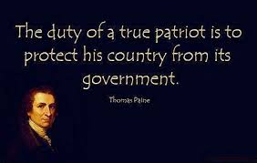
Common Sense
Thomas Paine
Common Sense (tried to sway those Loyal to the King)
Independence from Britain
Republican state governments (representatives)
Union of new states
Hated the King
Merit over inheritance

Slide 13
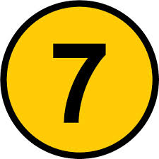
Seven Words or Less
In seven words or less, sum up this lesson on the causes of the American Revolution. Use your notes and what we discussed in class to guide you. You do not have to have a complete sentence, but it MUST make sense. Be prepared to share with the class.

