Slide 1
The Revolutionary War
Objectives
Analyze the strengths and weaknesses of the British and the Colonies
Understand how the tactics of each side contributed to outcome of the war

Slide 2
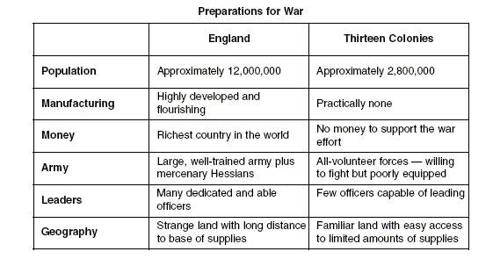
According to the chart, who should win this war?

Slide 3
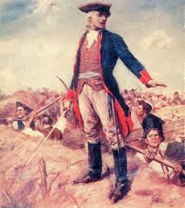
The British Mess up
Patriots surround the hills of Boston
Goal was to drive the British from the city
William Howe, British commander, attacks the Patriot position
Soldiers march up hill, carrying heavy packs
Wanted to set an example
He blew it

Slide 4
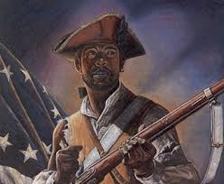
Britain just don’t get it
Was not a conventional war
Took seaports and the capital (Philadelphia)
Still lost
Patriots NEVER surrendered
Tried to win hearts and minds of undecided colonists

Slide 5
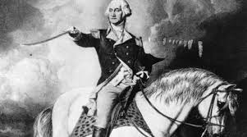
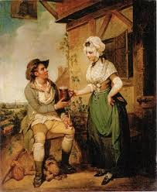
The Patriot’s Strengths
Washington’s leadership
Never risked it all
Retreated when he knew he was going to get beat
Support system
Needed help from civilians
Women’s contributions essential
Ran farms, shops
Made clothes, blankets, and food

Slide 6
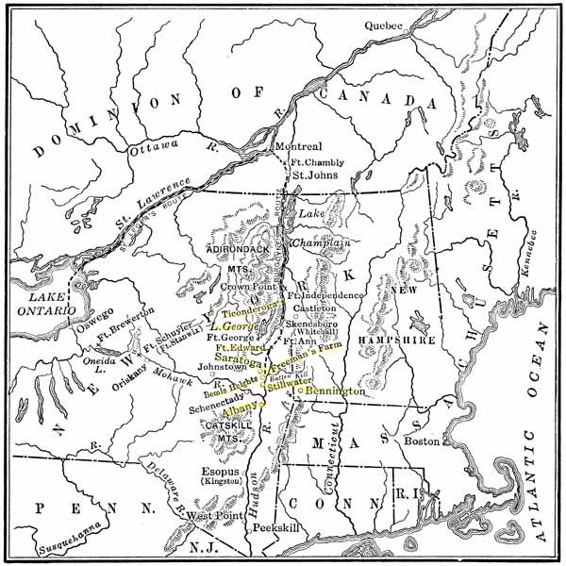
The New British Plan

Slide 7
Saratoga: The Turning Point
Burgoyne
Marches south down the Hudson Valley
Colonists burn bridges, tear up roads SABOTAGE
British numbers drop from 10,000 to 6,000
Inspired Colonial Army stuns the British at Saratoga
There is hope
French convinced US can win, pledge support

Slide 8
The British Surrender
Battle of Yorktown
Americans with French help overwhelm the British
British surrender
Treaty of Paris 1783
Impact of American Revolution
13 Colonies were now independent and could form the United States of America
Create their own government
All land east of the Mississippi River (except Florida)
The US could freely trade with the rest of the world

