Slide 1
The Monroe Doctrine
“The occasion has been judged proper for asserting, as a principle in which the rights and interests of the United States are involved, that the American continents, by the free and independent condition which they have assumed and maintain, are henceforth not to be considered as subjects for future colonization by any European powers.”

Slide 2
The Monroe Doctrine
“We owe it, therefore, to candor and to the amicable relations existing between the United States and those powers to declare that we should consider any attempt on their part to extend their system to any portion of this hemisphere as dangerous to our peace and safety. With the existing colonies or dependencies of any European power we have not interfered and shall not interfere.”

Slide 3
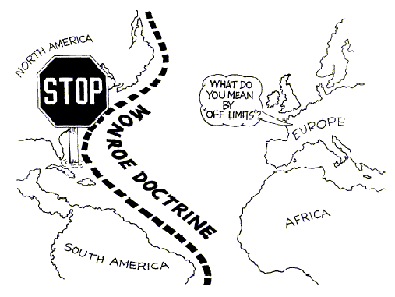

Slide 4
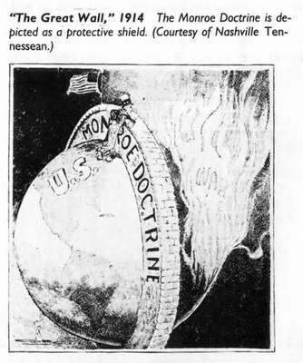

Slide 5
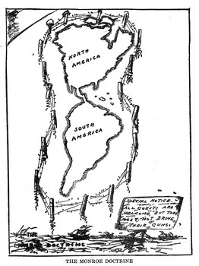

Slide 6
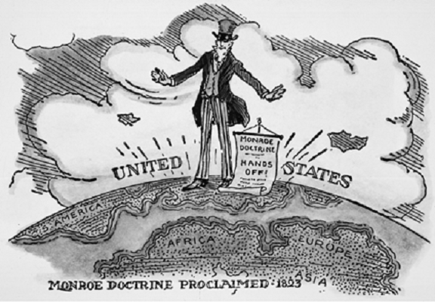

Slide 7
