Slide 1
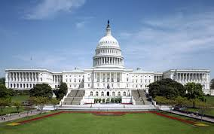
AP Government and Politics
Mr. Young
dyoung@bville.org
@MrYoungBvilleUS

Slide 2
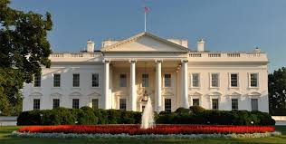
Day One or so
Introductions
Books
Folders
Expectations and Routines
Syllabus
Website
Questions

Slide 3
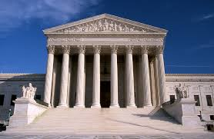
Five Units of Study
I. Foundations of American Government
II. Civil Liberties, Civil Rights
III. American Political Ideologies & Beliefs
IV. Political Participation
V. Interaction Among the Branches

Slide 4
Typical Chapter Outline
Critical thinking activity or document annotation
Notes
Vocabulary
Supreme Court case analysis
Quiz (5 to 20 questions)
Free Response Question
There will be a Unit Test at the end of each unit of study that will consist of at least 20 multiple choice questions and (maybe) a free response question. The multiple choice will include some quantitative and qualitative questions.

Slide 5
Tests
For unit tests ONLY, students may use a 3x5 card to aid them in answering the test questions. You may use the front and back. The card must be stapled to your test when you turn it in.
On the next school day after the test, students will be put in groups of five or six and given the same test to be completed as a group. You may not use any materials, but are free to discuss the questions as much as you like. The group test will be graded, and the two test scores will be averaged. This will be your grade on the test. If you scored a 100 on the first test, you will NOT have your score averaged. A 100 will be entered into the grade book.

Slide 6
Tests (continued)
If you are absent on the day of the test, you will be sent to the Test Center to take the test. Although you may still use your 3x5 card, you will not be eligible to have your grade raised by the group grade test score. I cannot emphasize enough how important it is to be here on test days.

Slide 7
Grading
This course uses a total point method of grading. Dividing your accumulated points by the total points available will give you your grade for the quarter. Tests are always worth 100 points. Unless otherwise noted, all work is due at the beginning of class. As this is a college-level course, late work will not be accepted. If you are absent the day an assignment is due it is expected that you turn it on the first day of your return. If you miss a test due to absence or some other school function, a ZERO will be entered into School Tool until the test is taken. At the end of each quarter, I will empty out my folder in the test center. Any test not taken will not be allowed to be made up.

Slide 8
AP Exam
55 Multiple Choice, 80 minutes
4 Free Response Questions, 100 minutes
Concept application
Quantitative analysis
Supreme Court Comparison
Argumentative essay
Each section is worth 50% of the total test score.
Usually, if you earn 75% of the total points available, you will receive a score of 5

Slide 9
2019 Baker Results AP GOV Exam
Score | 5 | 4 | 3 | 2 | 1 | Total Students | Average
Total Students | 6 (8%) | 9 (13%) | 20 (28%) | 29 (40%) | 8 (11%) | 72 | 2.67

Slide 10
What is at stake?
A score of 4 or 5 (in some cases a 3) will be accepted by colleges as three credit hours (one course) of Political Science. The average cost of a three-credit hour course is $3117
The fee for the AP Government and Politics test is about $90
This course is a perfect example of the saying “you get out what you put in.” If you are willing to read, work hard, ask questions, and strive to improve your skills, not only will you get a good score on the exam, but you will save yourself $3000 AND HAVING TO TAKE THE SAME COURSE OVER AGAIN AS A FRESHMAN

