Slide 1
Campaign Finance Reform

Slide 2
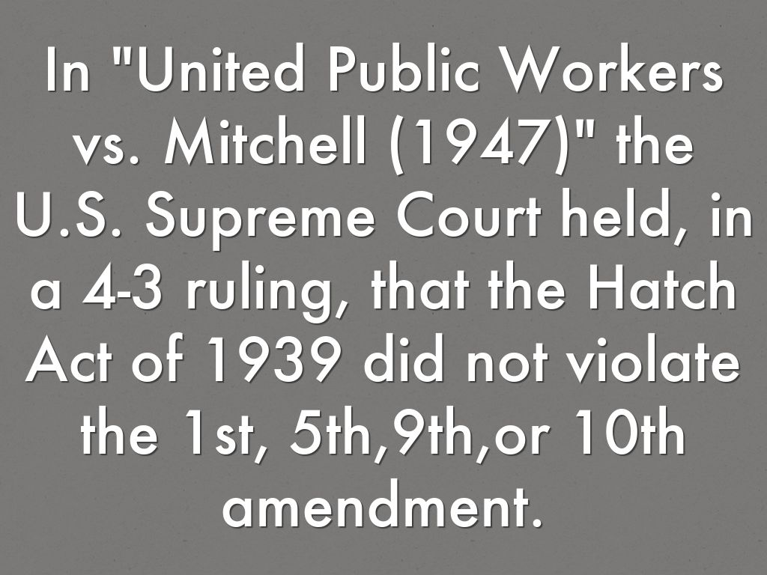
Early Attempts
1907 Tillman Act: no corporate money for political purposes.
1939 Hatch Act: Federal employees restricted from campaign activities.

Slide 3
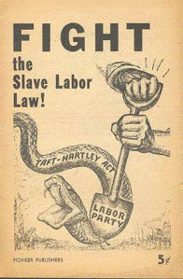
Post-WWII Efforts
1947 Taft-Hartley Act
Although its main purpose was to curtail strikes by labor unions, the Taft-Hartley Act also banned contributions to candidates by labor unions.
Leads to a decades-long decline of the labor union movement.

Slide 4
1974 Federal Elections Campaign Act
Requires public reporting of donations and how they were spent.
Set individual limits (chart on next slide)
Established the Federal Election Commission (FEC) for enforcement.
Presidential campaign fund
Matching funds from FEC (limited)
Obama first to decline funds.

Slide 5
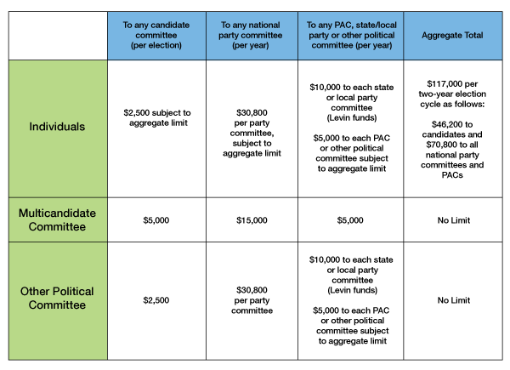

Slide 6
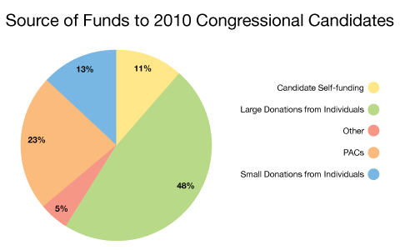

Slide 7
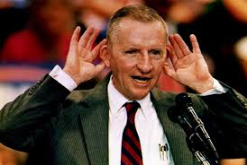
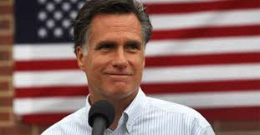
Buckley v. Valeo 1976
Struck down parts of the FECA
Individual could give an unlimited amount of their own money to their campaign
Ross Perot: 60 million in 1992
Mitt Romney: 44 million in 2008

Slide 8
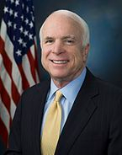
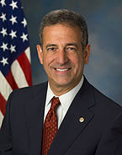
McCain-Feingold ACt
Bipartisan Campaign Reform Act (BCRA)
Bans “soft” money (party building money for general purposes)
Individual limits increase incrementally with inflation.
Hydraulic Theory of Money and Politics

Slide 9
Loopholes!
527 Groups
Independent political groups
NO restrictions (no specific candidate)
Can’t say “vote for” or “vote against”
Contributions must be reported to IRS
Examples:
MoveOn.org (anti-Bush)
Swift Boat Veterans for Truth (anti-Kerry)

Slide 10
Electioneering
Corporations and Unions may not engage in electioneering.
Candidate may not be named in an ad within:
30 days for primary
60 days for general
Citizen’s United: electioneering restrictions unconstitutional
No spending limits as long as it is not coordinated with a candidates campaign.

Slide 11
Whack a Mole
501 c Groups
Can receive unlimited contributions
Not reported to the FEC (IRS instead)
Can only spend half their $ on political activities
Electioneering allowed

Slide 12
Super Pacs
Super PACS
May accept donations of any size
Can endorse candidates
Periodically report to FEC

Slide 13
Biggest 10 Super PAC donations in 2012

