Slide 1
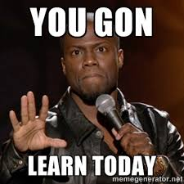
Civil Liberties and Public Policy
Chapter 4

Slide 2
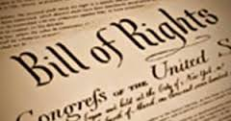
The Bill of Rights– Then and Now
Civil Liberties: the legal constitutional protections against the government
The Bill of Rights: first 10 amendments, which protect basic liberties, such as religion and speech

Slide 3
The Bill of Rights—Then and Now
The Bill of Rights and the States
Written to restrict the national government
“Congress shall make no law…”
Barron v. Baltimore (1833)
Most have been “incorporated” through the 14th Amendment, and now restrict state and local governments
First Amendment protection of speech first incorporated to states in Gitlow v. New York (1925)

Slide 4
The 14th Amendment
Section 1. All persons born or naturalized in the United States, and subject to the jurisdiction thereof, are citizens of the United States and of the State wherein they reside. No State shall make or enforce any law which shall abridge the privileges or immunities of citizens of the United States; nor shall any State deprive any person of life, liberty, or property, without due process of law; nor deny to any person within its jurisdiction the equal protection of the laws.

Slide 5
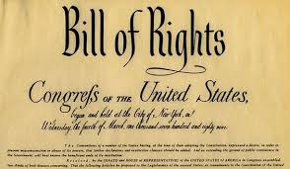
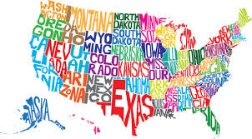
The 14th Amendment

Slide 6
The Nationalization of the Bill of Rights
Date | Amendment | Right | Case
1925 | First | Freedom of speech | Gitlow v. New York
1931 | First | Freedom of press | Near v. Minnesota
1937 | First | Freedom of religion | De Jonge v. Oregon
1940 | First | Free exercise of religion | Cantwell v. Connecticut
1947 | First | Establishment of religion | Everson v. Board of Education
1958 | First | Freedom of association | NAACP v. Alabama
1963 | First | Right to petition gov’t | NAACP v. Button
2008 | Second | Right to bear arms | District of Columbia v. Heller

Slide 7
The Nationalization of the Bill of Rights
Date | Amendment | Right | Case
2010 | Second | Right to bear arms | McDonald v. Chicago
 | Third | No quartering of soldiers | Not Incorporated
1949 | Fourth | No unreasonable search and seizures | Wolf v. Colorado
1961 | Fourth | Exclusionary rule | Mapp v. Ohio
1897 | Fifth | Guarantee of just compensation | Chicago, Burlington, and Quincy RR v. Chicago
1964 | Fifth | Immunity from self-incrimination | Mallory v. Hogan
1969 | Fifth | Double jeopardy | Benton v. Maryland
1969 | Fifth | Right to grand jury indictment | Not Incorporated

Slide 8
The Nationalization of the Bill of Rights
Date | Amendment | Right | Case
1932 | Sixth | Right to counsel in capital cases | Powell v. Alabama
1948 | Sixth | Right to public trial | In re Oliver
1963 | Sixth | Right to counsel in felony cases | Gideon v. Wainwright
1965 | Sixth | Right to confront witnesses | Pointer v. Texas
1966 | Sixth | Right to impartial jury | Parker v. Gladden
1967 | Sixth | Right to a speedy trial | Klopfer v. North Carolina
 | Seventh | Right to a jury trial in civil cases | Not Incorporated

Slide 9
The Nationalization of the Bill of Rights
Date | Amendment | Right | Case
1962 | Eighth | Freedom from cruel and unusual punishment | Robinson v. California
 | Eight | Freedom from excessive fines | Not incorporated
1965 | Ninth | Right to privacy | Griswold v. Connecticut

Slide 10
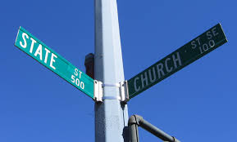
Freedom of Religion
The Establishment Clause
“Congress shall make no law respecting the establishment of religion…”
Lemon v. Kurtzman (1971)
Secular legislative purpose
Neither advance nor inhibit religion
No excessive government “entanglement”

Slide 11
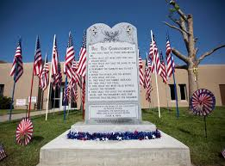
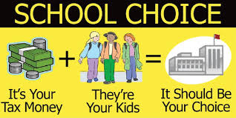
Freedom of Religion
The Establishment Clause (continued)
Are school vouchers constitutional?
Zelman v. Simmons-Harris (2002)
Prayer in public schools violates Establishment Clause.
Engel v. Vitale (1962)
What about displays of the Ten Commandments?

Slide 12
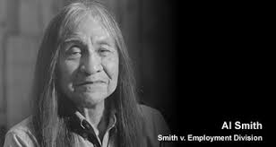
Freedom of Religion
The Free Exercise Clause
Prohibits government from interfering with the practice of religion
Some religious practices may conflict with other rights, and then be denied or punished
Employment Division v. Smith (1990)
Religious Freedom Restoration Act (1993)
Overturned Smith

Slide 13
Freedom of Expression
Prior Restraint
Definition: a government preventing material from being published; censorship; unconstitutional
Near v. Minnesota (1931)
May be permissible during wartime
One may be punished after something is published.

Slide 14
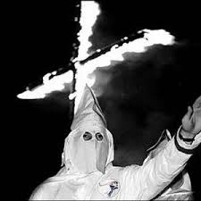
Freedom of Expression
Free Speech and Public Order
Speech is limited if it presents a “clear and present danger.”
Schenck v. US (1919)
Permissible to advocate the violent overthrow of government in abstract, but not to incite anyone to imminent lawless action
Brandenburg v. Ohio (1969)

Slide 15
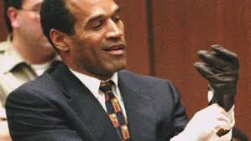
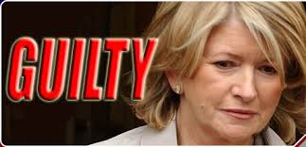
Freedom of Expression
Free Press and Fair Trials
Is extensive press coverage of high profile trials (OJ Simpson; Martha Stewart) permissible?
The public has a right to know what happens; trial must be open to the public.
The press’ own information about a trial may not be protected.
Yet, some states have passed shield laws to protect reporters.

Slide 16
Freedom of Expression
Obscenity
No clear definition on what constitutes obscenity
Justice Potter Stewart: “I know it when I see it.”
Miller v. California (1973) stated that materials were obscene if the work:
appeals “to a prurient interest in sex”
showed “patently offensive” sexual conduct
lacks “serious literary, artistic, political or scientific value”
Decisions on obscenity are based on local community standards.

Slide 17
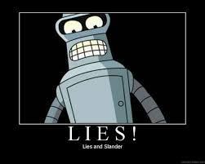
Freedom of Expression
Libel and Slander
Libel: the publication of false or malicious statements that damage someone’s reputation
Slander: the same thing, only spoken instead of printed
New York Times v. Sullivan (1964): statements about public figures are libelous only if made with reckless disregard for truth.
Private individuals have lower standard to meet to win libel lawsuits.

Slide 18
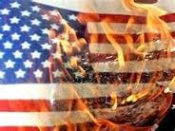
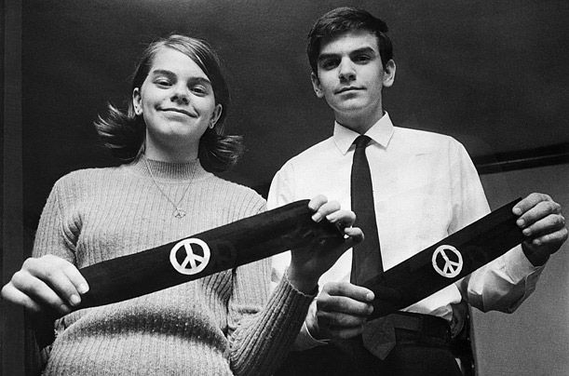
Freedom of Expression
Symbolic Speech
Definition: nonverbal communication, such as burning a flag or wearing an armband
Generally protected along with verbal speech
Texas v. Johnson (1989): Burning the American flag is symbolic speech protected by the First Amendment.

Slide 19
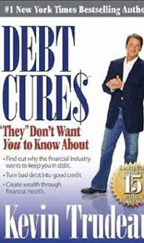
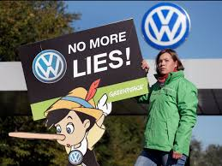
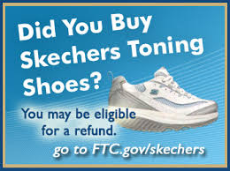
Commercial Speech
Definition: communication in the form of advertising
Generally the most restricted and regulated form of speech (Federal Trade Commission)

Slide 20
Commercial Speech
Regulation of the Public Airwaves
Broadcast stations must follow Federal Communication Commission rules.
Regulation must be narrowly tailored to promote a compelling governmental interest.
United States v. Playboy Entertainment Group (2000)

Slide 21
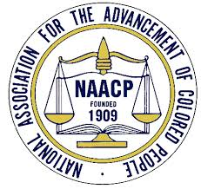
Freedom of Assembly
Right to Assemble
Generally permissible to gather in a public place, but must meet reasonable local standards, such as fire codes and apply for permits
Balance between freedom and order
Right to Associate
Freedom to join groups or associations without government interference
NAACP v. Alabama (1958)

Slide 22
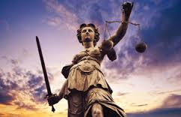
Defendants’ Rights
Much of the Bill of Rights (Amendments 4, 5, 6, 7, and 8) apply to defendants’ rights.
Interpreting Defendants’ Rights
Criminal Justice personnel are limited by the Bill of Rights and failure to follow constitutional protections may invalidate a conviction.
Courts continually rule on what is constitutional and what is not.

Slide 23
Right to Bear Arms
Common National, State, and Local Gun Laws
Restrictions on owning and carrying handguns.
Background checks
Limited the sale of certain types of weapons.
Requirements that guns be stored in a fashion to prevent their theft or children from accessing and firing them.
Courts have usually upheld reasonable restrictions.

Slide 24
Right to Bear Arms
Militia Clause:
Many advocates of gun control argued that the Second Amendment applied only to the right of states to create militias.
District of Columbia v. Heller (2008)
Individual right to possess a firearm unconnected with service in a militia.
Use that arm for traditionally lawful purposes, such as self-defense within the home.

Slide 25
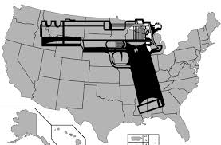
Right to Bear Arms
McDonald v. Chicago (2010)
Supreme Court ruled that the 2nd amendment was applicable to the states

Slide 26
Although our criminal justice system is complex, it can be broken down into stages. The Constitution protects the rights of the accused at every stage.
Stage | Protections
1. Evidence gathered | Unreasonable search and seizure forbidden (4)
2. Suspicion cast | Guarantee that “writ of habeas corpus” will not be suspended, forbidding imprisonment without evidence (Article I, Section 9)
3. Arrest made | Right to assistance of counsel (6)
4. Interrogation held | Forced incrimination forbidden (5), excessive bail forbidden (8)
5. Trial held | Speedy and public trial by an impartial jury (6), double jeopardy (5), right to confront witnesses (6)
6. Punishment imposed | Cruel and unusual punishment forbidden (8)

Slide 27
Defendants’ Rights
Searches and Seizures
Probable Cause: when the police have reason to believe that a person should be arrested
Unreasonable searches and seizures: evidence is obtained in a haphazard or random manner, prohibited by the Fourth Amendment
Exclusionary Rule: the rule that evidence, no matter how incriminating, cannot be introduced into trial if it was not constitutionally obtained
Mapp v. Ohio (1961)

Slide 28
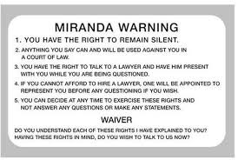
Defendants’ Rights
Self-Incrimination
Definition: when an individual accused of a crime is compelled to be a witness against himself or herself in court
Police must inform suspects of these and other Fifth Amendment protections upon arrest.
Miranda v. Arizona (1966)
Protection from coerced confessions and entrapments

Slide 29
Defendants’ Rights
The Right to Counsel
The state must provide lawyers in most criminal cases (Sixth Amendment).
Gideon v. Wainwright (1963)
Trials
Plea bargaining: a bargain between the prosecution and defense for a defendant to plead guilty to a lesser crime; 90 percent of cases end here and do not go to trial
Juries generally consist of 12 people, but unanimity is not always needed to convict.
The Sixth Amendment also guarantees a “speedy and public” trial.

Slide 30
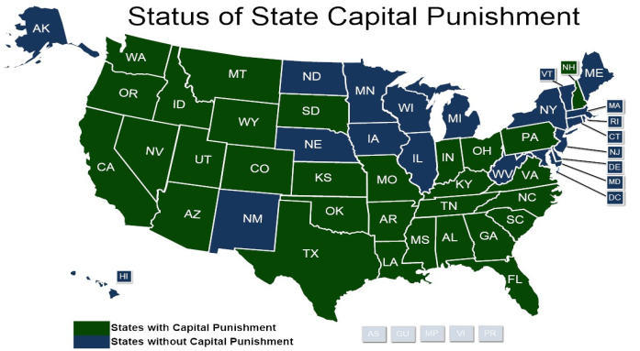
Defendants’ Rights
Cruel and Unusual Punishment
The Eighth Amendment forbids cruel and unusual punishment.
The death penalty is not cruel and unusual. It is “an extreme sanction, suitable to the most extreme crimes.”
Gregg v. Georgia (1976)
The death penalty’s use and application varies by state.

Slide 31
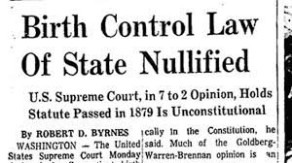
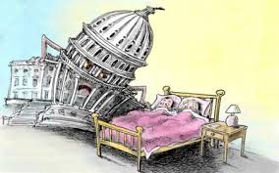
The Right to Privacy
Is There a Right to Privacy?
Definition: the right to a private personal live free from the intrusion of government
Not explicitly stated in the Constitution, but implied by the First, Third, Fourth and Ninth Amendments
Griswold v. Connecticut (1965)

Slide 32
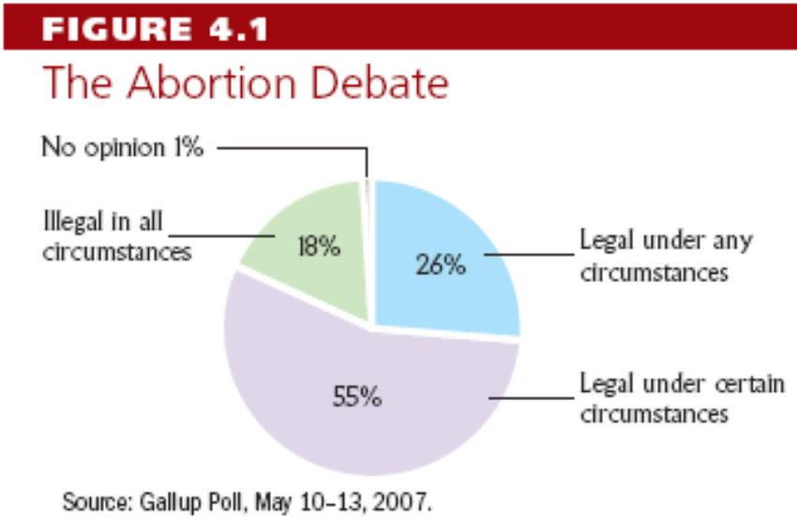
The Right to Privacy
Controversy over Abortion
Roe v. Wade (1973)
Planned Parenthood v. Casey (1992)

Slide 33
Understanding Civil Liberties
Civil Liberties and Democracy
Rights ensured in the Bill of Rights are essential to democracy.
Courts typically protect civil liberties from excesses of majority rule.
Civil Liberties and the Scope of Government
In deciding between freedom and order, the United States generally chooses liberty.
Civil liberties limit the scope of government, even though government efforts are needs to protect rights

