Slide 1
Civil Rights and Public Policy
Chapter 5

Slide 2
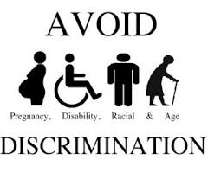
Introduction
Civil Rights
Definition: policies designed to protect people against arbitrary or discriminatory treatment by government officials or individuals
Racial Discrimination
Gender Discrimination
Discrimination based on age, disability, sexual orientation, and other factors

Slide 3
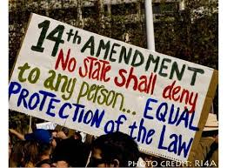
Two Centuries of Struggle
Conceptions of Equality
Equal opportunity: same chances
Equal results: same rewards
Early American Views of Equality
The Constitution and Inequality
Equality is not in the original Constitution.
First mention of equality in the 14th Amendment: “…equal protection of the laws”

Slide 4
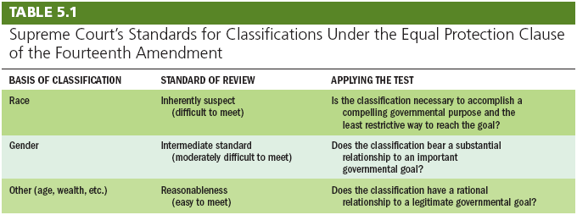
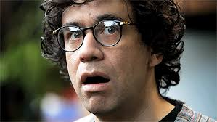
Can the government make a law that discriminates based on…..?

Slide 5
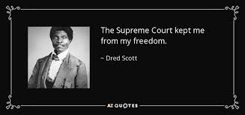
Race, the Constitution, and Public Policy
The Era of Slavery
Dred Scott v. Sandford (1857)
Slaves had no rights.
Invalidated Missouri Compromise
The Civil War
The Thirteenth Amendment
Ratified after Union won the Civil War
Outlawed slavery

Slide 6
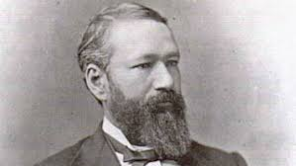
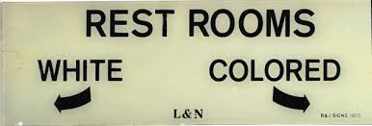
Race, the Constitution, and Public Policy
The Era of Reconstruction and Desegregation
Jim Crow or segregation laws
Relegated African Americans to separate facilities
Plessy v. Ferguson (1896)
Upheld the constitutionality of “equal but separate accommodations”

Slide 7
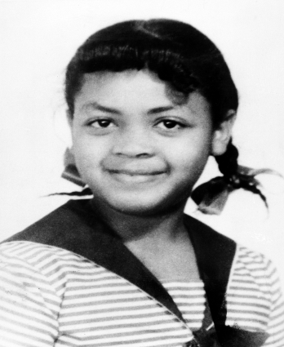
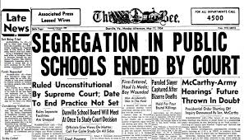
Race, the Constitution, and Public Policy
The Era of Civil Rights
Brown v. Board of Education (1954)
Overturned Plessy
School segregation inherently unconstitutional
Integrate schools “with all deliberate speed”
Busing of students solution for two kinds of segregation:
de jure, “by law”
de facto, “in reality”

Slide 8
Get Going!

Slide 9
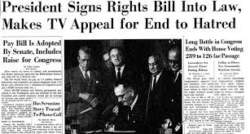
Race, the Constitution, and Public Policy
The Era of Civil Rights (continued)
Civil Rights Act of 1964
Made racial discrimination illegal in hotels, restaurants, and other public accommodation
Forbade employment discrimination based on race
Created Equal Employment Opportunity Commission (EEOC)
Strengthened voting right legislation

Slide 10
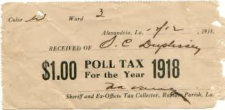
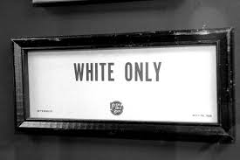
Race, the Constitution, and Public Policy
Getting and Using the Right to Vote
Suffrage: the legal right to vote
Fifteenth Amendment: extended suffrage to African Americans
Poll Taxes: small taxes levied on the right to vote
White Primary: Only whites were allowed to vote in the party primaries.

Slide 11
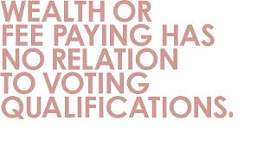
Race, the Constitution, and Public Policy
Getting and Using the Right to Vote
Smith v. Allwright (1944): ended white primaries
Twenty-fourth Amendment: eliminated poll taxes for federal elections
Harper v. Virginia State Board of Elections (1966): no poll taxes at all
Voting Rights Act of 1965: helped end formal and informal barriers to voting

Slide 12
Race, the Constitution, and Public Policy
Other Minority Groups
Native Americans
Santa Clara Pueblo v. Martinez (1978)
Strengthened tribal power
Hispanic Americans
Mexican American Legal Defense and Education Fund
Asian Americans
Korematsu v. United States (1944)

Slide 13
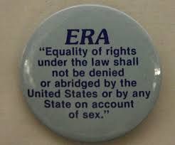
Women, the Constitution, and Public Policy
The Battle for the Vote
Nineteenth Amendment: extended suffrage to women in 1920
The “Doldrums”: 1920-1960
Laws were designed to protect women, and protect men from competition with women.
Equal Rights Amendment first introduced in Congress in 1923

Slide 14
Women, the Constitution, and Public Policy
The Second Feminist Wave
Reed v. Reed (1971)
“Arbitrary” gender discrimination violated 14th Amendment’s Equal Protection Clause
Craig v. Boren (1976)
“Medium scrutiny” standard established for gender discrimination
Equal Rights Amendment fails ratification by states (1982)

Slide 15
Women, the Constitution, and Public Policy
Women in the Workplace
The Civil Rights Act of 1964 banned gender discrimination in employment.
Wage Discrimination and Comparable Worth
The Supreme Court has not ruled on this issue.
Women in the Military
Only men may be drafted, women may serve in ground combat.
Sexual Harassment
Prohibited by Title VII of Civil Rights Act of 1964

Slide 16
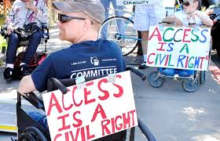
Newly Active Groups Under the Civil Rights Umbrella
Civil Rights and the Graying of America
Age classifications not suspect category, but fall under rational basis test.
Civil Rights and People with Disabilities
Americans with Disabilities Act of 1990
Requiring employers and public facilities to make “reasonable accommodations” for those with disabilities
Prohibits employment discrimination against the disabled

Slide 17
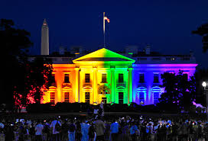
Newly Active Groups Under the Civil Rights Umbrella
Gay and Lesbian Rights
Bowers v. Hardwick (1986)
Upheld state ban on homosexual acts
Lawrence v. Texas (2003)
Overturned Bowers
Private homosexual acts are protected by the Constitution
Gay marriage
Obergefell v. Hodges (2015)
State bans on same-sex marriage violated the 14th amendment.

Slide 18
Affirmative Action
Definition: a policy designed to give special attention to or compensatory treatment of members of some previously disadvantaged group
In education
Regents of the University of California v. Bakke (1978)
Racial set asides unconstitutional (no quotas)
Race could be considered in admissions

Slide 19
Affirmative Action
Gratz v. Bollinger (2003)
Holding spots for purposes of a diverse student body was not constitutional
Grutter v. Bollinger (2003)
Race could be considered a “plus” in admissions

Slide 20
Affirmative Action
In employment
United Steelworks v. Weber (1979)
Quotas to remedy past discrimination are constitutional.
White worker claimed “reverse” discrimination
Adarand Constructors v. Pena (1995)
To be constitutional, affirmative action must be “narrowly tailored” to meet a “compelling governmental interest.”
Did not ban affirmative action, but severely limited its reach
proof of past injury does not in itself establish the suffering of present or future injury

Slide 21
Understanding Civil Rights and Public Policy
Civil Rights and Democracy
Equality favors majority rule.
Suffrage gave many groups political power.
Civil Rights and the Scope of Government
Civil rights laws increase the size and power of government.
Civil rights protect individuals against collective discrimination.

Slide 22
Summary
Racial minorities and women have struggled for equality since the beginning of the republic.
Constitutional amendments and civil rights legislation guarantee voting and freedom from discrimination.
Civil rights have expanded to new groups.

