Slide 1
Elections and Voting Behavior
Edwards Chapter 9

Slide 2
How American Elections Work
Three types of elections:
Select party nominees (primary elections)
Select officeholders (general elections)
Select options on specific policies
Referendum: state-level method of direct legislation that gives voters a chance to approve proposed legislation or constitutional amendment
Initiative petition: process permitted in some states whereby voters may put proposed changes in the state constitution to a vote, given a sufficient number of signatures

Slide 3
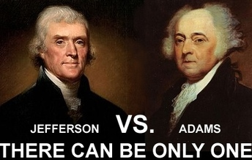
A Tale of Three Elections
1800: The First Electoral Transition of Power
No primaries, no conventions, no speeches
Newspapers were very partisan.
Campaigns focused not on voters but on state legislatures who chose electors.
After many votes in the House, the office of the presidency was transferred to Jefferson peacefully.

Slide 4
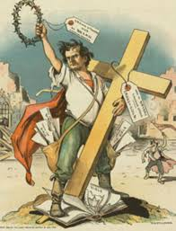
A Tale of Three Elections
1896: A Bitter Fight over Economic Interests
Democrats’ main issue: unlimited coinage of silver
William Jennings Bryan won the Democratic Party nomination with speeches about the virtues of silver.
McKinley won the election and the Republicans regained majority status.

Slide 5
A Tale of Three Elections
2004: The Ratification of a Polarizing Presidency
George W. Bush became the fourth Republican since McKinley to win a second term.
The intensity of the election was in part due to the controversy of the 2000 election.
The 2004 campaign was characterized by negative campaigning.
Leadership of the War on Terrorism and “moral values” proved to be key issues.

Slide 6
Whether to Vote: A Citizen’s First Choice
Suffrage: the legal right to vote
Extended to African Americans by the Fifteenth Amendment
Extended to Women by the Nineteenth Amendment
Extended to people over 18 years of age by the Twenty-Sixth Amendment

Slide 7
Whether to Vote: A Citizen’s First Choice
U.S. has low voter turnout
Those who see clear differences between parties are likely to vote.
If indifferent, then one may rationally abstain from voting.
Political Efficacy: the belief that one’s political participation really matters
Civic Duty: the belief that in order to support democratic government, a citizen should always vote

Slide 8
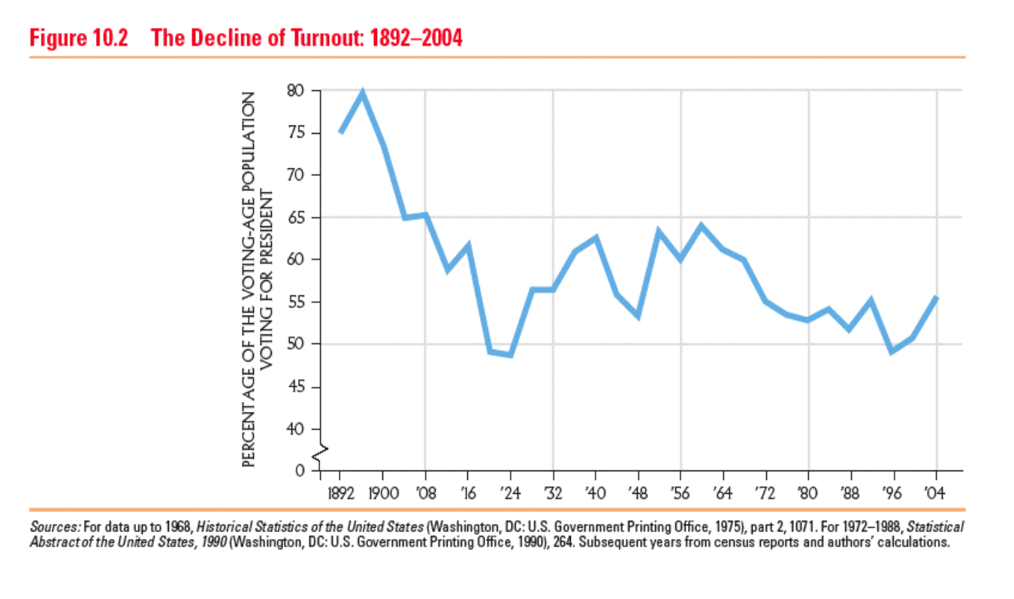
Shame on us

Slide 9
Whether to Vote: A Citizen’s First Choice
Registering To Vote
Voter Registration: a system adopted by the states that requires voters to register well in advance of the election day
Registration procedures differ by state.
Motor Voter Act: passed in 1993, requires states to permit people to register to vote when they apply for their driver’s license

Slide 10
Whether to Vote: A Citizen’s First Choice
Who Votes?
Education: More education = more likely to vote. Most important factor
Age: Older = more likely to vote
Race: Caucasian = more likely to vote. BUT, other ethnicities are higher with comparable education
Gender: Female = more likely to vote

Slide 11
Whether to Vote: A Citizen’s First Choice
Who Votes?
Marital Status: Married = more likely to vote
Union Membership: Union member = more likely to vote
Traits are cumulative–possessing several adds up

Slide 12
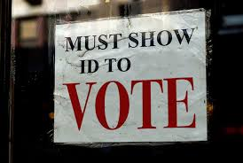
Voter ID Laws
Voter ID (identification) is a way to protect a person’s right to vote. No citizen should be prevented from exercising this basic right, but it is also the duty of governing officials to ensure that valid votes are cast so that the results of an election are representative of the desires of the community.

Slide 13
Voter ID Laws
Pros | Cons
Voter ID laws provide a reliable form of identification to use. | It deprives people of their right to vote if they don’t carry “correct” identification.
This legislation can reduce the chances of voting multiple times. | Obtaining a voter ID is costly for people, even if the identification is free.
It protects the value of the votes for everyone who casts a ballot legally. | Minorities are disproportionally impacted by voter ID laws.

Slide 14
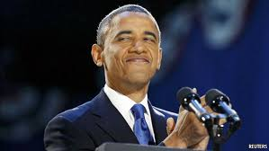
Explaining Citizens’ Decisions
Mandate Theory of Elections
The idea that the winning candidate has a mandate from the people to carry out his or her platforms and politics
Politicians like the theory better than political scientists do.

Slide 15
Explaining Citizens’ Decisions
Party Identification
People still generally vote for a party they agree with.
With the rise of candidate-centered politics, parties’ hold on voters declined in the 1960s and 1970s.
Many more voters make an individual voting decision and are up for grabs each election, (so-called floating voters).

Slide 16
Explaining Citizens’ Decisions
How Americans See the Candidates
Candidates want a good visual image.
Especially on dimensions of integrity, reliability, and competence
Personality plays a role in vote choice, especially if a candidate is perceived to be incompetent or dishonest.

Slide 17
Explaining Citizens’ Decisions
Policy Voting: Basing your vote choice on issue preferences and where the candidates stand on policy issues
Policy voting may occur if :
Voters know where they and the candidates stand on issues and see differences between candidates
Unlikely to occur because:
Candidates can be ambiguous on the issues.
Media tend to focus on the “horse race” not issues.

Slide 18
The Electoral College
Electoral college actually elects the president—founders wanted him chosen by the elite of the country
States choose the electors
Winner-Take-All system gives bigger emphasis to more populated states

Slide 19
The Electoral College
How it works today:
Each state has as many votes as it does Representatives and Senators.
Winner of popular vote typically gets all the Electoral College votes for that state
Electors meet in December, votes are reported by the vice president in January
If no candidate gets a majority (270 votes), the House of Representatives votes for president, with each state casting one vote. Senate votes for VP

Slide 20
Understanding Elections and Voting Behavior
Democracy and Elections
The greater the policy differences between candidates, the more likely voters will be able to steer government policy by their choices.
Unlikely—candidates do not always clarify issues
Candidates who vow to continue popular policies are more likely to win elections.
Retrospective voting: voters cast a vote based on what a candidate has done for them lately

Slide 21
Understanding Elections and Voting Behavior
Elections and the Scope of Government
Elections generally support government policies and power.
Voters feel they are sending a message to government to accomplish something
Thus, the government expands to fill the needs of the voters.

Slide 22
Summary
Voters make two basic decisions at election time:
Whether to vote
Who to vote for
Party identification, candidate evaluations, and policy positions drive vote choice.
Elections are fundamental to a democracy.

