Slide 1
Interest Groups
Edwards Chapter 10

Slide 2
The Role of Interest Groups
Interest group
An organization of people with shared policy goals entering the policy process at several points to try to achieve those goals
Interest groups pursue their goals in many arenas.
Interest groups are distinct from parties.
Political parties fight election battles; interest groups do not field candidates for office but may choose sides.
Interest groups are policy specialists; political parties are policy generalists.

Slide 3
Theories of Interest Group Politics
Pluralist Theory
Politics is mainly a competition among groups, each one pressing for its own preferred policies.
Elite Theory
Societies are divided along class lines and an upper-class elite rules, regardless of the formal niceties of governmental organization.
Hyperpluralist Theory
Groups are so strong that government is weakened. This is an extreme, exaggerated form of pluralism.

Slide 4
Theories of Interest Group Politics: Hyperpluralism
Subgovernments
Networks of groups that exercise a great deal of control over specific policy areas.
Consist of interest groups, government agency, and congressional committees that handle particular policies
Also known as iron triangles
The hyperpluralist critique
Groups have become too powerful as the government tries to appease every interest.
Many subgovernments (iron triangles) aggravate the process.
Trying to please every group results in contradictory policies.

Slide 5
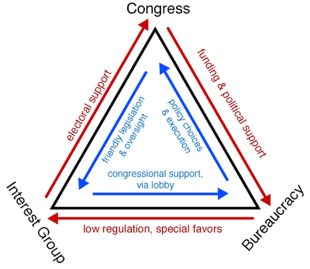

Slide 6
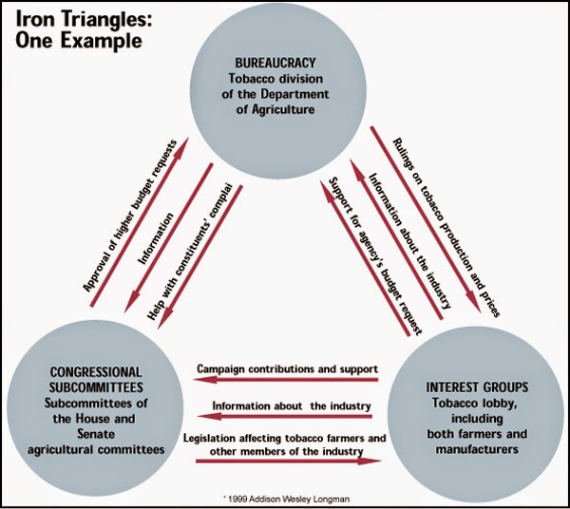

Slide 7
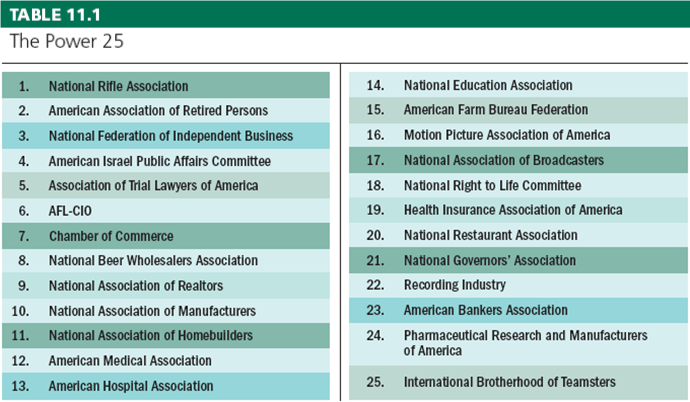

Slide 8
What Makes an Interest Group Successful?
The Surprising Ineffectiveness of Large Groups
Potential group: all the people who might be interest group members because they share a common interest
Actual group: the part of the potential group consisting of members who actually join
Collective good: something of value that cannot be withheld from a group member

Slide 9
What Makes an Interest Group Successful?
Free-Rider Problem
Some people don’t join interest groups because they benefit from the group’s activities without officially joining.
Bigger the group, larger the problem
Large groups are difficult to organize
Olson’s law of large groups:
“The larger the group, the further it will fall short of providing an optimal amount of a collective good.”
Overcome Olson’s law by providing selective benefits: Goods that a group can restrict to those who pay their annual dues

Slide 10
What Makes an Interest Group Successful?
Small groups are better organized and more focused on the group’s goals.
Consumer groups have a difficult time getting significant policy gains because the benefits are spread over the entire population.
Public interest lobbies seek “a collective good, the achievement of which will not selectively and materially benefit the membership activities of the organization.”

Slide 11
Then you don’t know aarp

Slide 12
What Makes an Interest Group Successful?
Intensity
Single-Issue groups: groups that focus on a narrow interest, dislike compromise, and often draw membership from people new to politics
Groups may focus on an emotional issue, providing them with a psychological advantage.
Intensity encourages non-conventional means of participation, i.e.—protests

Slide 13
What Makes an Interest Group Successful?
Financial Resources
Not all groups have equal amounts of money.
Monetary donations usually translate into access to the politicians, such as a phone call, meeting, or support for policy.
Wealthier groups have more resources—and presumably more access—but they do not always win on policy.

Slide 14
How Groups Try to Shape Policy
Lobbying
“communication by someone other than a citizen acting on his own behalf, directed to a governmental decision maker with the hope of influencing his decision”
Two basic types of lobbyists:
Regular, paid employees of a group
Temporary hires

Slide 15
How Groups Try to Shape Policy
Lobbying
Lobbyists:
are a source of information
help politicians plan political strategies for legislation
help politicians plan political strategies for reelection campaigns
are a source of ideas and innovations
Mixed evidence as to whether lobbying works

Slide 16
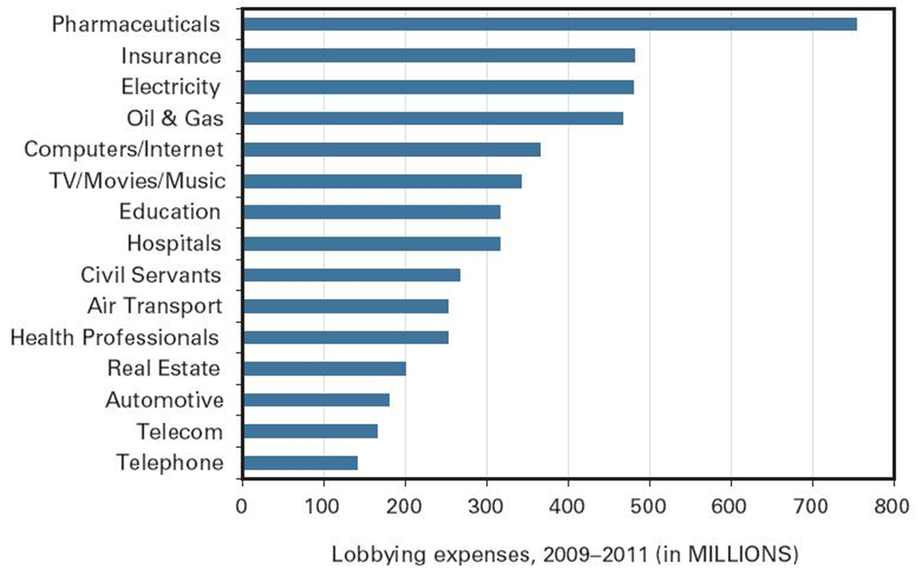
Industries’ big spenders on lobbying, 2009-2011

Slide 17
How Groups Try to Shape Policy
Electioneering
Direct group involvement in the election process
Groups can help fund campaigns, provide testimony, and get members to work for candidates; some form PACs.
Political Action Committee (PAC): Political funding vehicles created by 1974 campaign finance reforms, PACs are used by interest groups to donate money to candidates.
PACs help pay the bill for increasing campaign costs.
Most PAC money goes to incumbents.

Slide 18
How Groups Try to Shape Policy
Litigation
If an interest group fails in one arena, the courts may be able to provide a remedy.
Interest groups can file amicus curiae briefs to influence a court’s decision.
amicus curiae: briefs submitted by a “friend of the court” to raise additional points of view and present information not contained in the briefs of the formal parties
Class Action lawsuits permit a small number of people to sue on behalf of all other people similar situated.

Slide 19
How Groups Try to Shape Policy
Going Public
Because public opinion makes its way to policymakers, groups try to:
cultivate a good public image to build a reservoir of goodwill with the public
use marketing strategies to influence public opinion of the group and its issues
advertise to motivate and inform the public about an issue

Slide 20
Types of Interest Groups
Economic Interests
Labor
Agriculture
Business
Environmental Interests
Equality Interests
Consumer and Public Interest Lobbies

Slide 21
Understanding Interest Groups
Interest Groups and the Scope of Government
Interest groups seek to maintain policies and programs that benefit them.
Interest groups continue to pressure government to do more things.
As the government does more, does this cause the formation of more groups?

Slide 22
Summary
Group theories: pluralism, elitism, and hyperpluralism
A number of factors influence a group’s success, i.e., being small
Interest groups affect policy process through lobbying, electioneering, litigation, and going public.

