Slide 1
The Mass Media and the Political Agenda
Edwards Chapter 7

Slide 2
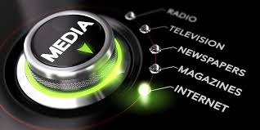
Introduction
Mass Media:
  Television, radio, newspapers, magazines, the Internet and other means of popular communication
High-Tech Politics:
  A politics in which the behavior of citizens and policymakers and the political agenda itself are increasingly shaped by technology

Slide 3
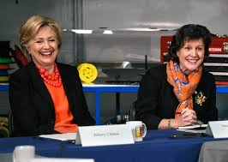
The Mass Media Today
Effective communication through media is key to political success.
  Media Events: events purposely staged for the media that nonetheless look spontaneous.
    Media events can be staged by almost anybody.
  Image making and news management is important, especially for presidents.

Slide 4
The Development of Media Politics
Introduction
  The news media wasn’t always so important.
  Press Conferences: meetings of public officials with reporters.
    Franklin Roosevelt held over 1,000
  Investigative Journalism: the use of in-depth reporting to unearth scandals, scams & schemes putting reporters & politicians opposite each other.
  Coverage of presidential candidates has become less favorable.

Slide 5
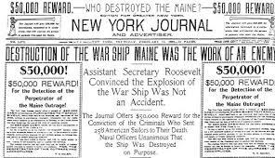
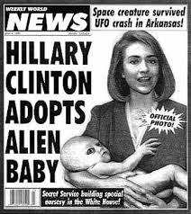
The Development of Media Politics
The Print Media
  Newspapers and magazines
  “Yellow journalism”: a sensational style of reporting characterized newspapers at the turn of the century.
  Pecking order among newspapers
    New York Times has largest impact
  Newspaper and newsweekly circulation has declined.

Slide 6
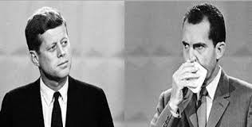
The Development of Media Politics
The Broadcast Media
  Television and radio
  Brought government and politics into peoples’ homes.
    Vietnam War
  Politicians’ appearances and mannerisms more important.
    Kennedy-Nixon presidential debate

Slide 7
The Development of Media Politics
Government Regulation of the Broadcast Media
  The Federal Communications Commission (FCC) regulates the use of airwaves in three ways:
    Prevent near monopoly control of market
    Reviews performance of stations
    Issues fair treatment rules for politicians

Slide 8
The Development of Media Politics
From Broadcasting to Narrowcasting: The Rise of Cable News Channels
  Narrowcasting: media programming on cable TV or Internet that is focused on one topic and aimed at a particular audience, e.g., C-SPAN
  Potential of cable to report on news as it happens and offer myriad choices
  Yet resources are limited and stories are not substantive (“Breaking News”)

Slide 9
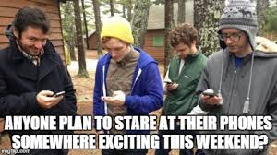
The Development of Media Politics
The Impact of the Internet
  Potential to inform Americans about politics
  Internet is purposive—people choose what to learn about
  Since Americans are generally disinterested in politics, they will not necessarily use the Internet for political information.
  Blogs and podcasts provide additional information about news stories.

Slide 10

The Development of Media Politics
Private Control of the Media
  Only a small number of TV stations are publicly owned in America.
  Independent in what they can report, media are totally dependent on advertising revenues.
  Chains: massive media conglomerates that account for over four-fifths of the nation’s daily newspaper circulation
    Also control broadcast media

Slide 11
Reporting the News
Finding the News
  Beats: specific locations from which news frequently emanates, such as Congress or the White House
  Trial Balloons: an intentional news leak for the purpose of assessing the political reaction
  Reporters and their sources depend on each other—one for stories, the other to get them out.

Slide 12
Reporting the News

Slide 13
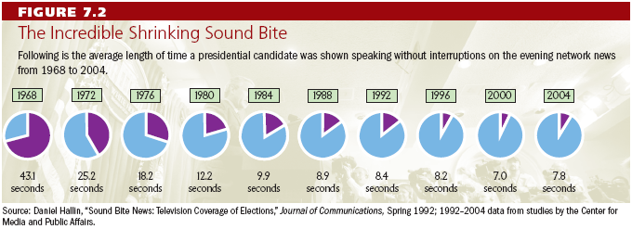
Reporting the News
Presenting the News
  Superficial describes most news coverage today.
  Sound Bites: short video clips of approximately 10 seconds

Slide 14
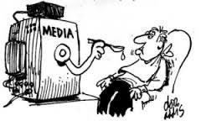
Reporting the News
Bias in the News
  Many people believe the news is biased in favor of one point of view.
  Generally is not very biased toward a particular ideology
  News reporting is biased towards what will draw the largest audience—good pictures and negative reporting

Slide 15
Reporting the News

Slide 16
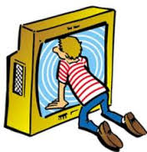
The News and Public Opinion
Television news can affect what people think is important.
  Agenda-setting effect
The media influence the criteria by which the public evaluates political leaders.
Some stories or events can be made more important, others less important, depending on their coverage.

Slide 17
The Media’s Agenda-Setting Function
Policy Agenda
  The issues that attract the serious attention of public officials and other people actively involved in politics at the time
Policy Entrepreneurs
  People who invest their political “capital” in an issue to get it placed high on governmental agenda
  Use media to raise awareness of issue

Slide 18
Understanding the Mass Media
The Media and the Scope of Government
  Media as watchdog restricts politicians
  New proposals are met with skepticism which restricts scope of government, what it can do
  If media identifies a problem, it forces government to address it, which expands the scope of government

Slide 19
Understanding the Mass Media
Individualism and the Media
  Candidates run on their own by appealing to people on television
  Easier to focus on one person like the president, than groups, e.g., Congress or the courts
Democracy and the Media
  “Information is the fuel of democracy.”
  But news provides more entertainment than information; it is superficial.
  News is a business, giving people what they want.

Slide 20
Summary
Media shape public opinion on political issues and influence policy agenda.
Broadcast media have replaced print media over time.
Narrowcasting and the Internet are further shifting media.
Seeking profits, media are biased in favor of stories with high drama.

