Slide 1
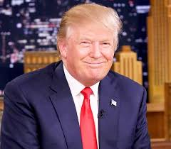
The President
Chapter 12

Slide 2
The Presidents
Great Expectations
Americans are of two minds about the presidency.
On the one hand, they want to believe in a powerful president, one who can do good.
On the other hand, Americans dislike a concentration of power.

Slide 3
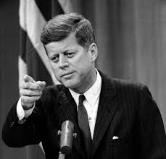
The Presidents
Who They Are
The Constitution states that the president must be a natural-born citizen at least 35 years old and must have resided in the U.S. for at least 14 years.
All American presidents have been white (except for Barack Obama), male, and Protestant (except for John Kennedy).

Slide 4
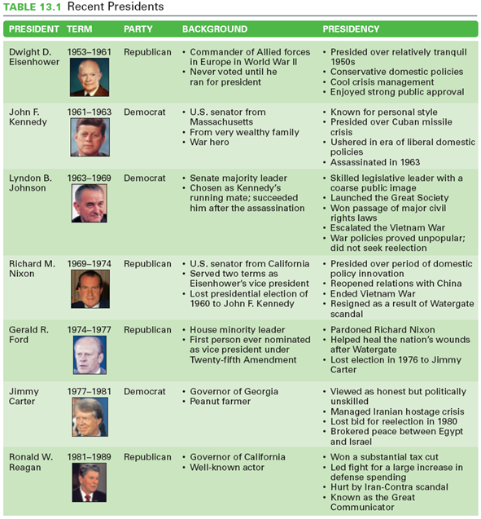
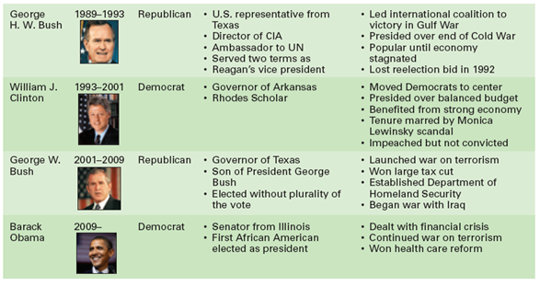

Slide 5
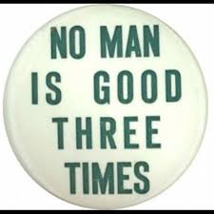
The Presidents
How They Got There
Once elected, the president serves a term of four years.
22nd Amendment (1951) limited the number of terms to two.
36 of 45 presidents have been elected to office.

Slide 6
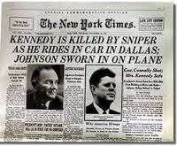
The Presidents
How They Got There (cont.)
Succession – Vice president succeeds if the president leaves office (9 presidents) due to death, resignation, or removal.
25th Amendment – Vice president becomes acting president if the vice president and president’s cabinet determine that the president is disabled

Slide 7
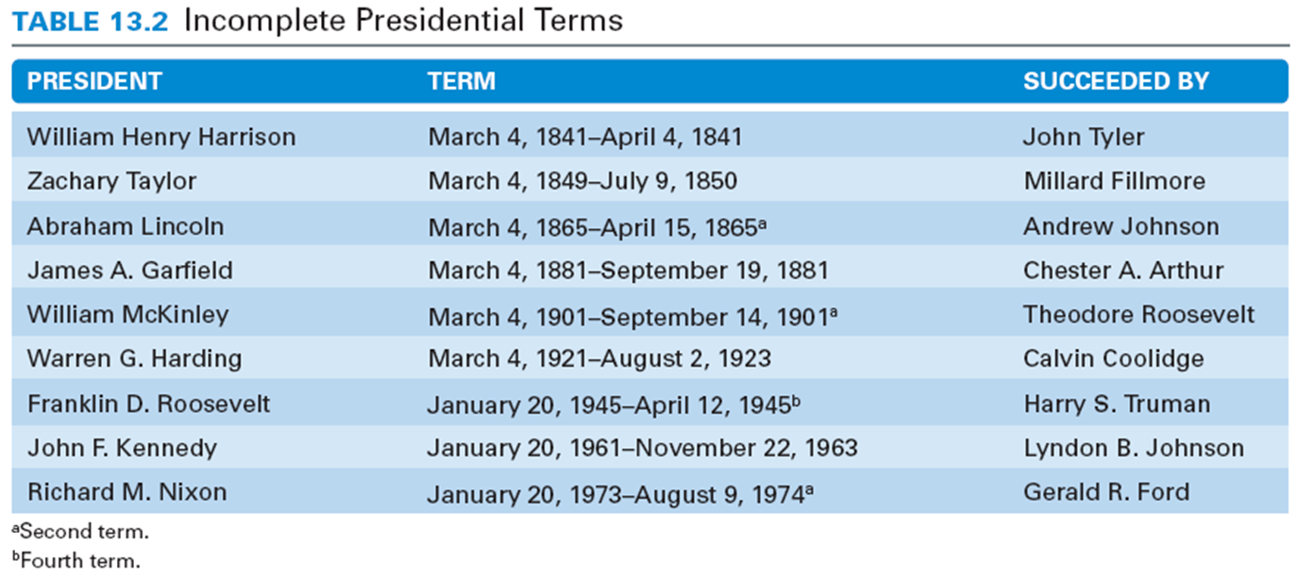

Slide 8
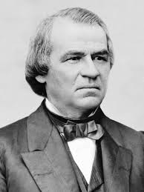
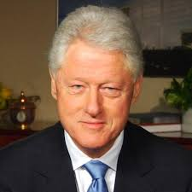
The Presidents
How They Got There (cont.)
Impeachment – Accusation after a majority vote in the House.
Charges may be brought for “Treason, Bribery, or other high Crimes and Misdemeanors.”
An impeached president is tried by the Senate.
Three presidents have been impeached and none of them were convicted. (A. Johnson, Clinton, Trump)
NOT NIXON!

Slide 10
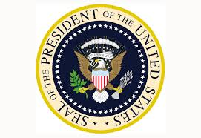
Presidential Powers
Constitutional Powers
National Security – Commander in chief of the armed forces; Make treaties with other nations with two-thirds Senate approval; Nominate ambassadors with majority Senate approval; and Receive ambassadors of other nations (diplomatic recognition on other governments).

Slide 11
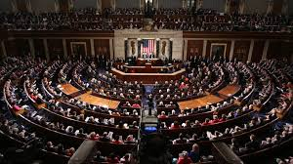
Presidential Powers
Legislative Powers – Present the State of the Union to Congress; Propose legislation to Congress; Convene both houses of Congress on special session; Adjourn Congress if both houses cannot agree on adjournment; and Veto legislation (two-thirds vote of each house can override veto).

Slide 12
Presidential Powers
Administrative Powers – “Take care that the laws be faithfully executed”; Appoint officials as provided for by Congress with a majority Senate approval; Request written opinions of administrative officials; and Fill administrative vacancies during congressional recesses.

Slide 13
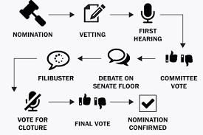
Presidential Powers
Judicial Powers – Give reprieves and pardons for federal offenses (except impeachment); and Appoint federal judges with the agreement of a majority of the Senate.

Slide 14
Presidential Powers
“Informal” Powers of the President
Executive Orders: a rule or order issued by the president to the executive branch of the government and having the force of law.
Executive Agreement: an agreement between the U.S. and a foreign government made by the executive branch either alone or with Congressional approval and dealing usually with routine matters

Slide 15
The Chief Executive
President presides over the administration of government.
Today, federal bureaucracy spends $3 trillion a year and numbers more than 4 million employees.
Presidents appoint about 500 high-level positions and 2,500 lesser jobs.

Slide 16
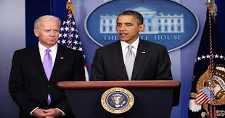
The Chief Executive
The Vice President
Constitutionally, they are assigned the minor task of presiding over the Senate and voting in case of a tie, and deciding the evaluating the presidents ability to govern (25th amendment).
Recent presidents have involved their vice presidents in policy discussions and important diplomacy.

Slide 17
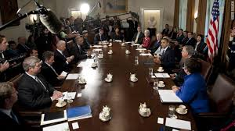
The Chief Executive
The Cabinet
Cabinet – Group of presidential advisers not mentioned in the Constitution, although every president has had one.
Today, the cabinet is composed of 14 secretaries and the attorney general.

Slide 18
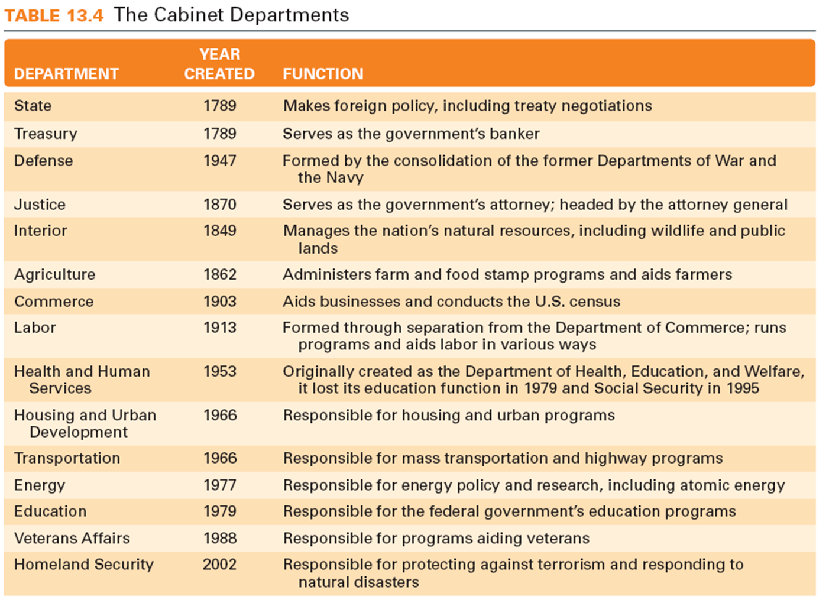

Slide 19
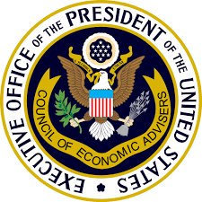
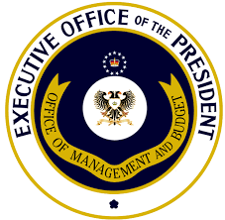
The Chief Executive
The Executive Office
Started in 1939 when President Roosevelt established it and is made up of several policymaking and advisory bodies.
Three major policymaking bodies are the National Security Council (NSC), the Council of Economic Advisers (CEA), and Office of Management and Budget (OMB).

Slide 20
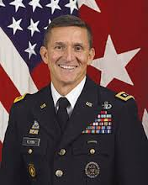
The Chief Executive
National Security Council – This committee links the president’s foreign and military policy advisers.
Formal members are president, vice president, secretary of state, and secretary of defense, and it is managed by president’s national security assistant.

Slide 21
The Chief Executive
Council of Economic Advisers – A three-member body appointed by the president to advise the president on economic policy.
Office of Management and Budget – Prepares president’s budget, advises presidents on agencies’ proposals, and reviews agencies’ proposed regulations.

Slide 22
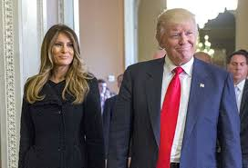
The Chief Executive
The First Lady
No official government position, but active in politics.
Most focus on a single issue; Hillary Clinton and health care, Michelle Obama and ruining school lunches, Melania Trump and cyberbullying.

Slide 23
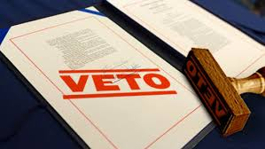
The President and The Congress
Chief Legislator
Veto – The constitutional power of the president to send a bill back to Congress with reasons for rejecting it.
A two thirds vote in each house can override a veto.

Slide 24
The President and The Congress
Pocket Veto – A type of veto occurring when Congress adjourns within 10 days of submitting a bill to the president and the president simply lets the bill die by neither signing nor vetoing it

Slide 25
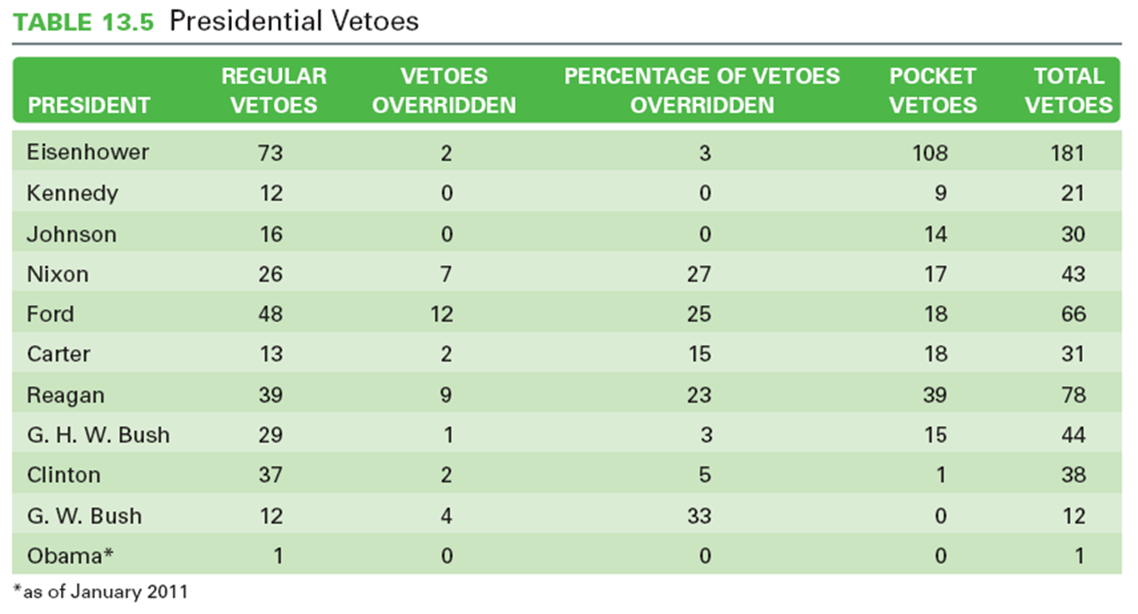

Slide 26
The President and The Congress
Party Leadership
The Bonds of Party – Being in the president’s party creates a psychological bond between legislators and presidents, increasing agreement.
Slippage in Party Support – They cannot always count on party support on controversial issues. (DeVos)

Slide 27
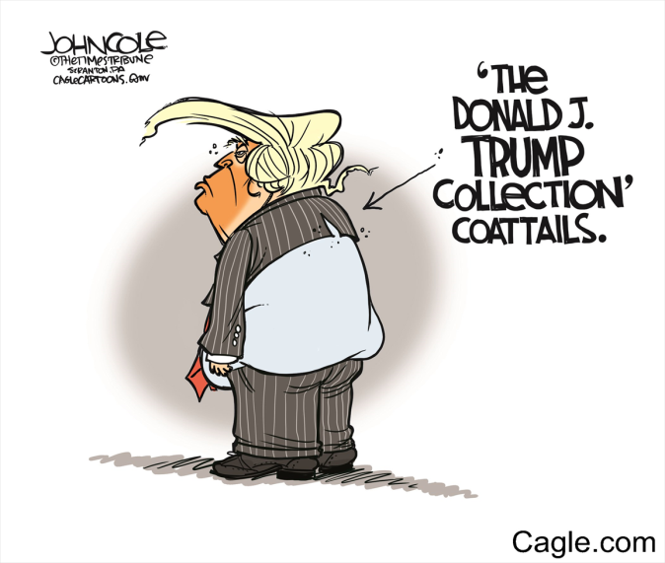
The President and The Congress
Party Leadership (cont.)
Leading the Party – Work with party leadership in Congress and support party candidates.
Presidential coattails – When voters cast their ballots for congressional candidates of the president’s party because they support the president.

Slide 28
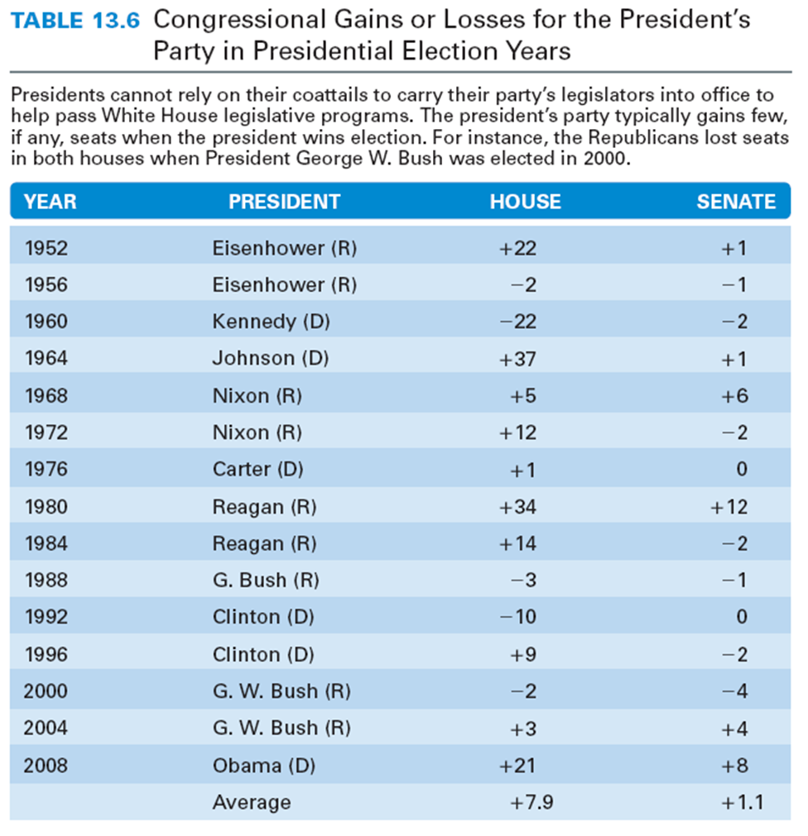

Slide 29
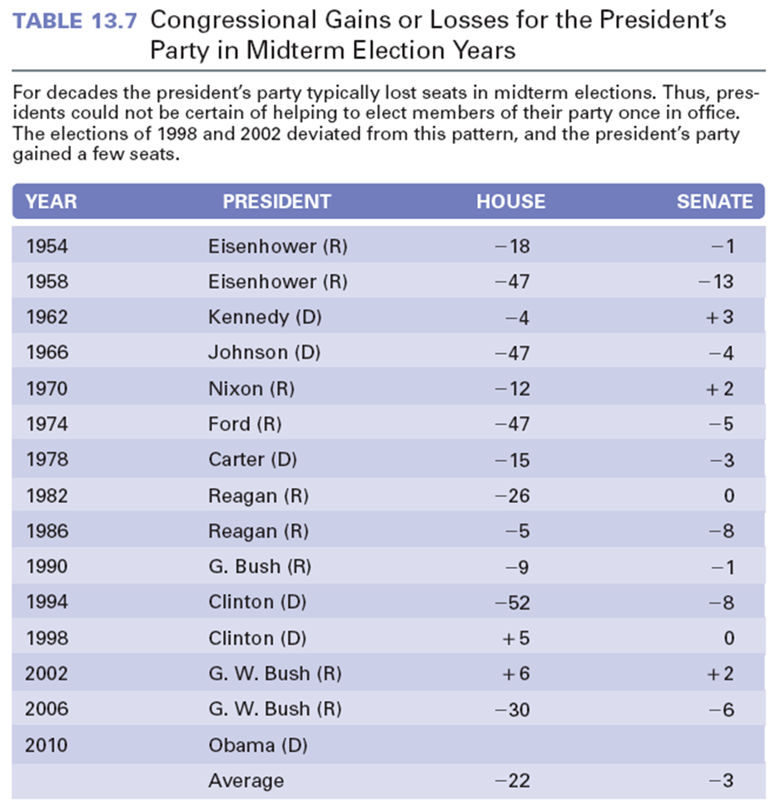

Slide 30
The President and The Congress
Public Support
Public Approval – A source of presidential leadership of Congress.
Public approval gives the president leverage, not command; it does not guarantee success.
Mandates – Perception that the voters strongly support the president’s character and policies.
Mandates are infrequent, but presidents claim a mandate anyway. (Trump?)

Slide 31
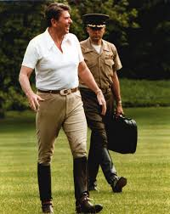
The President and National Security
Commander in Chief
Writers of the Constitution wanted civilian control of the military.
Presidents often make important military decisions.
Presidents command a standing military and nuclear arsenal.

Slide 32
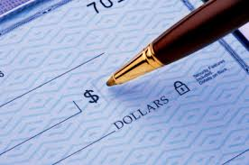
The President and National Security
War Powers Resolution – A law passed in 1973 due to fighting in Vietnam and Cambodia that requires presidents to consult with Congress whenever possible prior to using military force and to withdraw forces after 60 days unless Congress declares war or grants an extension.
Within 48 hours of deployment, the President must inform Congress the purpose and scope of his action.

Slide 33
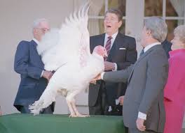
The Public Presidency
Going Public
Public support is a president’s greatest source of influence.
Presidential appearances are staged to get the public’s attention.
As head of state, presidents often perform many ceremonial functions, which usually result in favorable press coverage.

Slide 34
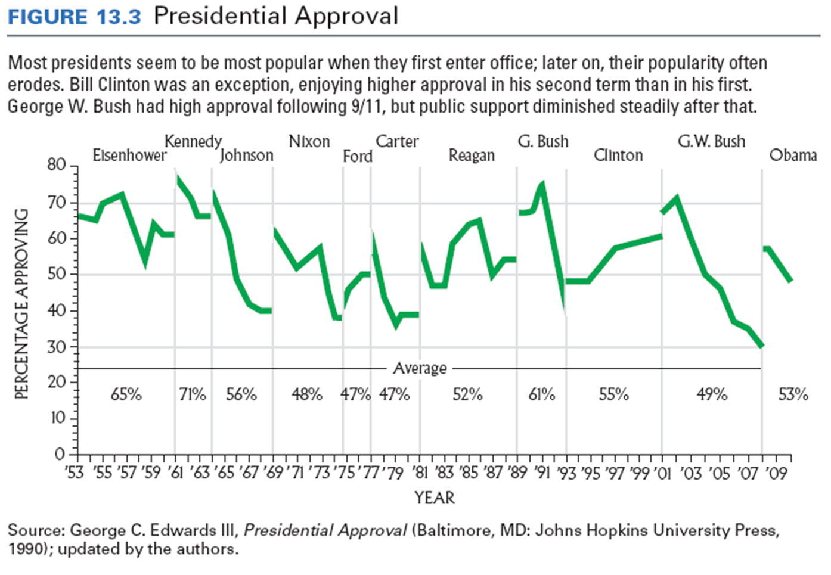
The Public Presidency
Presidential Approval

Slide 35
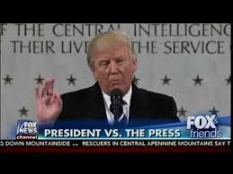
The President and the Press
The Presidents
Policy advocates and want to control the amount and timing of information about their administration.
The Press
Wants all the information that exists without delay.

Slide 36
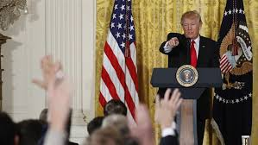
The President and the Press
Press Secretary
Serves as conduit of information from White House to the press.
Conduct daily press briefings, and arrange private interviews, photo opportunities, and travel arrangements for reporters.
Presidential Press Conference
Direct interaction between the president and the press.

