Slide 1
Unit 3
American Political ideology and beliefs

Slide 2
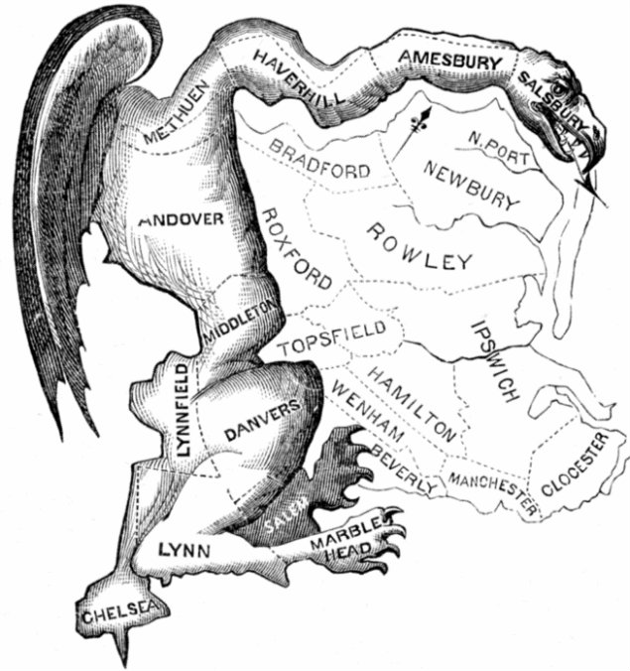
Gerrymandering
Exotically shaped Congressional districts (House) designed to yield political advantage for political parties or incumbents
Census→ Reallocation→ Redistricting
Baker v. Carr
“One person, one vote”
Prevents malapportionment: poorly apportioned, especially divided, organized, or structured in a manner that prevents large sections of a population from having equitable representation in a legislative body.
Equal protection clause was violated
Districts usually not larger than 650,000 people

Slide 3
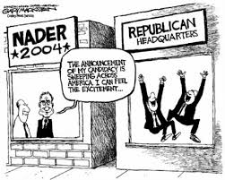
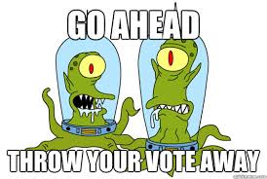
Third Parties
A vote for a third party is sometimes viewed as a “throwaway vote”
Progressive third parties can impact the Democratic vote
Third party candidates rarely win
Winner-take-all Electoral College
Plurality winner of Congressional districts

Slide 4
Typical Republican Voter | Typical Democratic Voter Most women align themselves with the Democratic party
Opposes government regulation of business | Favors increased spending on entitlements (welfare programs)
Pro-Life on Abortion Issue | Pro-Choice on Abortion Issue
In favor of military spending | Favors decreased military spending
In favor of tax cuts | Against tax cuts for the rich
In favor of preserving the Second Amendment | Favors gun control
Against marriage equality | Favors same-sex marriage
Less diverse | More diverse

Slide 5
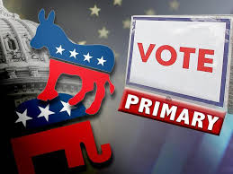
Primaries
Primaries are the main device to determine the party’s nominee
Closed primaries: Only people who have registered with the party can vote for that party’s candidates.
Forbids minor party participation
Open primaries: Voters decide on Election Day whether they want to vote in the Democrat or Republican primary.
If you vote in a primary, you are most likely to belong to a political party

Slide 6
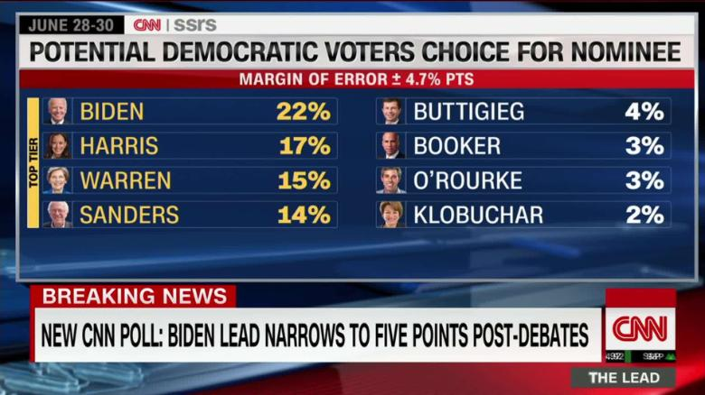
Public Opinion Polls
Criteria for a legitimate poll
1. Questions must be worded in a clear and neutral fashion
2. The subjects in the sample must be randomly selected
3. The survey or poll (sample size) must be sufficiently large that the built-in sampling error is reasonably small
Poll results most widely reported in the media
Cue voters as to the likely winner

Slide 7
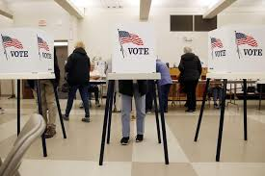
Weakening Political Parties
Decentralization of power
More power lies in the state and local parties
Party dealignment: disengagement of people from parties as evidenced by shrinking party identification
Leads to an increase in split ticket voting

Slide 8
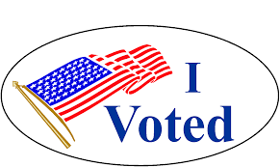
Political Participation
Definition: As all the activities used by citizens to influence the selection of political leaders or the policies they pursue
Conventional forms
Voting
Running for office
Watching a debate
Unconventional forms
Protest (flag burning, sit-in, chucking rocks)
The older you are, the more likely you are to participate in politics

Slide 9
Conservative Economic Policy
Trickle Down Economics
(Supply Side)
New Profits
New Jobs
Gov.’t Loans and Tax Cuts to Business
Plant Expansion
New Investment
New Investment & Plant Expansion
Increased Demand
New $Money$ in Circulation
New Jobs
Increased Production
Relief Payments and Government infusion of cash into industry
More $Wages$ in Circulation
Liberal Economic Policy
“Keynsian Economics”
Demand Increases

