Slide 1
Amateurism
Answer the following questions on a piece a paper and be prepared to hand it in. (30 points)
What is your definition of amateur? Be specific.
Are Division I college sports amateur sports according to your definition? Explain your answer.
Should the NCAA give up and just allow college athletes to be paid? Explain your answer.

Slide 2
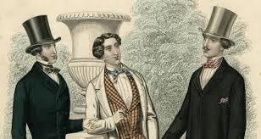
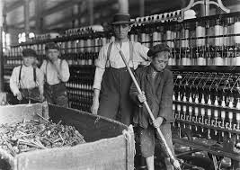
Amateurism
Origin: Upper class English Sportsmen developed the idea; later adopted by American Upper class.
Goal: Separate the upper class pastimes from ordinary people.

Slide 3
Rules of Amateurism
Play without pay (unmanly to mix money with sports
Play done in a special way
Always exhibit principle of fair play
Never seek advantage by unfair means or seize advantage by exploiting an opponents disadvantage.
No need for officials.
Exhibit great skill without great training or exertion.

Slide 4
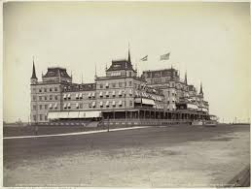
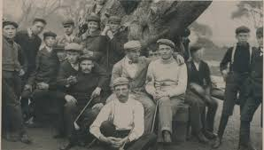
The Club Scene
1879: National Association of Amateur Athletics of America (N4A)redefined amateurism in America:
Never have competed for admission money
Never competed with professionals for a prize
Never taught or assisted in pursuit of athletic exercise as a means of livelihood.
The goal in America as it was in England was to separate the classes

Slide 5
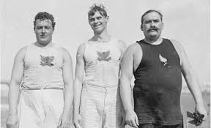
But in reality…
There is no aristocracy in America
People earn money through hard work and a win at all cost mentality
Seeps in clubs regardless of rules
Break the rules, just don’t get caught.

Slide 6
Evolution of Amateurism
1880’s
Clubs begin to develop competitive vigor and compete with each other for athletic supremacy
Top athletes are admitted to clubs free (except if you were black, rude, or both)
Leads to disputes about eligibility of athletes
New York Athletic club leaves the N4A and forms the AAU

Slide 7
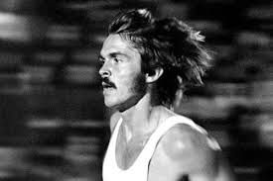
The AAU
Goal was to create common standards in amateur sports
Worked closely with the United States Olympic Committee to prepare US athletes for the Olympic Games.
Amateur Sports Act of 1978 stripped the AAU of its power over scheduling events and dictating standards

