Slide 1
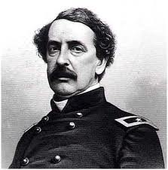
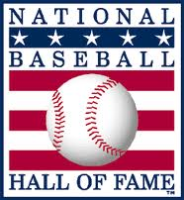
History and Development of Modern Baseball
Cooperstown Myth
1907 Albert Spalding establishes commission to research origin of baseball
Commission sends letters to “Old Timers” to ask their recollections on the subject
The letters establish that Abner Doubleday (a future war hero at the Battle of Gettysburg) “invented” baseball
In Cooperstown, NY (1839) while sitting on the banks of Otsego Lake Doubleday crafts rules to a variation of baseball while people play it around him.
Cooperstown is established as the home of baseball, making it a quasi-religious town where people make annual pilgrimages.

Slide 2
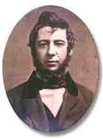
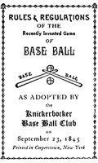
History and Development of Modern Baseball
Guess what?
It ain’t true.
True Origins
Game was a descendant from two English games: cricket and rounders.
1842 & 1843 Group of Brokers, merchants, clerks, and other gentlemen began playing bat and ball game on 27th St and 4th Ave in Manhattan .
Alexander Cartwright: convinces a group of bankers and stockbrokers to form a baseball club.
The New York Knickerbocker Baseball Club is born.

Slide 3
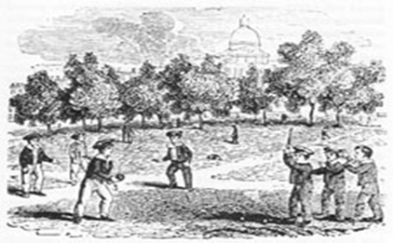
The Knickerbockers
Elysian Fields in Hoboken, NJ becomes home field.
Established first rules of the game:
Diamond infield
3 swinging strikes out
Umpires only on first base, and only there to solve conflicts
No gloves
Catcher several feet behind home plate, caught ball on one bounce
“Feeder” (pitcher) got a running start and delivered the ball underhand from 45 feet away.

Slide 4
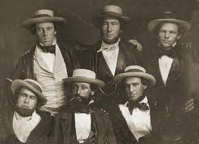
The Knickerbockers
Knickerbockers:
Became baseball fraternity with bylaws, elected officials, and regular meetings.
An athletic AND social organization
Membership restricted to gentleman amateurs, membership only by invitation.
Common love of baseball
Offered satisfaction outside of work (Industrial Revolution)
Excitement, companionship, belonging
Opportunity to show off skills
Rituals and off-season gatherings enhance the club
Winning team gets the ball with the score on it.

Slide 5
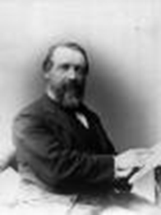
Expansion of Baseball
The game spreads rapidly with the help of Union soldiers during the Civil War.
1858: 62 Clubs; 1865: 91 Clubs in 10 states.
Outcomes start to become published in newspapers
Henry Chadwick
Reporter for the New York Clipper
Edited first guidebook for baseball which included rules, clubs, stats, and other news(1860’s 65,000 circulation)
Invented box score, and batting average (gives the game appeal)

Slide 6
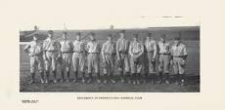
Expansion of Baseball
1850’s
Call to make baseball the National Game
Employers reluctant to hire club members. Thought they would not be able to focus on work.
Players claimed that baseball was better than other mischief.

Slide 7
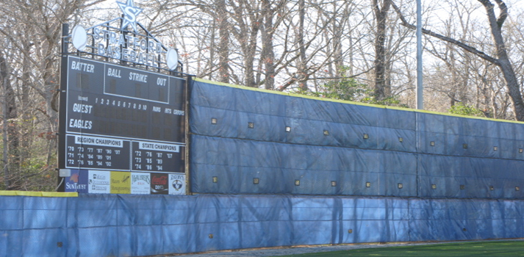
Expansion of Baseball
Baseball as a commercial enterprise
1862: William Cammeyer fenced in a field and charges admission. Launches enclosure movement.
Once money enters the equation, so does greed and corruption.
Fraternal bonds break and players begin to play more, practice more, and businessmen begin to recruit and pay top players

Slide 8
Expansion of Baseball
1860’s
Teams begin to see value in deceit of other team and umpires
Blue Collar workers (Irish, Italian immigrants) see baseball as a chance for social mobility.
Intense rivalries develop between cities.
1869: Harry Wright announces first all-salaried pro team.
Cincinnati Red Stockings

Slide 9
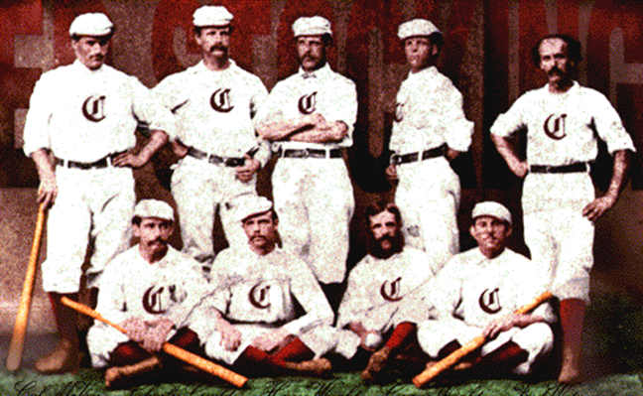
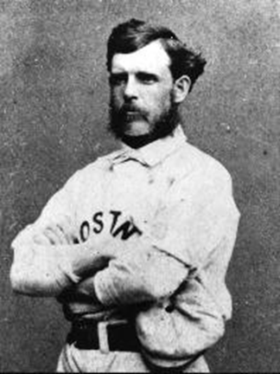
Expansion of Baseball
Cincinnati Red Stockings
Players recruited from all over the country. Only one player was from Cincinnati
Used railroad to travel the country and play games.
86 game winning streak attracts fans.
Play championship game against Brooklyn in 1870
Game is tied 5-5 after 9 innings
Wright “invents” extra innings on the spot
Cincinnati loses, fans lose interest, team moves to Boston.

Slide 10
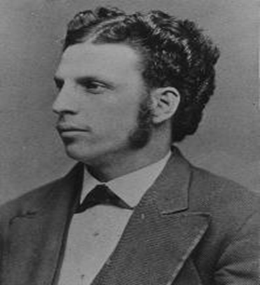
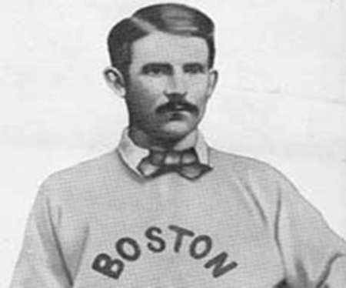
Early Leagues
1871-1875 : National Association of Professional Baseball Players
Loose alliance of clubs, had to pay $10 entry fee
Owners develop own schedules, and they could contend for pennant if they played all teams 5 times
1871 Philadelphia A’s win pennant over Harry Wright’s Boston Red Stockings
Harry Wright and Boston win next 4
Top players: George Wright (Harry’s brother) and Albert Spalding.
Poor play and open free agency hurt the league.

Slide 11
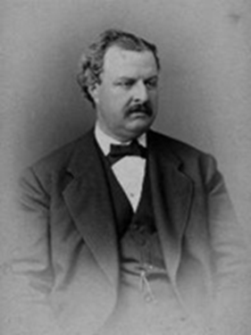
Early Leagues
1876: National League of Professional Baseball Clubs
William Hulbert (owner of Chicago White Stockings) and Albert Spalding lead movement against Association
Wanted power in hands of owners not players
City must have 75,000 residents to join league
1. Boston, Chicago, Cincinnati, Louisville, Hartford,
St. Louis, Philadelphia, New York
2. In order to join must get majority approval of other teams
Rules-No games on Sunday, no alcohol, 50 cent admission
No overall leader led to early turmoil as owners work for own self interest
1. Philadelphia and NY get kicked out for refusing to travel
2. Cincinnati gets booted for selling alcohol
3. Four Louisville players booted for corruption

Slide 12
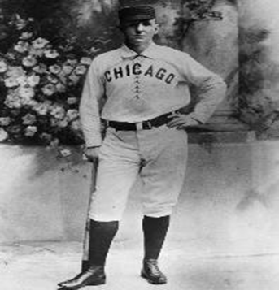
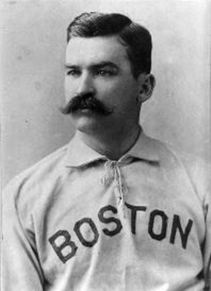
Early Leagues
1881 : American Association formed
Formed as a beer ball league by Cincinnati as sign of protest against National League
6 teams owned by breweries
Rules- Alcohol sold, Games on Sundays, 25 cent admission
Accepted National League players who wanted to jump ship
1882 : National League signs agreement with American Association and establish championship game
American Association-St. Louis Brown Stockings owned by Charles Commiskey win 4 American titles and 2 World Champion titles
National League-Chicago White Stockings led by Adrian “Cap” Anson and Michael “King” Kelly win 5 pennants between 1880-1886

Slide 13
The Players Revolt
National League owners like Albert Spalding (Chicago) were worried about their players’ drinking
Spalding hires a detective to watch player behavior
Report finds “King” Kelly at a bar at 3 am
National league begins to blacklist players dismissed by other teams
Reserve Clause- Teams get lifetime option on players
Players have no bargaining power because can only play for original team
Only 2 options for players
1. hold out
2. quit (no other jobs of = pay)
Owners tried to regulate social lives of ball players
Owners could sell players (ex King Kelly to Boston for $10,000)
Also led to establishment of salary cap of $2500 in 1887

Slide 14
The Players Revolt
1890 John Montgomery Ward triggers players revolt
Calls salary cap and selling of players slavery
Creates a Players League
Created 8 teams in existing baseball cities and lures players away from National League
1. “King” Kelly leaves for players league
2. Albert Spalding offered Kelly a blank check but Kelly says he can’t go against boys
Players league folds after 1 year
1. Competition in cities hurts fan base
2. Rules turned off working class citizen
No Sundays, No Alcohol, 50 cent admission
Spalding and National League survive because of large financial reserves while both Players League and American Association fold
Players had Spalding and reserve clause on mat but both are able to survive. Reserve clause until 1976.

Slide 15
Minorities in the game
1880’s total of 240 big leaguers
Most from lower socioeconomic backgrounds with a high number of Irish and Germans from Northeastern cities
Opportunity for social mobility in baseball
1867- National Association of Baseball Players bans blacks
1876- National League informal agreement against blacks
1883- Moses Fleetwood Walker and Weldy Walker allowed to play for Toledo in American Association but many opponents refuse to play against blacks so neither invited back in 1885.
1887- 6 out of 10 minor league teams have black players
Cap Anson refused to allow Chicago to take field against Newark if George Stovey pitched for Newark

Slide 16
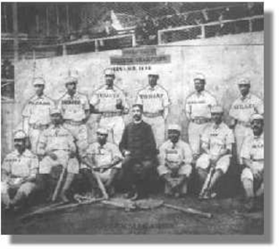
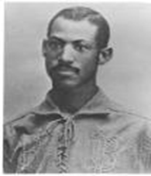
Minorities in the game
Total exclusion of blacks lasts until 1946
1867- All black teams formed and play each other
Philadelphia Excelsiors and Brooklyn Uniques
1885- Cuban Giants
All black team made up of hotel waiters from NY
Play 150 game season
1887 play major league teams in Cincinnati and Indianapolis
Defeat 4 of 5 NY teams

Slide 17
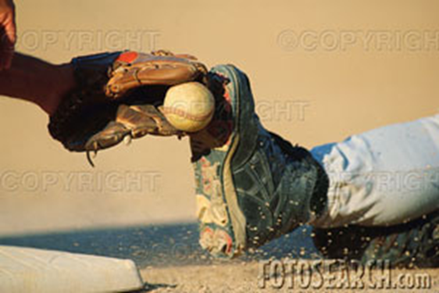
Rule Changes
1884- Overhand pitching allowed
1887- Batters can no longer call for pitch
1889- 4 balls = walk
1893- Overhand pitching forces team to use 3 man rotation
1890’s- development of bunting, hit and run, stealing, stretching hits
Overall game becomes tougher as players begin spiking each other, and shouting matches between players and umpires and players and players become more common.

