Slide 1
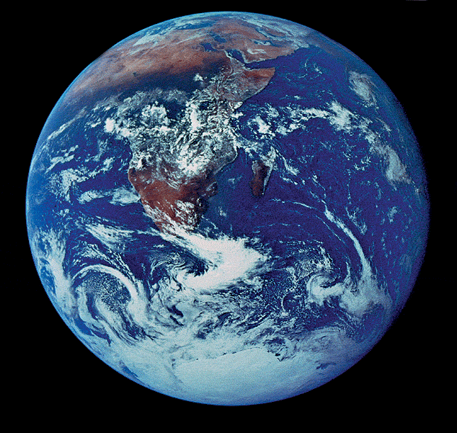
Chemistry of Life
Biochemistry is the best!

Slide 2
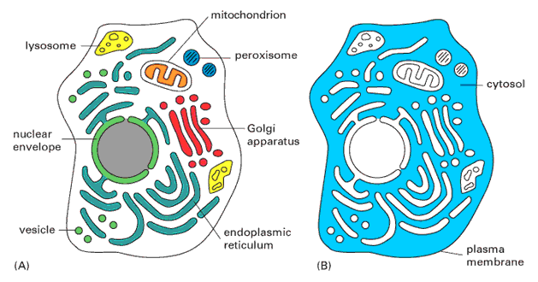
What about Water?
Why are we studying water?
All life occurs in water
  inside & outside the cell

Slide 3
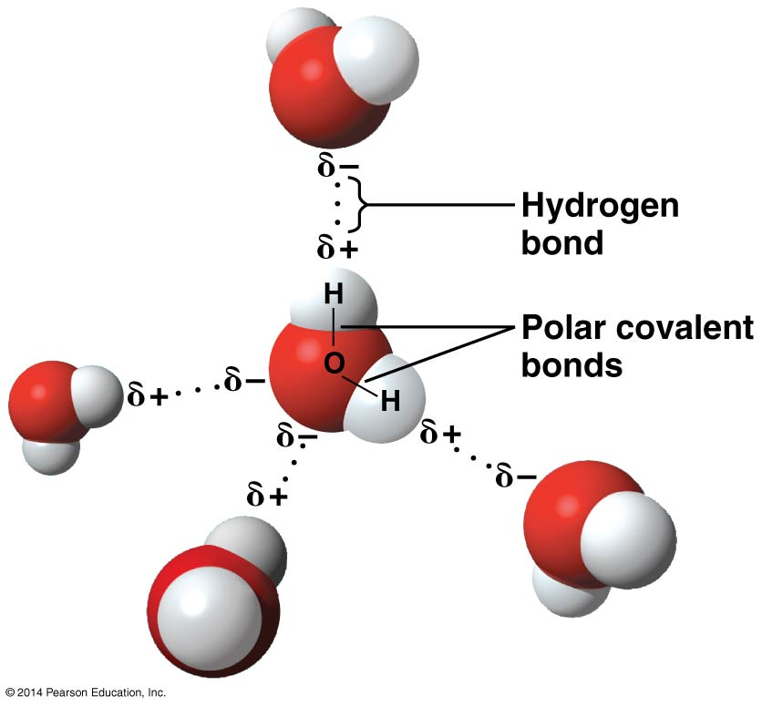
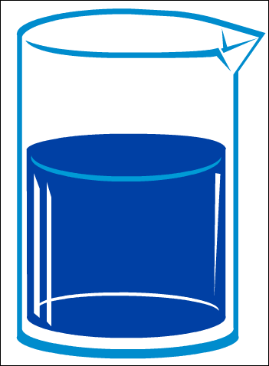
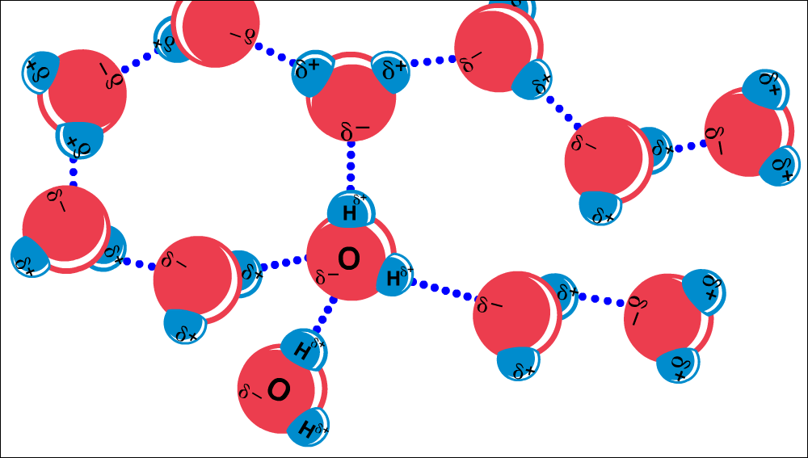
Chemistry of water
H₂O molecules form H-bonds
with each other
  +H attracted to –O
  Polar molecule
    makes it “sticky”
Notes:
APBio/TOPICS/Biochemistry/Movies AP/hydrogenbonds-Thinkwell.swf

Slide 4
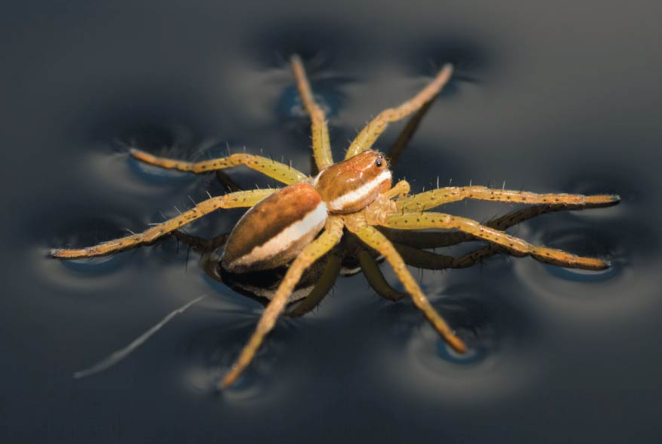
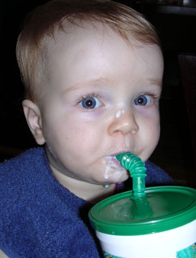
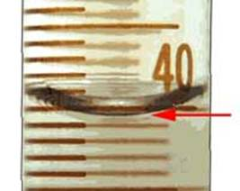
1. Cohesion & Adhesion
Cohesion
  H bonds between H₂O molecules
    can create Surface Tension
    drinking straw
Adhesion
  H bonds between H₂O & other substances
    capillary action
    meniscus
    water climbs up
    paper towel or cloth
Notes:
Cohesion
H bonding between H₂O molecules
water is “sticky”
surface tension
capillary action
drinking straw
Adhesion
H bonding between H₂O & other substances
capillary action
meniscus
water climbs up paper towel or cloth

Slide 5
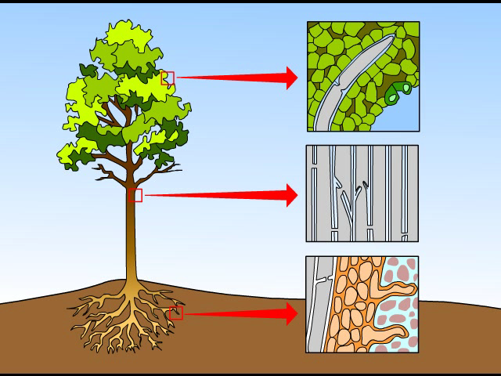
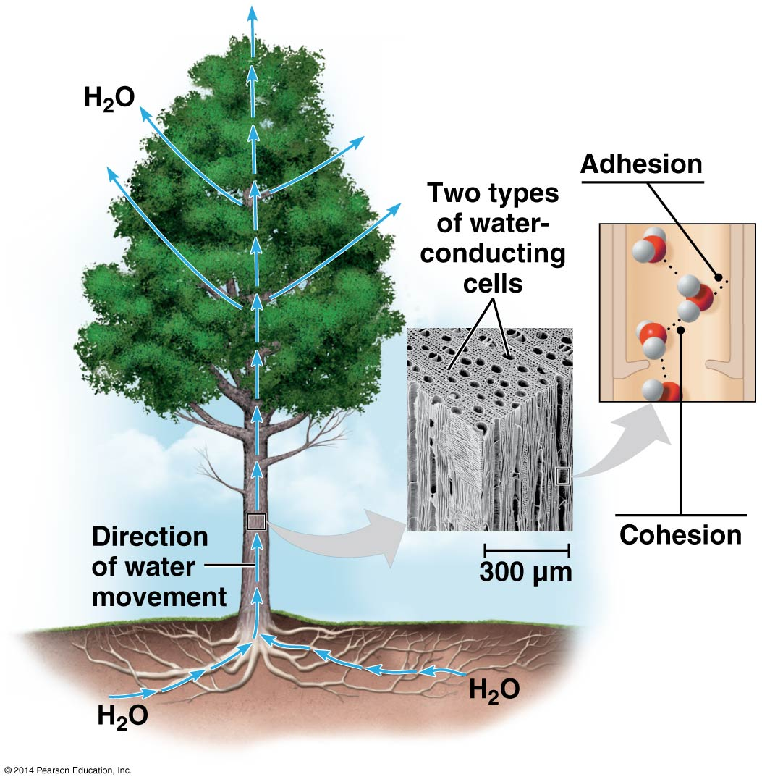
How does H₂O get to top of trees?
Transpiration is built on cohesion & adhesion
Notes:
APBio/TOPICS/04Biochemistry/MoviesAP/03_03WaterTransport_A.swf

Slide 6
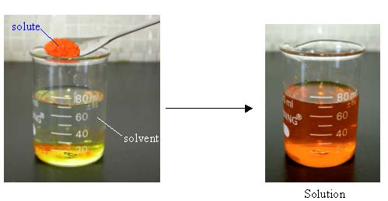
2. Universal Solvent
Polarity makes H₂O a good solvent
  polar H₂O molecules surround + & – ions
  solvents dissolve solutes creating solutions
Notes:
2. Water is a good solvent = the solvent of life
Polarity makes H₂O a good solvent
polar H₂O molecules surround + & – ions
solvents dissolve solutes creating solutions
What dissolves in water easily?
polar or non-polar molecules?
How about oxygen -- does that dissolve in H₂O?

Slide 7
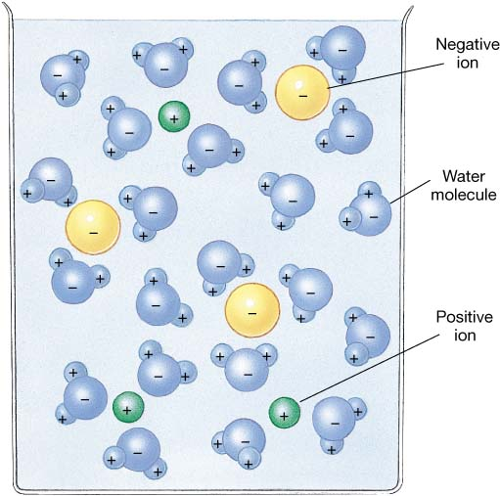
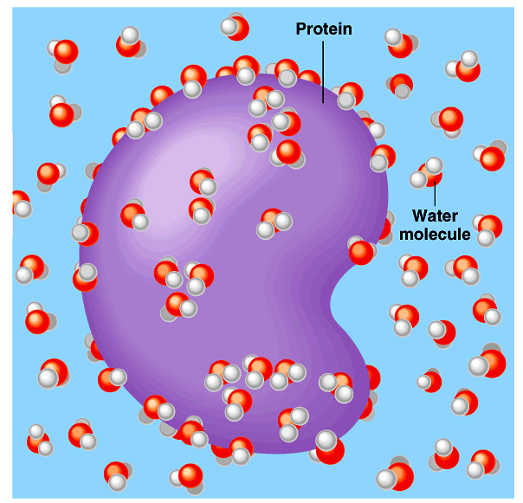
What dissolves in water?
Hydrophilic (Water loving!)
  What kind of substances are hydrophilic?
Notes:
Hydrophilic
substances have attraction to H₂O

Slide 8
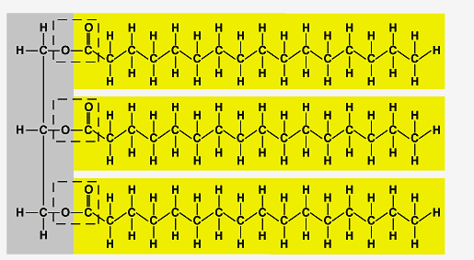
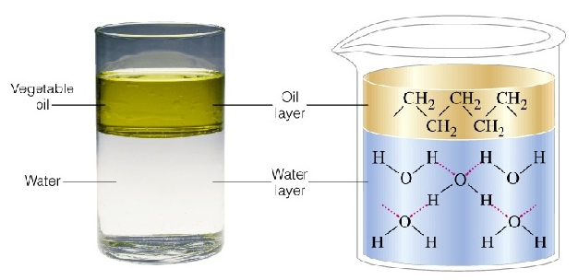
What doesn’t dissolve in water?
Hydrophobic (Water Fearing!)
  What kind of substances
  are hydrophobic?
Oh, look
hydrocarbons!
Notes:
Hydrophobic
substances that don’t have an attraction to H₂O

Slide 9
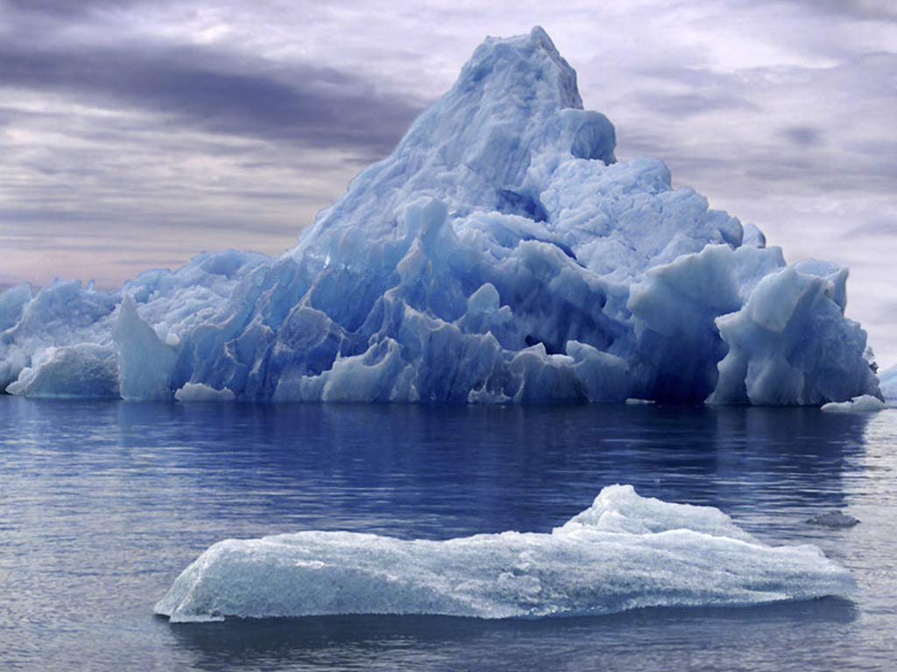
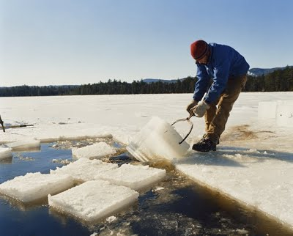
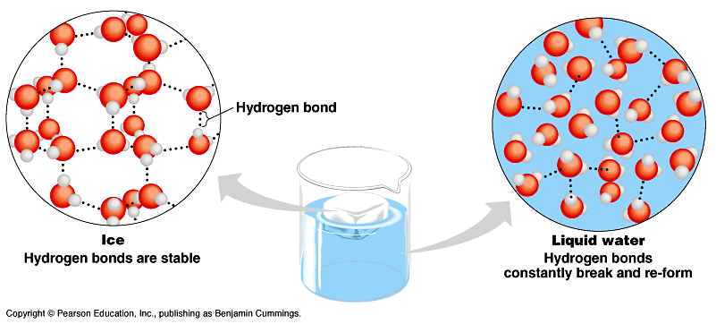

3. Less Dense as Solid
Ice floats!
  H bonds form a crystal
  bonds are stable
  EXPANDS as it freezes
Ice!
I could use
more ice!
And this has
made all the
difference!
Notes:
Most (all?) substances are more dense when they are solid, but not water…
Lower density as a solid = Ice floats!
H bonds form a crystal

Slide 10
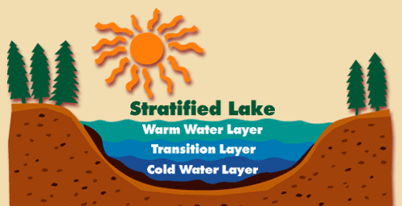
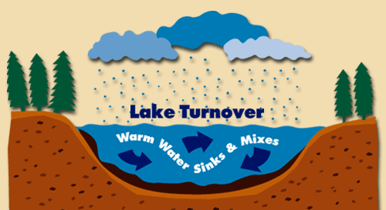
Why is “ice floating” important?
surface ice insulates water below
    allowing life to survive through the winter
  if ice sank…
    ponds, lakes & even oceans would freeze solid
seasonal turnover of lakes
    sinking of cold H₂O cycles nutrients in autumn and spring
Notes:
Oceans & lakes don’t freeze solid
surface ice insulates water below
allowing life to survive the winter
if ice sank…
ponds, lakes & even oceans would freeze solid
in summer, only upper few inches would thaw
seasonal turnover of lakes
sinking cold H₂O cycles nutrients in autumn

Slide 11
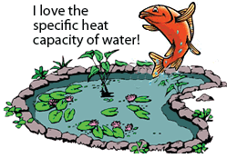
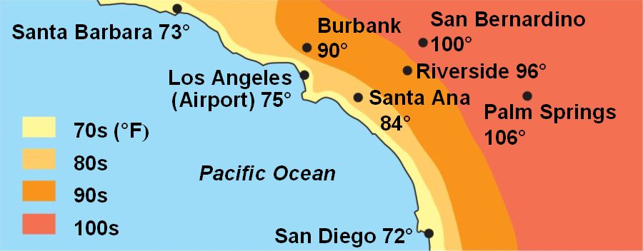
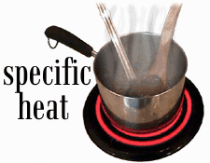
4. High Specific Heat
H₂O resists changes in temperature
H₂O moderates temperatures on Earth
    takes a lot of energy to heat
    slowly loses energy to cool
Don’t touch the metal!
Why is San Bernardino always warmer than LA?
Notes:
Specific heat
H₂O resists changes in temperature
high specific heat = heats & cools slowly
takes a lot to heat it up
takes a lot to cool it down
H₂O moderates temperatures on Earth

Slide 12
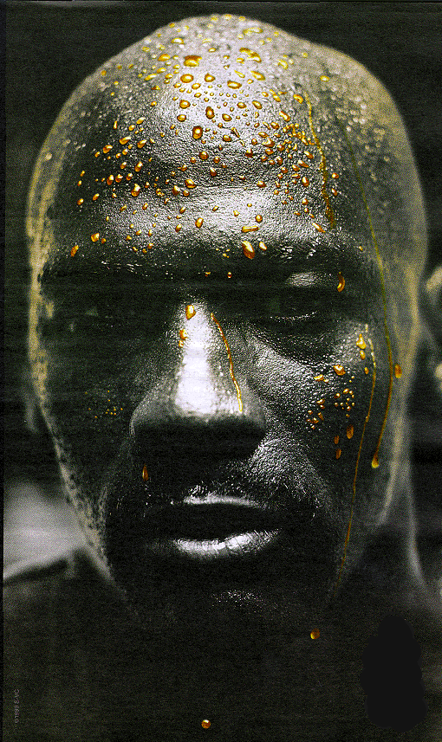

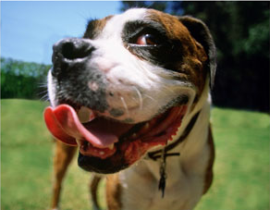
5. Evaporative Cooling
Heat of vaporization
  Water moves from liquid to gas
  Heat energy moves with the gas
Why is this good for life?
  Cooling body temps/sweating
  Moderating Earth’s climate
    Which type of climate slows evaporative cooling?

Slide 13
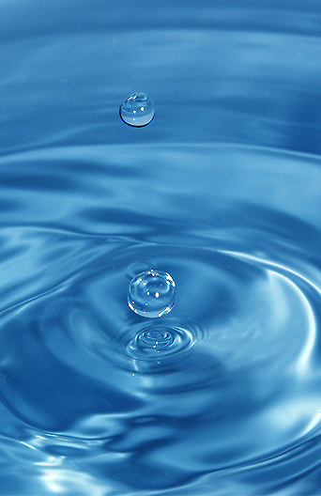
Elixir of Life
Special properties of water
  1. cohesion & adhesion
  2. good solvent
  3. lower density as a solid
  4. high specific heat
  5. evaporative cooling
Ice!
I could use
more ice!
It is the hydrogen bonding that accounts for all its magical properties!

Slide 14
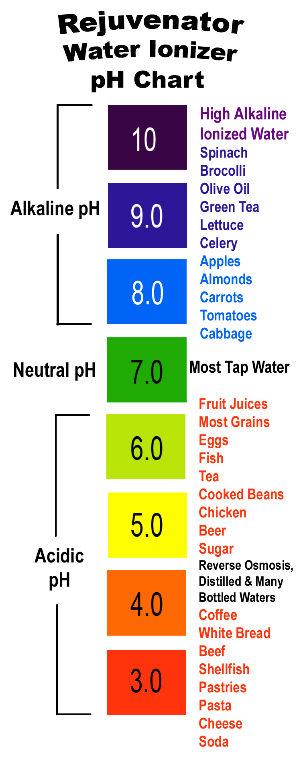
Ionization of Water and pH
When water ionizes…
  H⁺ splits off from H₂O, leaving OH–
    if [H⁺] = [⁻OH], solution is neutral
  Other aqueous solutions:
    if [H⁺] > [⁻OH], solution is acidic
    if [H⁺] < [⁻OH], solution is basic
pH scale
  measures the concentration of H+
  Determines how acidic or basic a solution is
  1 → 7 → 14
Notes:
Water ionizes
H⁺ splits off from H₂O, leaving OH–
H₂O → H⁺ + OH–
if [H⁺] = [⁻OH], water is neutral
if [H⁺] > [⁻OH], water is acidic
if [H⁺] < [⁻OH], water is basic
pH scale
how acid or basic solution is
1 → 7 → 14

Slide 15

pH Scale
H⁺ Ion
Concentration
Examples of Solutions
pH
10⁰
0
Hydrochloric acid
10^{–1}
1
tenfold change
in H+ ions
pH1 → pH2
10⁻¹ → 10⁻²
10 times less H⁺
pH8 → pH7
10⁻⁸ → 10⁻⁷
10 times more H⁺
pH10 → pH8
10⁻¹⁰ → 10⁻⁸
100 times more H⁺
10^{–2}
2
Stomach acid, Lemon juice
10^{–3}
3
Vinegar, cola, beer
10^{–4}
4
Tomatoes
10^{–5}
5
Black coffee, Rainwater
10^{–6}
6
Urine, Saliva
10^{–7}
7
Pure water, Blood
10^{–8}
8
Seawater
10^{–9}
9
Baking soda
10^{–10}
10
Great Salt Lake
10^{–11}
11
Household ammonia
10^{–12}
12
Household bleach
10^{–13}
13
Oven cleaner
10^{–14}
14
Sodium hydroxide
Notes:
In pure water only 1 water molecule in every 554 million is dissociated
tenfold change in H+ ions
pH1 → pH2
10⁻¹ → 10⁻²
10 times less H⁺
pH8 → pH7
10⁻⁸ → 10⁻⁷
10 times more H⁺
pH10 → pH8
10⁻¹⁰ → 10⁻⁸
100 times more H⁺

Slide 16
pH Math…
pH = - log [H⁺]
pH = - log (10⁻³) = 3
pH = 7 then [H⁺] = 10⁻⁷
[ H⁺10⁻⁷] [OH⁻10⁻⁷] = 10^{-14 add exponents}
Ex: Acid precipitation has lowered the H+ concentration of a particular lake is 10⁻⁴.
  What is the pH of the lake? 4
  What is the [OH⁻]? 10⁻¹⁰
EX: One liter of a solution has a pH 4. How many times more H+ are there in 1 L of a solution of pH 7?
1000 times more

Slide 17
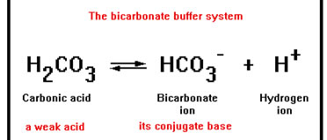
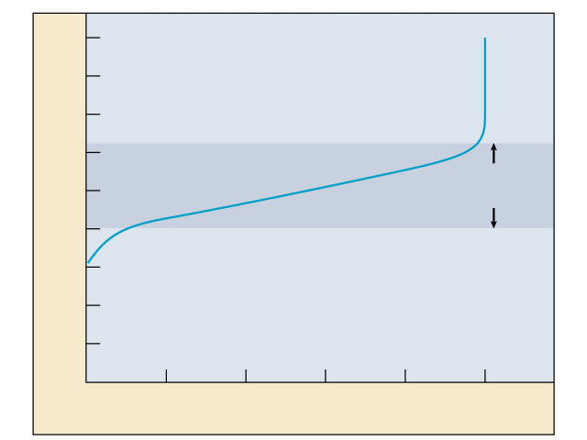
Buffers & Cellular Regulation
pH of cells must be kept ~7…why?
  pH affects shape of molecules
  shape of molecules affect function
  therefore, pH affects cellular function
Control pH by buffers
  donate H+ when [H⁺] falls, pH basic
  absorb H+ when [H⁺] rises, pH acidic
9
8
7
6
5
Buffering
range
pH
4
3
2
1
0
0
1
2
3
4
5
Amount of base added
Notes:
Exercise = acidic in muscles
CO₂ = carbonic acid
lactic acid
body uses buffers to counter act this

Slide 18
Quiz Time!
Were you paying attention?

Slide 19
Water shows high cohesion and surface tension and can absorb large amounts of heat because of large numbers of which of the following bonds between water molecules?
strong ionic bonds
nonpolar covalent bonds
polar covalent bonds
hydrogen bonds
weak ionic bonds
Notes:
19
Answer: D
This question emphasizes that the unique nature of water is due to extensive hydrogen bonding.

Slide 20
Surfactants reduce surface tension of a liquid. Which of the following would result if water was treated with surfactants?
Surfactant-treated water droplets would form a thin film instead of beading on a waxed surface.
Surfactant-treated water would form smaller droplets when dripping from a sink.
Water striders would sink.
All of the above would occur.
Only A and C would occur.
Notes:
20
Answer: D

Slide 21
Scientists predict that acidification of the ocean will lower the concentration of dissolved carbonate ions (CO₃²⁻), which are required for coral reef calcification. To test this hypothesis, what would be the independent variable?
ocean pH
the rate of calcification
the amount of atmospheric CO₂
time
volume of seawater
Notes:
Answer: A

Slide 22
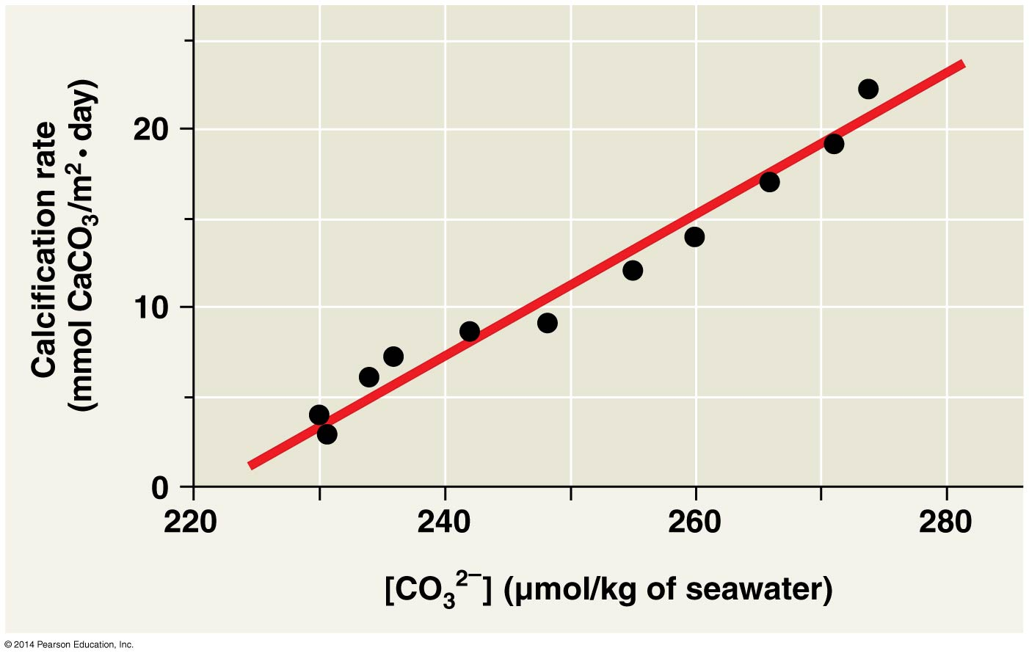
Based on this graph, what is the relationship between carbonate ion concentration and calcification rate?
As the acidity of the seawater increased, the rate of calcification decreased.
As the rate of calcification increased, the concentration of carbonate ions increased.
As the concentration of carbonate ions increased, the rate of calcification
decreased.
As the concentration of
carbonate ions increased,
the rate of calcification
increased.
Notes:
Answer: D

Slide 23
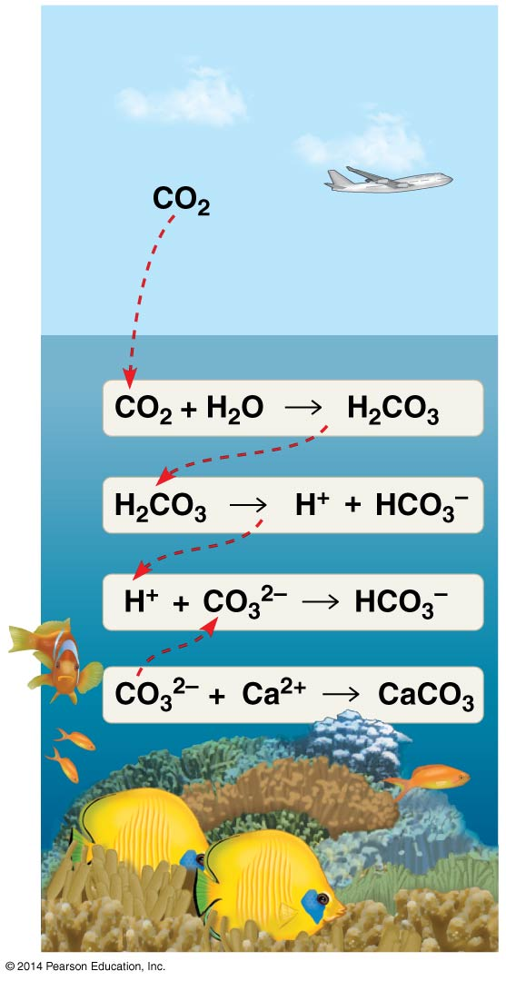
This figure suggests that increased atmospheric concentrations of CO₂ will slow the growth of coral reefs. Do the results of the previous experiment support that hypothesis?
No; more atmospheric CO₂ causes a decrease in the amount of CO₃²⁻
in seawater, leading to faster reef
growth.
Yes; more CO₂ causes an increase
in the amount of CO₃²⁻ in seawater, leading to slower reef growth.
No; more atmospheric CO₂ causes an increase in the amount of CO₃²⁻
in seawater, leading to faster reef
growth.
Yes; more CO₂ causes a decrease
in the amount of CO₃²⁻ in seawater, leading to slower reef growth.
Notes:
Answer: D

Slide 24
Answers to slides
d, d, a, d, d

Slide 25
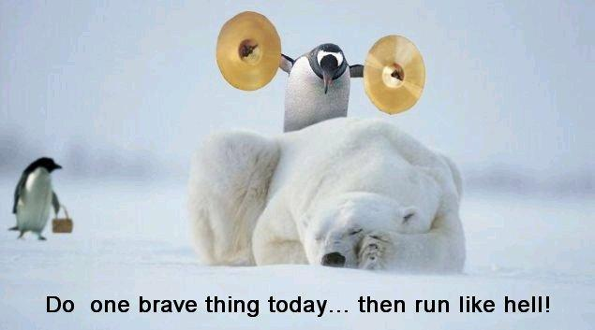
He’s gonna
earn a
Darwin Award!
Any
Questions?
Do one brave thing today…then run like hell!

