Slide 1
Quantitative Skills 4: The Chi-Square Test
“Goodness of Fit”

Slide 2
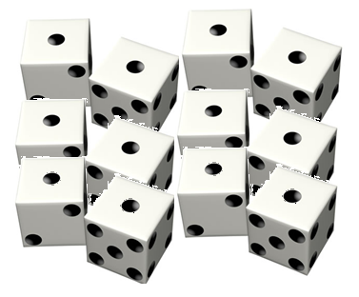
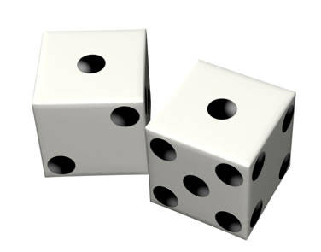
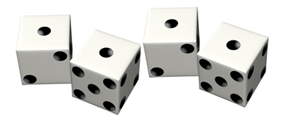
The Chi-Square (X²) Test is used to examine the difference between an actual sample and a hypothetical sample that would be expected due to chance.
Possibly due to chance
Probably due to chance
Probably not due to chance

Slide 3
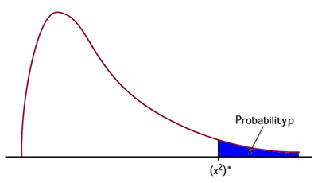
Using Chi-Square, it is possible to discern whether experimental results are valid, or whether they are probably due to chance alone.

Slide 4
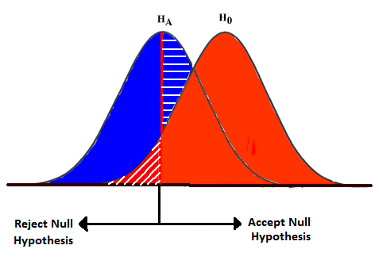
The Chi-Square test compares two rival hypotheses (the null hypothesis and an alternative hypothesis) to see which hypothesis is best supported by the data.

Slide 5
Establishing a null hypothesis (H₀) and an alternative hypothesis (H_{A})
A null hypothesis states that there is no relationship between two variables.
The finding probably occurred by chance.
An alternative hypothesis states that there is a relationship between two variables.
The finding probably did not occur by chance.

Slide 6
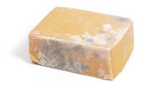
Example : “I think my cheese will mold if I leave it out on the counter too long.”
Example null hypothesis (H₀): If cheese is kept at room temperature for a week, then it will have the same amount of mold on it as the same amount of cheese kept in a refrigerator for a week.
Example alternative hypothesis (H_{A}): If cheese is kept at room temperature for a week, then it will have more mold on it than the same amount of cheese kept in a refrigerator for a week.

Slide 7
The goal of the Chi-Square Test is to either accept or reject the null hypothesis.
If the null hypothesis is accepted, then there probably is no relationship between the two variables and the experimental results were probably due to chance alone.
If the null hypothesis is rejected, then there probably is a relationship between the two variables, and the experimental results are probably not due to chance.

Slide 8
Observed and Expected Results
Observed results are what you actually observed in your experiment.
Expected results are a theoretical prediction of what the data would look like if the experimental results are due only to chance.

Slide 9
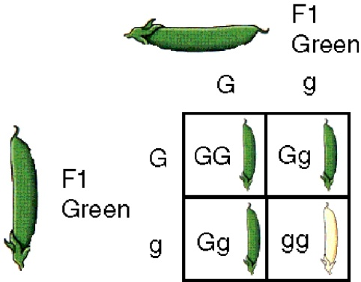
How do you get expected results?
If you are working with a genetics problem, then use the Punnett square ratio as your expected result.
If you are working with a another type of problem, use probability.
P(green) = .75
P(heads) = .5

Slide 10
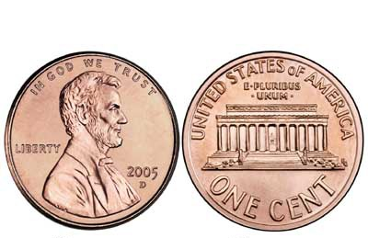
Obtaining the X² value:
Example: We flip a coin 200 times to determine if the coin is fair.
H₀: There is no statistically significant difference between our coin flips and what we would expect by chance. (The coin is fair.)
H_{A}: There is a statistically significant difference between our coin flips and what we would expect by chance. (The coin is not fair.)

Slide 11
The Chi-Square equation:
X ² =
Ʃ
(o – e)²
e

Slide 12
X ² =
Ʃ
(o – e)²
e
X ² = (sum of all)
(observed – expected )²
expected

Slide 13
Example: We flip a coin 200 times to determine if a coin is fair.
Setting up this kind of table is a VERY good idea!
classes | Observed | Expected | (o – e) | (o – e)² | (o – e)² e
Heads | 108
Tails | 92
X ²
100
8
64
.64
100
-8
64
.64
1.28

Slide 14
Critical Value Table
Now you need to look up your X ² value in a critical value table to see if it is over a certain critical value.

Slide 15
Typically, in biology we use the p = 0.05 confidence interval.
The p-value is a predetermined choice of how certain we are. The smaller the p-value, the more confidence we can claim. p = 0.05 means that we can claim 95% confidence.

Slide 16
Calculating Degrees of Freedom
Degrees of Freedom = # classes -1
DF = 2 - 1 = 1
In our example experiment, the classes were heads and tails (2 classes).
Degrees of Freedom in our experiment would be:

Slide 17
Accept or Reject the Null Hypothesis
If the X ² value is less than the critical value, accept the null hypothesis. (The difference is not statistically significant.)
If the X ² value is greater than or equal to the critical value, reject the null hypothesis. (The difference is statistically significant.)

Slide 18
In our example, the X ² value we calculated was 1.28, which is less than the critical value of 3.84. Therefore:
We accept our null hypothesis.
We reject our alternative hypothesis .
We determine that our coin is fair.

