Slide 1
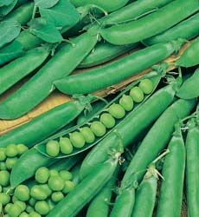
Pre-Lab #5 Cell Respiration
AP Biology

Slide 2
Introduction
Cellular respiration
the release of ENERGY from organic compounds
Uses oxidation in mitochondria within each cell
Involves a series of enzyme-mediated reactions
O₂ is required for this energy-releasing process to occur.
C₆H₁₂O₆ + 6O₂ → 6 CO₂ + 6 H₂O + ATP

Slide 3
Lab Overview
You will work with pea seeds that are living but dormant.
The pea’s biological activity is suspended
not actively growing but protected (as by bud scales or seed coat) from the environment

Slide 4
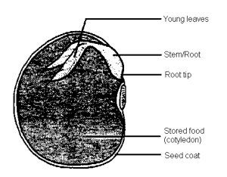
A seed contains…
an embryo plant and a food supply surrounded by a seed coat
When the necessary conditions are met, germination occurs, and the rate of cellular respiration greatly increases.

Slide 5
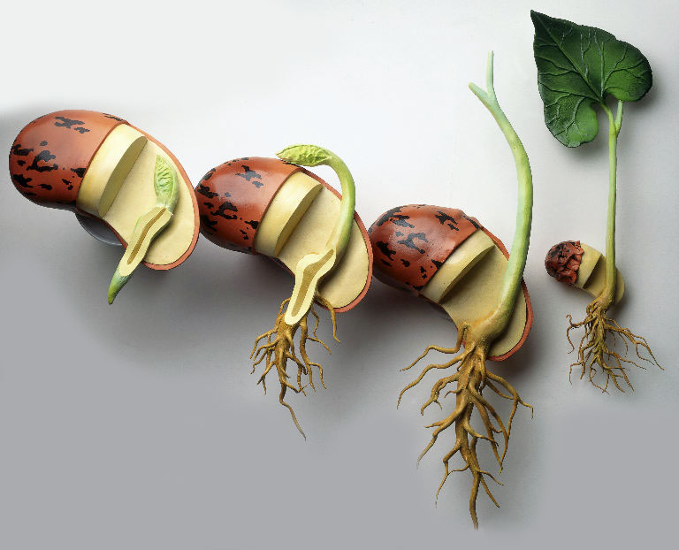
In this experiment…
You will measure O₂ consumption during germination & the rate of cellular respiration at 2 different temperatures
Germination = when growth emerges from a period of dormancy. The most common example = the sprouting of a seedling from a seed.
NOTE: NO PHOTOSYNTHESIS CAN OCCUR IN A SEED. WHY???

Slide 6
Respirometers
You will measure the change in gas volume in respirometers containing either germinating or nongerminating pea seeds.
In addition, you will measure the rate of respiration of these peas at two different temperatures and after 0, 5, 10, and 20 minutes
What’s the IV and DV?

Slide 7
Key Concepts
glucose + oxygen + ADP = carbon dioxide + water + ATP
(C₆H₁₂O₆ + 6O₂ → 6 CO₂ + 6 H₂O + 686 Kilocal/mol glucose)
From equation above, notice there are 3 ways to measure cellular respiration
Consumption of O₂ ( How many moles of oxygen are consumed in cellular respiration?)
Production of CO₂ (How many moles of carbon dioxide are produced by cellular respiration?)
Release of energy (ATP) during cellular respiration.
http://www.phschool.com/science/biology_place/labbench/lab5/process.html
In this experiment, the relative volume of O₂ consumed by germinating and nongerminating (dry) peas at two different temperatures will be measured over time.

Slide 8
Lab Design
We are going to measure the amount of O₂ consumed by using a respirometer
By submerging respirometer under H₂O → no air will enter
The amount of H₂O that enters respirometer is DIRECTLY PROPORTIONAL to the amount of O₂ used up by the organism in the respirometer.
What is the organism being used???
Peas!!!

Slide 9
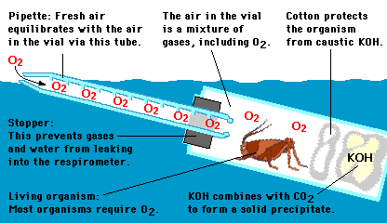
Respirometer

Slide 10
Helpful Hints
All 3 vials need equal VOLUME of contents.
add glass beads to vial w/ dormant peas, since dry peas take up less space than an equal quantity of germinating peas. Why???
Because you are measuring the rate of respiration at two different temperatures, prepare two sets of 3 vials.
You need 6 vials TOTAL!!!

Slide 11
CAUTION
Use layer of nonabsorbent cotton between the KOH and peas.
The stopper must be firmly inserted for an air-tight seal. Wet the seal!!!
Check that NO peas or beads block the opening to the pipette. Try to make the end just above peas/beads.
Let respirometers equilibrate for several minutes in their waterbaths. This will minimize volume changes due to change in air temperature.

Slide 12
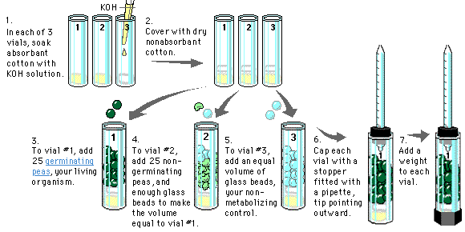
Building the Respirometer

Slide 13
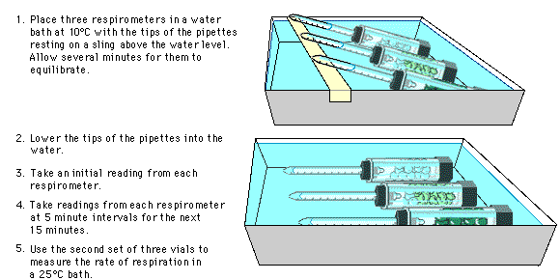
How to Measure the Rate of Respiration

Slide 14
Six respirometers should be set up as follows
Respirometer | Temperature | Contents
1 | Room | Germinating seeds
2 | Room | Dry Seeds and Beads
3 | Room | Beads
4 | 10⁰C | Germinating Seeds
5 | 10⁰C | Dry Seeds and Beads
6 | 10⁰C | Beads

Slide 15
Ideal Gas Law
A number of physical laws relating to gases are important to the understanding of how the respirometer in this lab works.
The laws are summarized by the ideal gas law
PV = nRT where,
P is the pressure of the gas,
V is the volume of the gas,
n is the number of molecules of gas
R is the gas constant, and
T is the temperature of the gas (in K).

Slide 16
Gas law implies following important concepts about gases
PV = nRT
1. If T and P are kept constant, then V of the gas is directly proportional to the n (number of molecules) of gas.
2. If the T and V remain constant, then the P of the gas changes in direct proportion to n (number of molecules) of gas present.
3. If the n and the T remain constant, then P is inversely proportional to V.
4. If the T changes and n is kept constant, then either P or V (or both ) will change in direct proportion to the T.
5. Gases and fluids flow from regions of high pressure to regions of low pressure.

Slide 17
So what should happen when the temp decreases?
If temperature decreases…
KINETIC energy decreases
Molecules move slower
Pressure decreases
BUT…
Diffusion rate decreases/slows down
O₂ takes longer to get INTO the mitochondria in the cell
WHAT WILL HAPPEN TO THE RATE OF O₂ consumption and rate of cellular respiration?
IT WILL SLOW DOWN!!!

Slide 18
How are we going to measure ONLY O₂ gas?
CO₂ produced during cellular respiration will be removed by potassium hydroxide (KOH) and will form solid potassium carbonate (K₂CO₃) according to the following reaction.
CO₂ (g) + 2 KOH (l)----> K₂CO₃ (s) + H₂O (l)
Since CO₂ is being removed, the change in the volume of gas in the respirometer will be directly related to the amount of oxygen consumed.

Slide 19
In the respirometer…
If H₂O temperature and volume remain constant, H₂O will move toward the region of lower pressure.
During respiration, O₂ will be consumed (taken in by peas).
O₂ volume will be reduced, because the CO₂ produced is being converted to a solid.
The net result is a decrease in gas volume within the tube, and a related decrease in pressure in the tube.

Slide 20
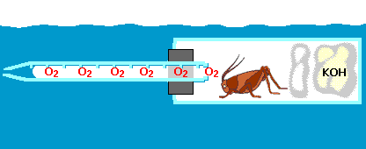
So….what’s really going on?
As O₂ is used up, the pressure of gases inside the respirometer decreases. This causes water to enter the pipette.
http://www.phschool.com/science/biology_place/labbench/lab5/respwork.html

Slide 21
What about the control vial?
Any change in volume in vial with glass beads alone will be due to atmospheric pressure changes or temperature changes.
Only slight changes (if any) should be expected…why???
The amount of oxygen consumed will be measured over a period of time.

Slide 22
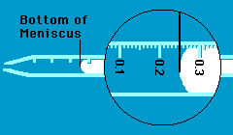
How do you read the pipette?
Place food coloring dye on end of pipette

Slide 23
Post-Lab #5 Cell Respiration
AP Biology

Slide 24
Temperature and the Gas Law
Gas volume is related to the temperature of the gas.
According to the gas law (PV=nRT) , a change in temperature will cause a direct change in volume.
Because temperature in respirometers may vary during experiment, you must correct for differences in volume that are due to temperature fluctuation rather than the rate of respiration.
To do this…
subtract any difference in the movement of water into the control vial with glass beads from the experimental vials with seeds held at the same temperature.
This is an example of error analysis.
Record the result as the corrected difference.

Slide 25
Analysis of Results
After all data is collected for amount of O₂ consumed over time by germinating and nongerminating peas at two different temps, you can compare the rates of respiration.
How to calculate rate:
Rate = slope of the line, or in this case, y is the change in volume, and x is the change in time (in min).
You will find that germinating peas have a high respiratory rate, while non-germinating plants have a low respiratory rate. Why????

Slide 26
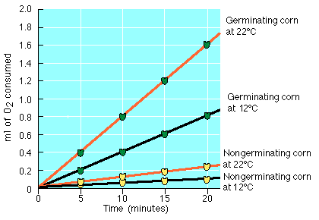
Conclusions
↓temp = ↓respiration
↑germination = ↑respiration

