Slide 1
Howdy?
On the back of your notes, finish this sentence and then answer the question
“I feel superior to others around me, therefore I am entitled to…”
WHY do you feel that way?

Slide 2
Objectives
Explain the Factors that fueled American imperialism
Describe U.S. acquisition of Alaska and annexation of Hawaii
Analyze a primary source passage

Slide 3
America & Imperialism
The Rise of American Power
1867-1914

Slide 4
Imperialism
What is it?
- Stronger nations extend their economic, political, and military control over weaker territories
Why? For what purpose?
- Global Competition: Africa and Asia, particularly China

Slide 5
American Imperialism
What motivated the U.S. to join in? 3 Factors:
Desire for military strength
Alfred T. Mahan & the growth of naval power
Thirst for new markets
…and raw materials (mercantilism)
Belief in cultural superiority
Social Darwinism
Missionary spirit

Slide 6
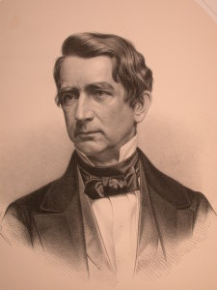
1867 Alaskan Purchase
William H. Seward
$7.2 million for Alaska
Seward’s Folly or Seward’s Icebox
Was it an act of folly?
Would you buy Alaska if you were Seward?
Timber
Minerals (gold, silver, zinc, etc.)
Oil (Drill, baby, drill!)
All for 2¢/acre
***The Seward House in Auburn

Slide 7
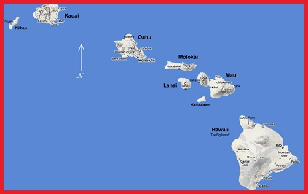
Hawaii
Why was Hawaii
important?
Notes:
One of the biggest reasons why the US wanted Hawaii was a similar reason for its imperialism- acquire strategic military bases. Because Hawaii is much further out into the Pacific Ocean, it provides the US with a military base closer to Asia. This came in handy during WWII, at the Pearl Harbor naval base, which was attacked by the Japanese on December 7, 1941. The base ended up being a crucial beginning point in our Pacific campaign against Japan.
Another reason the US wanted Hawaii was for its lucrative sugar trade. Hawaii was a large sugar producer, and the United States charged high tariffs for Hawaiian sugar merchants. By annexing with the United States, Hawaii no longer had to deal with tariffs, and the US could profit directly from Hawaiian sugar.

Slide 8
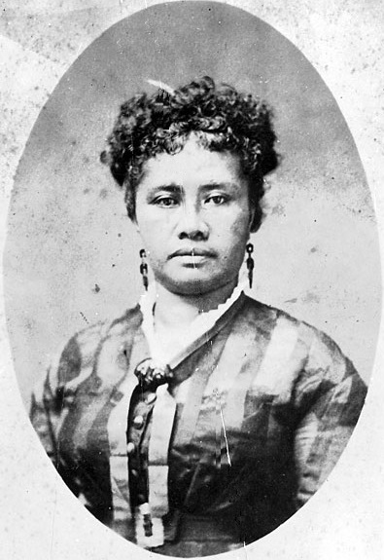
Hawaii
Aloha!
Midway point
Coaling/refueling
station
Pearl Harbor naval base
Sugar & pineapples
Sanford B.
- Overthrew Queen Liliuokalani
- U.S. annexed Hawaii in 1898

Slide 9
Primary Source Analysis
“Fate has written our policy for us; the trade of the world must and shall be ours… We will establish trading points throughout the world as distributing points for American products…”
Indiana Senator Albert J. Beveridge
Study the passage.
Which factor of imperialism is mentioned in the passage? Explain and support your answer.
Be prepare to share!
Submit your completed work on the way out. Thank you. (25 points)

