Slide 1
America & Imperialism
America as a World Power

Slide 2
Objectives
Identify the causes and effects of the Philippine-American War
Explain the purpose of the Open Door Notes in China
Describe the Roosevelt Corollary, Dollar Diplomacy, & Moral (Missionary) Diplomacy

Slide 3
The Philippines
How did the U.S. get involved?
2nd front during the Spanish-American War
Saw it as a part of an American overseas empire
Coaling stations (Factor #?)
How did the Filipinos first view the Americans?
As liberators and allies

Slide 4
The Philippine-American War (1899-1902)
Causes
The Treaty of Paris (1898)
$20 million for the Philippines
President McKinley installed a colonial government
The Filipinos resisted American rule

Slide 5
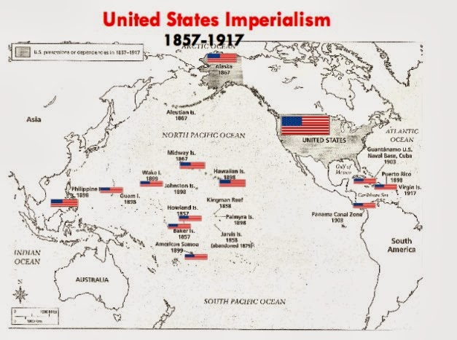

Slide 6
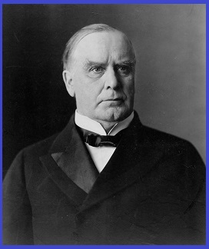
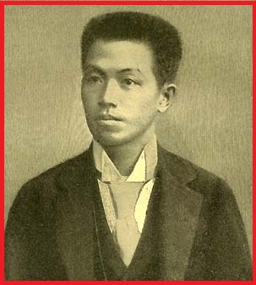
The Philippine-American War (1899-1902)
“They (the Filipinos) are
unfit for self-government”
(Factor #?)
Effects
Aguinaldo was captured in 1901
5,000+ U.S. casualties vs. 200,000+ Filipino casualties
Remained a U.S. territory until 1946

Slide 7
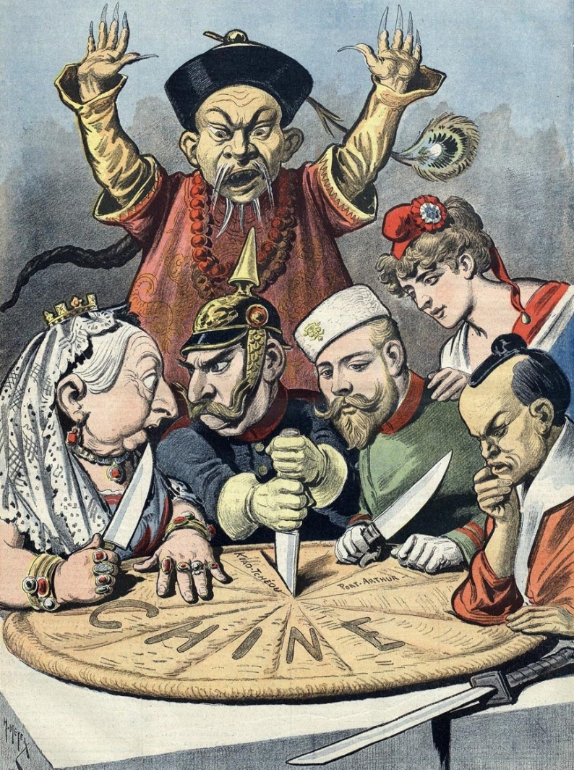
The Open Door Notes
Why was China
important?
(Factor #?)

Slide 8
The Open Door Notes
Whose door?
China
Secretary of State John Hay
sought to create an equal
market for all to trade in China
ordered European powers
and Japan not to annex any
Chinese territory
How did we plan to enforce it? (Factor #?)

Slide 9
The Boxer Rebellion (1900)
Who were the Boxers?
Hated foreigners. Why? (Factor #?)
Opposed Christianity, the ruling Qing Dynasty, and “foreign devils”
Hundreds of missionaries and foreigners were killed
Eight-Nation Alliance troops put down the rebellion
Thousands of Chinese died

Slide 10
The Boxer Rebellion (1900)
Eight-Nation Alliance

Slide 11
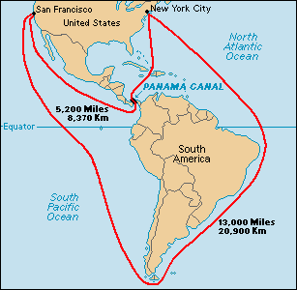
World Power
Theodore Roosevelt
- Russo-Japanese Peace Mediation
Nobel Peace Prize (1906)
Panama Canal
Connect the Atlantic and Pacific
Two ocean Navy
What was the big deal? (Factor #?)

Slide 12
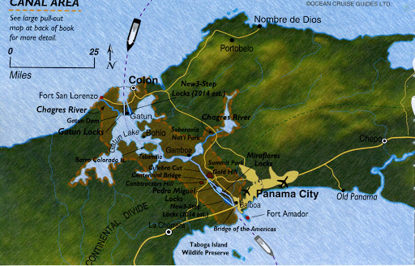

Slide 13
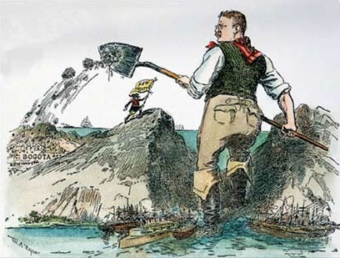

Slide 14
World Power
Theodore Roosevelt
Roosevelt Corollary
Extension of the Monroe Doctrine (Cat)
U.S. would utilize military action acting as an international police force
(Regents)
Corollary – an additional statement that follows logically from the first one

Slide 15
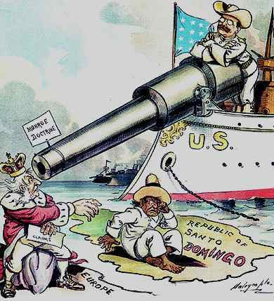

Slide 16
U.S. Foreign Policy (Latin America)
Roosevelt
Big Stick Policy
“Speak softly and carry a big stick.”
Intervened in Latin America to protect U.S. interests
Taft
- Dollar Diplomacy
Maintained order in other countries by increasing U.S. investments
Gave us the justification to intervene

Slide 17
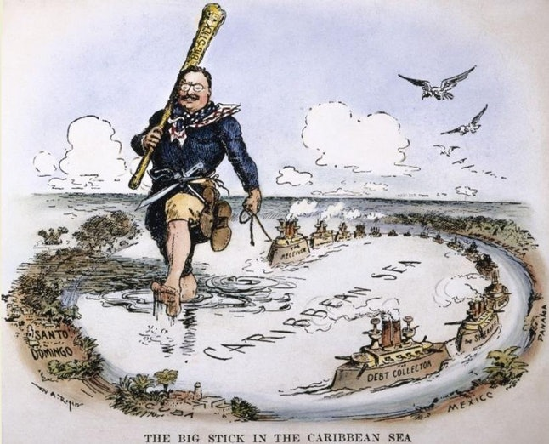

Slide 18
U.S. Foreign Policy (Latin America)
Wilson
- Moral (Missionary) Diplomacy
U.S. should model moral behavior
No trade or interaction with hostile governments

Slide 19
Evaluate U.S. Foreign Policy
“America has no permanent friends or enemies, only INTERESTS.”
Henry Kissinger, Secretary of State (1973-1977)
Guiding Question: Do you feel the discussed foreign policies were designed to protect American interests? How?
Present and defend your answers
Be prepared to share!

