Slide 1
Good Morning
Bell work: Think About It
How would you feel if you had to work 10 to 12 hours a day, 6 days a week in a noisy, dangerous factory instead of going to school?

Slide 2
The Progressive Movement
…a reform movement
aimed to return control
of the government to the
people, to restore economic
opportunities,
and to correct
social injustices

Slide 3
Objectives
Comprehend the 4 goals of progressivism.
Conduct a student-led group-to-group exchange to analyze the 4 goals of progressivism.
Connect modern social, economic, and social issues with progressivism.

Slide 4
Four Goals
Protecting social welfare
Creating economic reform
Fostering efficiency
Promoting moral improvement

Slide 5
Group-to-Group Exchange
Assign groups and topics.
Read topic individually, then discuss and complete graphic organizer as a group.
Present findings and ideas to the class.
Respond to questions and comments.
“I do and I understand.”

Slide 6
1. Protecting Social Welfare
…to soften some of the harsh conditions of industrialization.
Young Men’s Christian Association (YMCA)
Libraries, classes, swimming pools, & handball courts
Salvation Army
Soup kitchens & children nurseries
“Slum Brigades” to teach the poor about temperance and hard work
Florence Kelly
Worked to protect women and children
Helped with the 1893 Illinois Factory Act passage

Slide 7
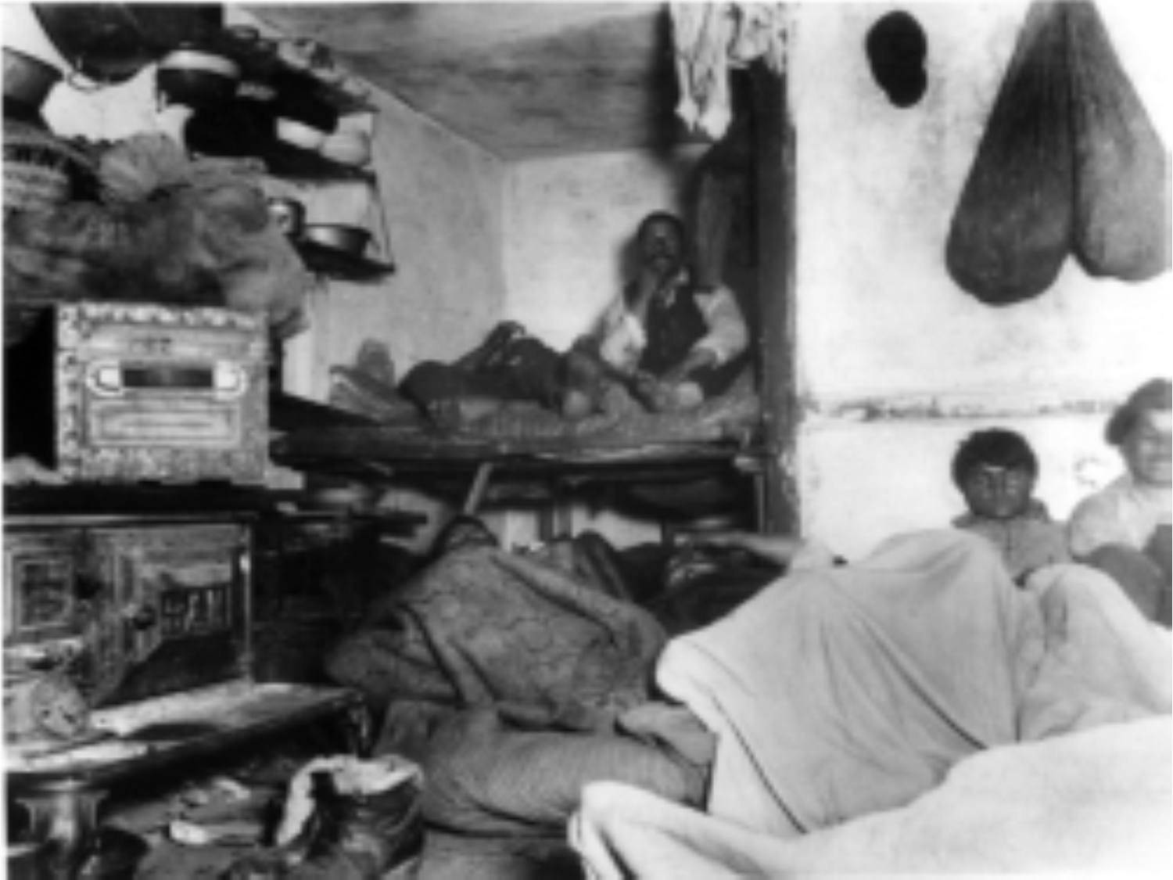

Slide 8
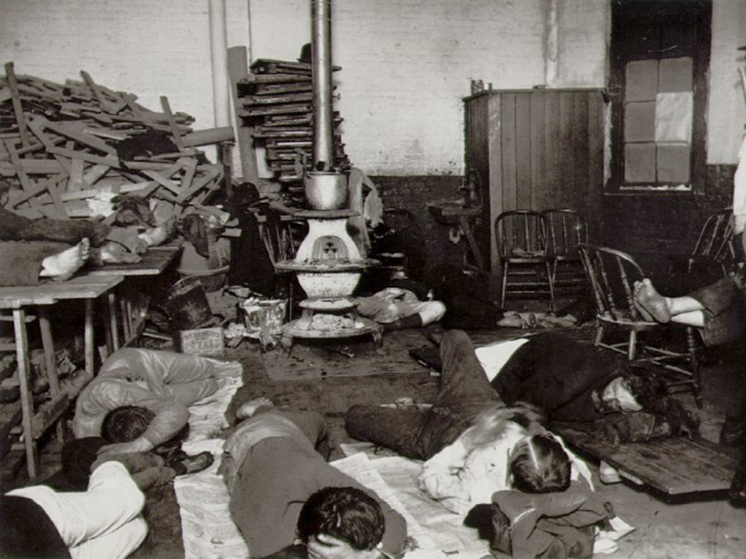

Slide 9
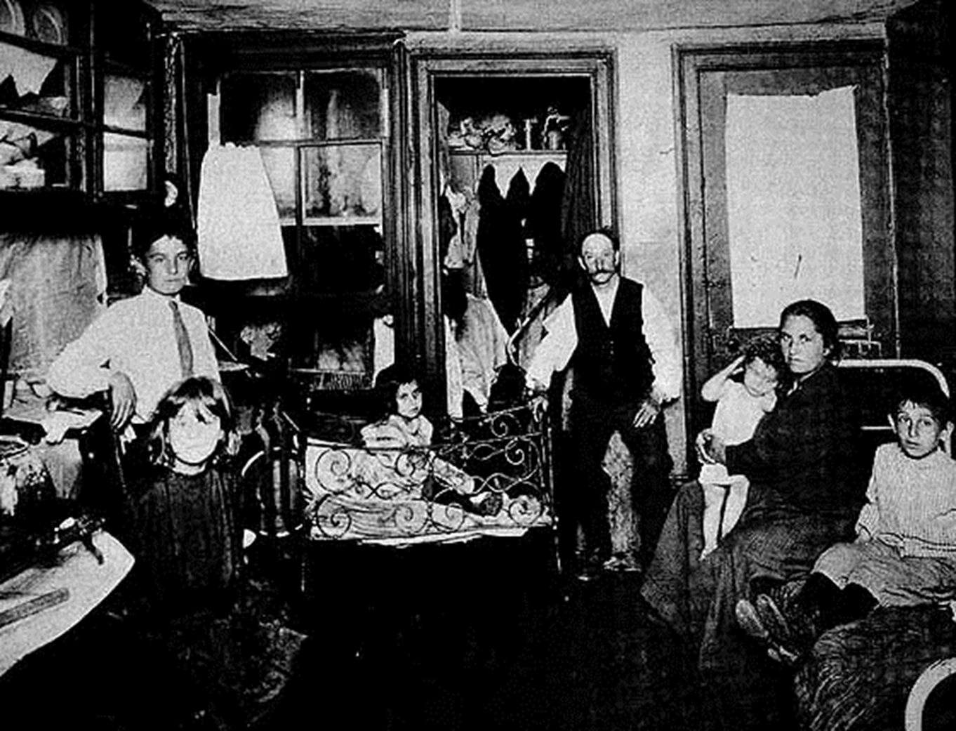

Slide 10
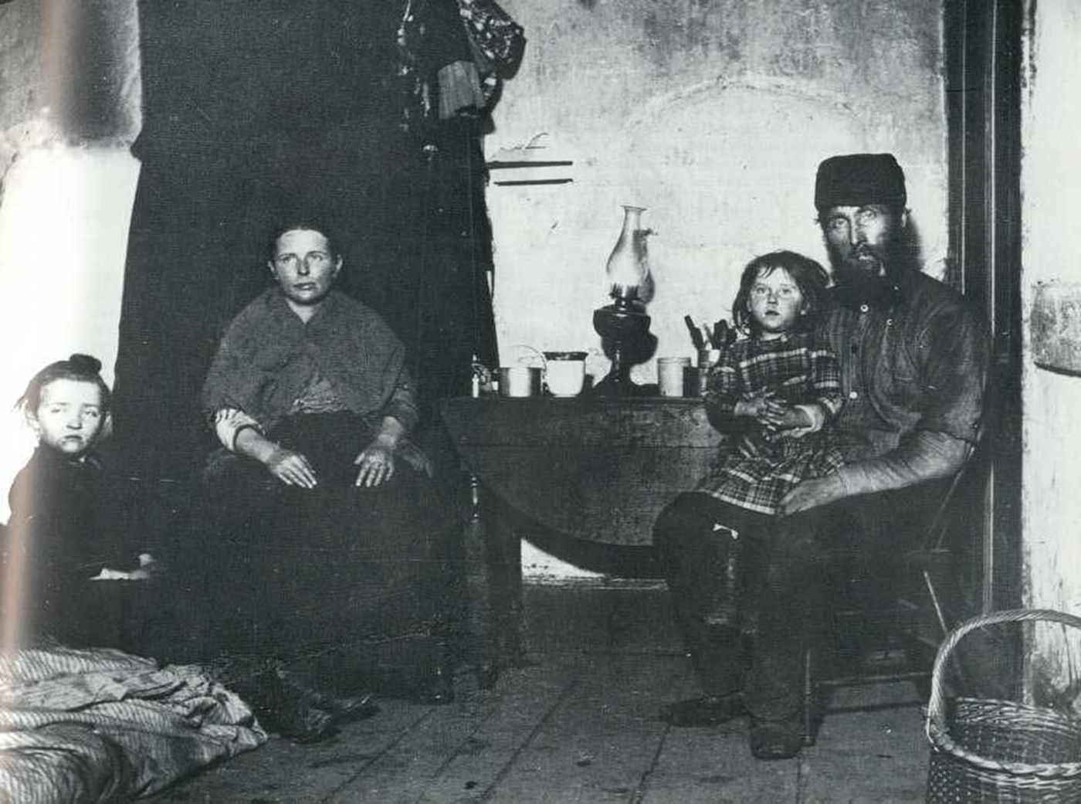

Slide 11
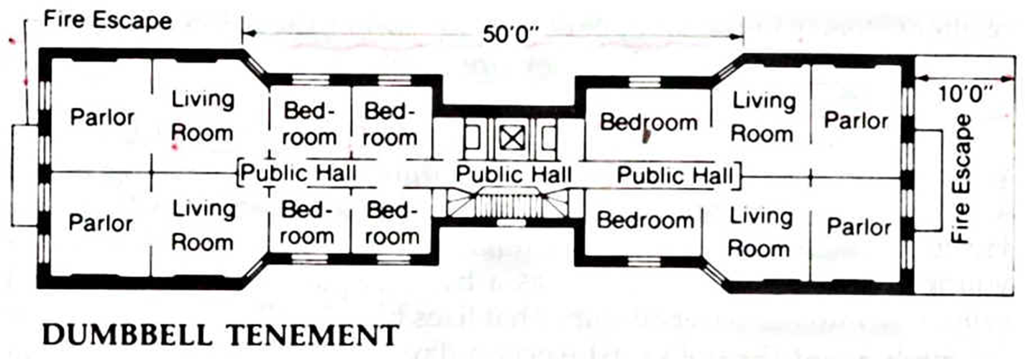

Slide 12
Child Labor

Slide 13
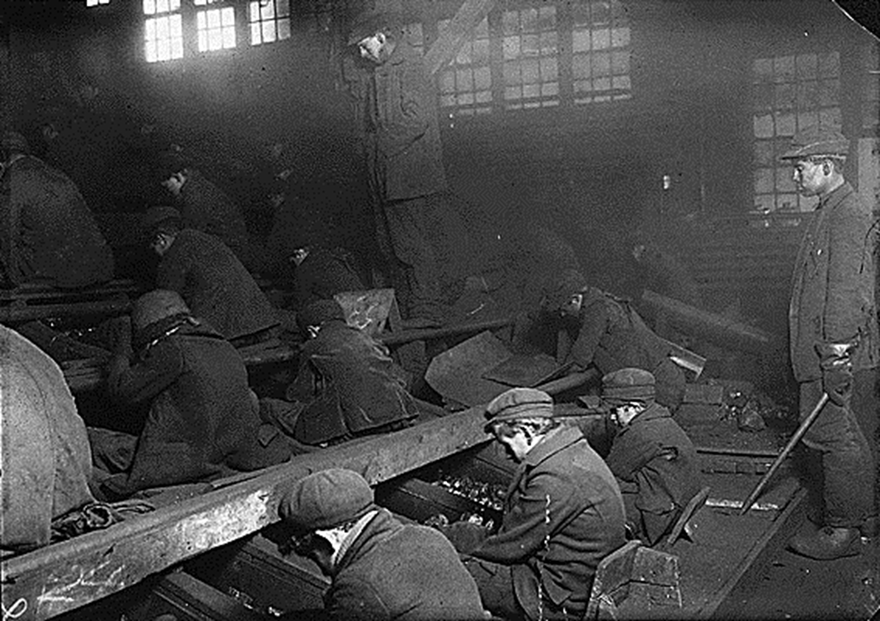

Slide 14
2. Creating Economic Reform
…to address the uneven balance among big business, government, and ordinary people
Socialism
Cooperative management of the economy and production
Eugene V. Debs
Started the first American Socialist Party
Muckrakers
Ida Tarbell – History of the Standard Oil Company
Upton Sinclair – The Jungle

Slide 15
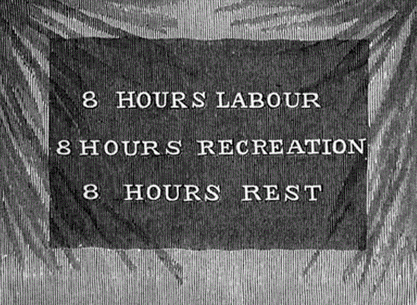
Labor

Slide 16
3. Fostering Efficiency
…to make society and the workplace more efficient
Brandeis Brief
Long hours were costly to individuals and society
Frederick Taylor
Taylorism –break manufacturing into smaller parts
Scientific management – how quickly each task could be performed
Results
People expected to work like machines

Slide 17
Assembly Line

Slide 18
4. Moral Improvement
…to help people to uplift themselves by improving their personal behavior
Prohibition
Founded by the Women’s Christian Temperance Union (WCTU)
Banning the sale and consumption of alcohol
Carrie Nation
Worked to end saloon business
Smashed bars up with a hatchet and bible
Anti-Saloon League
Worked to pass laws forcing people to change

Slide 19
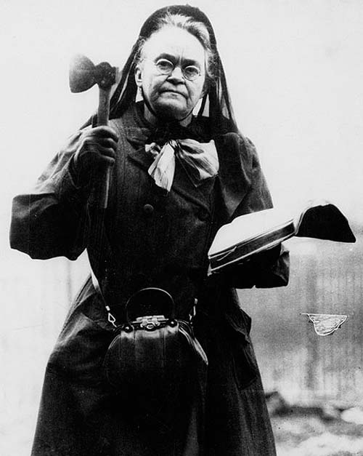
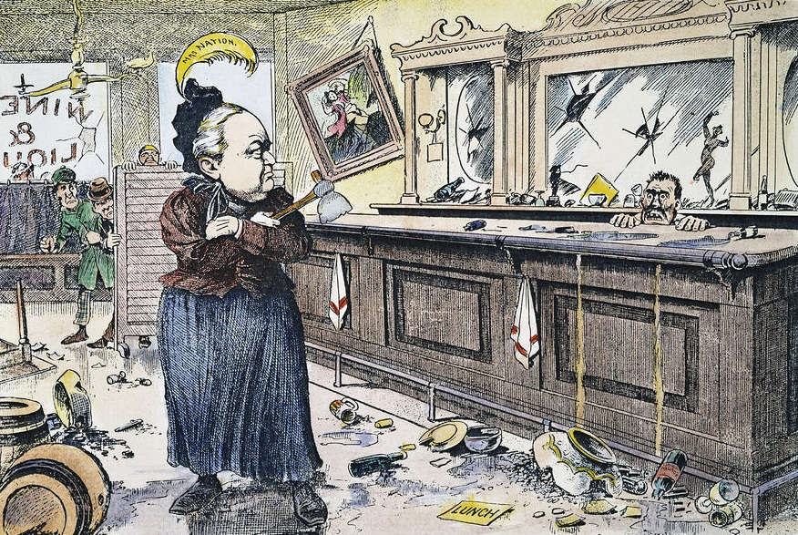
Moral Improvement
Carry Nation

Slide 20
Create an ACRONYM
Acronym – an abbreviation formed from the initial letters of other words and pronounced as a word
Examples:
AWOL – Absent Without Leave
ASAP – As Soon As Possible
Create an acronym to summarize the 4 goals of progressivism.

