Slide 1
Women in Public Life

Slide 2
Learning Objectives
Identify leaders of the woman suffrage movement.
Explain how woman suffrage was achieved.
Evaluate why the Western states were the first to grant full voting rights for women.

Slide 3
Guiding Questions
What strategies did women use to win the right to vote?
Why were the Western states the first in the nation to grant women full voting rights?

Slide 4
Terms & Names
NACW – the National Association of Colored Women—a social service organization founded in 1896.
Suffrage – the right to vote.
Susan B. Anthony – key leader of NAWSA.
NAWSA – the National American Woman Suffrage Association—an organization founded in 1890 to gain voting rights for women.

Slide 5
Women Workers: Late 1800s
Farm Women – domestic work and farm labor
Domestic Workers – servants, cooks, maids, and laundresses
Factory Workers *– manufacturing and garment trades; 1 out of 4 working women
White-collar Workers – stenographers, typists, bookkeepers, and teachers

Slide 6
Suffrage
Under the leadership of Susan B. Anthony, the NAWSA, created in 1890, tried 3 approaches.
To convince state legislatures to grant women the right to vote.
To pursue court cases to test the Fourteenth Amendment.
To push for a national constitutional amendment to grant women the right to vote.

Slide 7
The West was Ahead? Why?

Slide 8
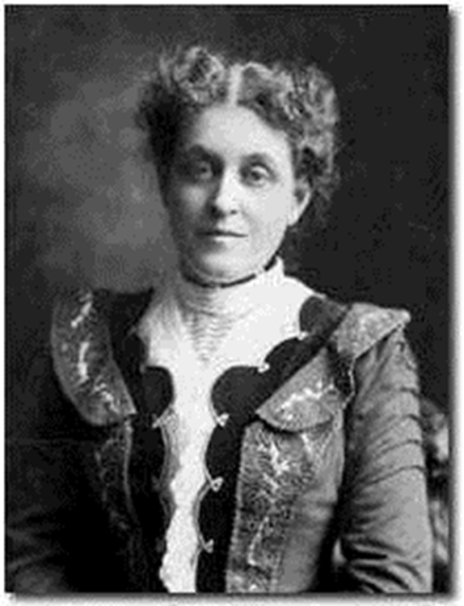
New Tactics in a New Century
Between 1900 and 1920, the woman suffrage movement modernized, adopting new tactics of lobbying, advertising, and grass-roots organizing under the leadership of Carrie Chapman Catt.

Slide 9
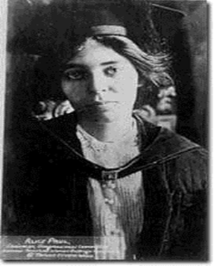
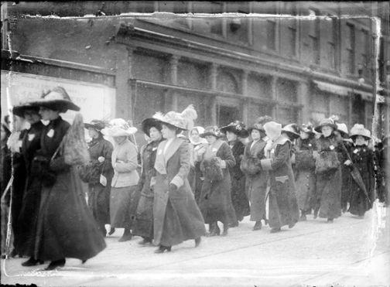
RADICALS!
Alice Paul and Lucy Burns gave a new direction to the women’s rights movement.
In 1913, Paul and Burns organized the National Woman’s Party (NWP), adopted the radical tactics of the British suffragettes, and campaigned for the first Equal Rights Amendment.
The Woman’s Party was one of the first groups in the United States to employ the techniques of classic non-violent protest.

Slide 10
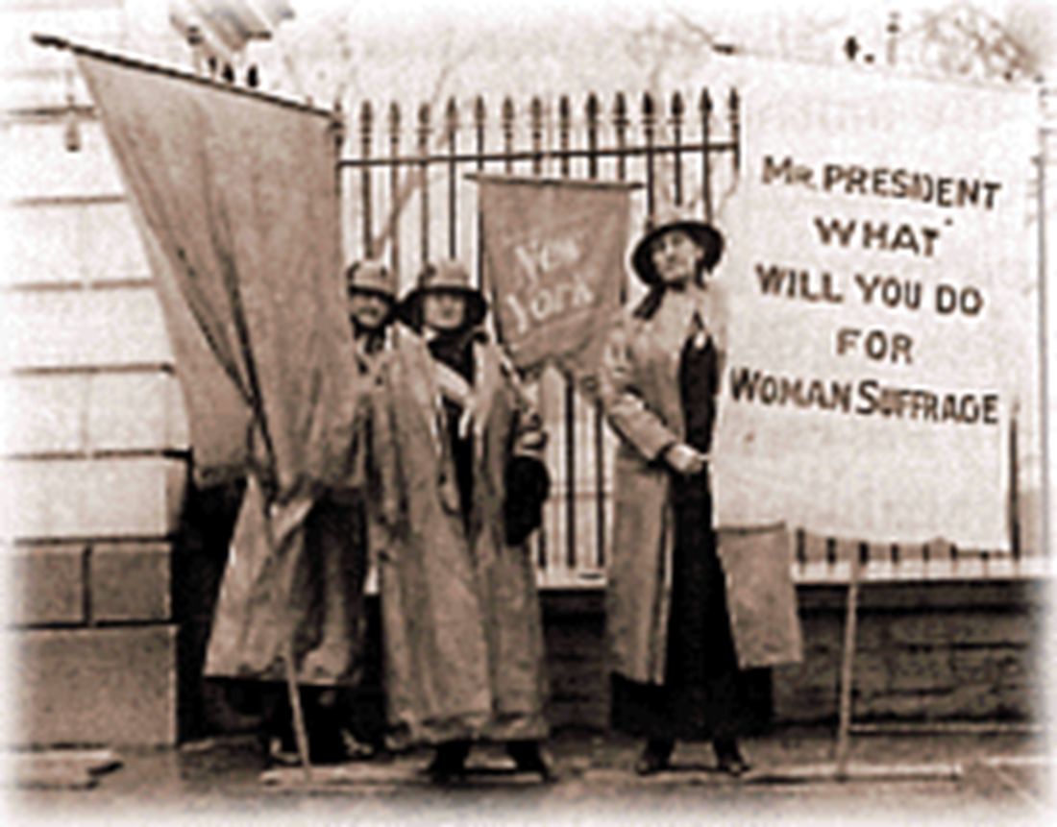
Trouble
Jan. 10, 1917: The NWP began to picket the White House.

Slide 11
19th Amendment
“The right of citizens of the United States to vote shall not be denied or abridged by the United States or by any State on account of sex. Congress shall have power to enforce this article by appropriate legislation.”
It was ratified on August 18th, 1920.

