Slide 1
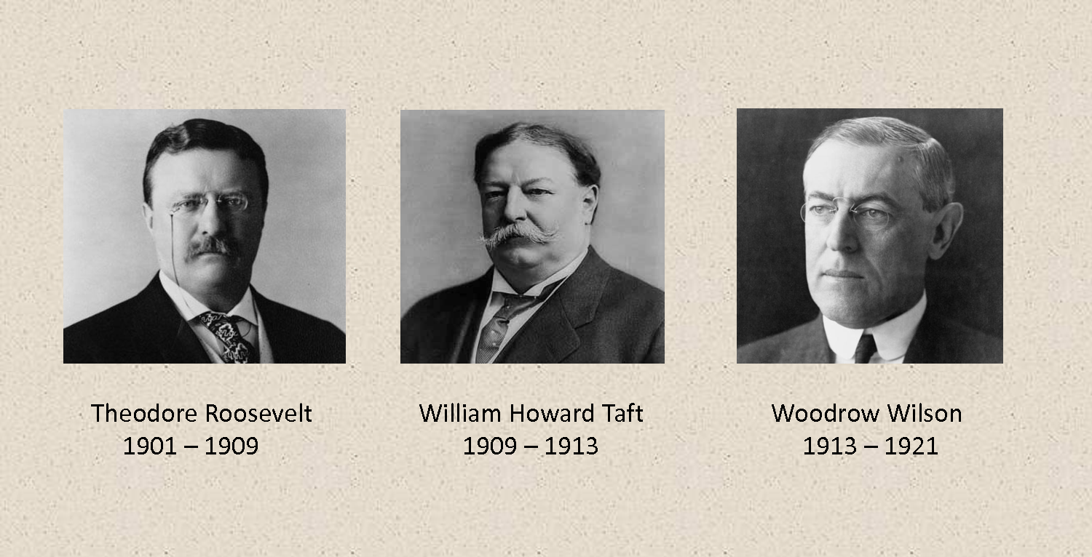
The Progressive Presidents

Slide 2
Learning Objectives
Explain how the Progressive Presidents used the power of the presidency to regulate business
Analyze laws passed to protect the public and the environment

Slide 3
Terms & Names
Conservation – the planned management of natural resources
Accommodation – adapting or making adjustments in order to satisfy someone else
NAACP – the National Association for the Advancement of Colored People, founded in 1909 to promote full racial equality
Bull Moose Party – the Progressive Party formed to support Theodore Roosevelt’s candidacy for the presidency in 1912

Slide 4
Theodore Roosevelt
1898 - Hero of the Spanish-American War
1899 - 33rd Governor of New York
1900 - Elected Vice President
1901 - Became 26th President when President McKinley was assassinated
- Youngest President in U.S. History
1904 - Elected as President
- Offered Americans a “Square Deal”

Slide 5
T. R. – Consumer Protection
Used presidential power to deal directly with social and economic problems
Meat Inspection Act (1906) - gave officials the power to check the quality of meats
Pure Food and Drug Act (1906) - banned the manufacture and sale of impure food, drugs and liquors; required correct labeling
Created the Food and Drug Administration (FDA) to prevent the sale of dangerous products to the public

Slide 6
T. R. – Regulating Business
Focused on strengthening regulations and breaking up trusts
Hepburn Act (1906) - required railroads to obtain permission from the Interstate Commerce Commission (ICC) before raising rates
Regulated “good trusts” and dissolved “bad trusts” earning T. R. a reputation as a trust buster

Slide 7
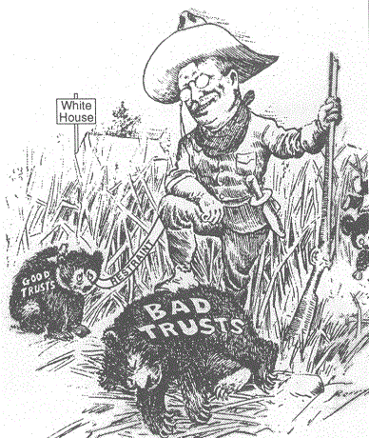
T. R. – Regulating Business
Formed the Bureau of Corporation to pressure trusts through official investigations and publicity

Slide 8
T. R. – Labor Conditions
Achieved important reforms in working conditions
The Anthracite Coal Strike (1902) - mine owners refused to negotiate with striking workers, T. R. threatened to send troops to take over the mines and arbitrated a deal limiting working hours and raising wages
Employers Liability Act (1906) - provided accident insurance for railroad workers

Slide 9
T. R. – Conservation
Interested in protecting the nation’s wilderness lands
The National Reclamation Act (1902) - set aside money to build dams and irrigation systems in the West
The U.S. Forest Service (1905) - headed by conservationist Gifford Pinchot oversaw the federal protection of 150 million acres of public lands

Slide 10
T. R. – Civil Rights
Failed to support civil rights for African Americans
Booker T. Washington - head of the Tuskegee Institute, an all-black training school, promoted accommodation
W. E. B. Du Bois - a founder of the NAACP who demanded for immediate social and economic equality for African Americans
Racial equality found little support in the Progressive Movement

Slide 11
William Howard Taft
1901 - Governor-General of the Philippines
1908 - Elected as the 27th President
- T. R. declined a third term and handpicked Taft to succeed him
- Heaviest President in U.S. History
1921 - 10th Chief Justice

Slide 12
Taft – Reforms
Brought twice as many lawsuits against big business as it had under Roosevelt
The Mann-Elkins Act (1910) - gave the ICC the power to regulate communication by telephone and telegraph
The Sixteenth Amendment (1913) - gave Congress the power to levy an income tax
Instituted the 8 hour work day and advocated for mine safety

Slide 13
Taft – Problems
Split the Republican Party into a Taft faction and a Progressive faction
The Payne-Aldrich Act (1909) - Taft wanted to lower tariffs yet praised Congress when it raised tariffs angering Progressives
Dismissed Gifford Pinchot – Secretary of the Interior Richard A. Ballinger sold several million acres of Alaskan public lands, Pinchot protested and Taft fired him further angering Progressives

Slide 14
Election of 1912
T. R. challenged Taft for the Republican nomination, the nomination went to Taft
Supporters of T. R. created a new political party, the Progressive Party or Bull Moose Party
Candidates:
Republican - William Howard Taft
Democratic - Woodrow Wilson
Bull Moose - Theodore Roosevelt
Socialist - Eugene V. Debs

Slide 15
Woodrow Wilson
1902 - 13th President of Princeton University
1911 - 34th Governor of New Jersey
1912 - Elected as the 28th President
- His platform was the “New Freedom”
- The only President in U.S. History to hold a Ph.D.
Dr. President?

Slide 16
Wilson – Financial Reforms
Aimed for a return to competition in the marketplace with enforcement of antitrust laws
The Underwood Tariff Act (1913) - lowered tariffs and provided for a graduated income tax
The Federal Reserve Act (1913) – created 12 national banks exercising monetary controls
Issue currency
Control the amount of money in circulation
Shift money from one bank to another as needed

Slide 17
Wilson – Business Regulation
The Federal Trade Commission Act (1914) - aimed to prevent unfair competition; created a commission to investigate such practices as false advertising and mislabeling
The Clayton Antitrust Act (1914) - extended the Sherman Antitrust Act (1897) to control business practices that threatened competition

Slide 18
Wilson – Other Reforms
The Adamson Act (1916) - set an 8 hour day for railroad workers
The Federal Farm Loan Act (1916) - made low-interest loans available to farmers
Ratification of the Nineteenth Amendment (1920) - gave women the right to vote

Slide 19
Progressivism Summary

Slide 20
One-Word Summaries
Write one word that summarizes the lesson’s topic.
Explain why you chose that word.
Example: Regulate. I chose “regulate” because one of the roles of government is to ensure safe and fair business practices.

