Slide 1
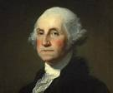
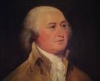
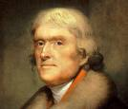
The United States and the World

Slide 2
Objectives
Analyze the foreign and domestic policies of the United States

Slide 3
Washington
Proclamation of Neutrality-1793
Jacobins in France declared revolution on all monarchies, including Britain.
US Split
Federalists-Supported Brits
Democratic-Republicans- supported French
Washington declared neutrality in all aspects of international affairs to continue economic vitality

Slide 4
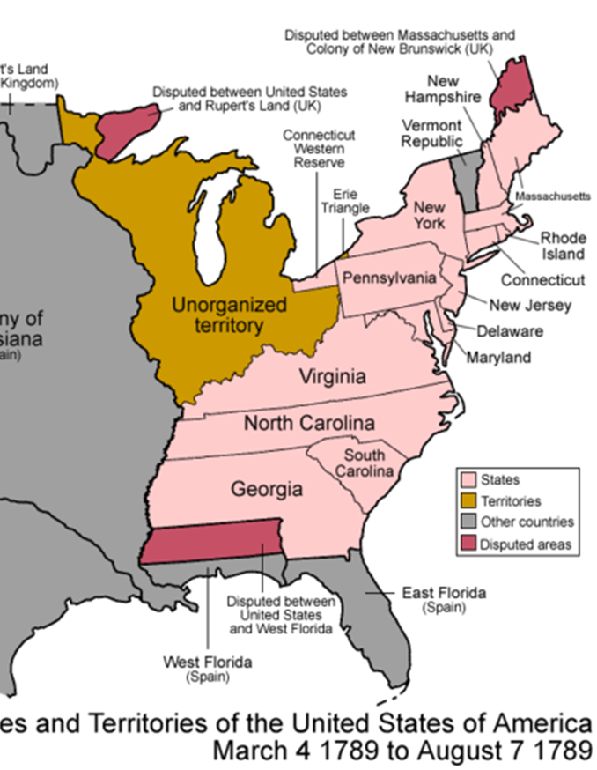
Pinckney’s Treaty
Treaty of San Lorenzo/ SPAIN
1795
US received
All land east of the Mississippi (except FLA)
31st parallel the southern most boundary
Shipping rights on the Mississippi River
Use of the Port of New Orleans

Slide 5
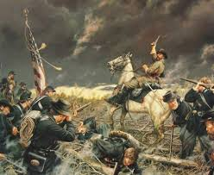
Interactions with Native Americans

Slide 6
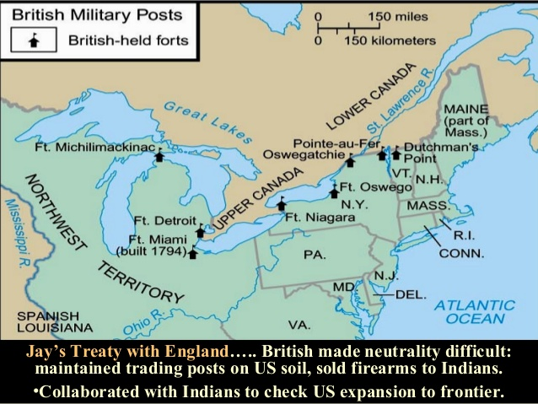
Dealing with the British
Jay’s Treaty
Brits conceded to remove troops from the Northwest territories (but really did not!)
Brits were allowed to continue fur trade in the US/ Canadian border

Slide 7
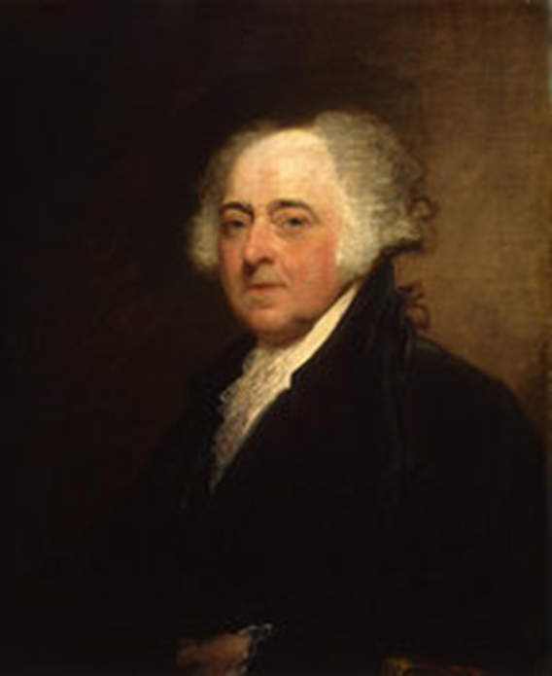
The election of 1796
1796 election
John Adams (Fed)- 71 Electoral votes
T. Jefferson (D-R)- 68
Adams becomes president
Jefferson becomes vice-president

Slide 8
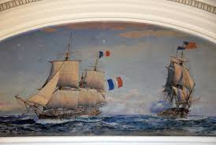
War with France?
French are mad about Jays Treaty.
Adams sends a delegation to meet Talleyrand
Charles Pinckney
John Marshall
Elbridge Gerry
Talleyrand sends his delegation of lowly diplomats
Mr. X, Y and Z
Demands 250,000 dollar bribe
Adams “Millions for defense, but not one cent for tribute!”
Builds up the military to be prepared
Gerry eventually brokers peace

Slide 9
Retribution
Alien and Sedition Acts passed!
Residency changed from 5-14
Deport or jail any undesirables
Sedition- jail or fine anyone for trying to hinder the government or saying anything against the government
Hmmmmmm……

Slide 10
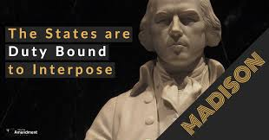
The states respond
Virginia and Kentucky Resolutions
Jefferson and Madison
Nullification- states could declare a federal law null and void
Declared the Alien and Sedition acts unconstitutional
Hmmmmmmmmmmmmmmm……….

Slide 11
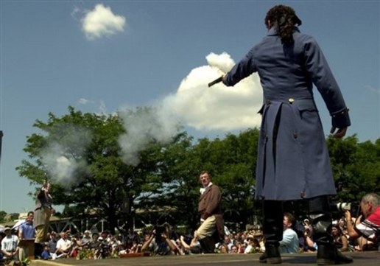
Jefferson pushes forward
Election of 1800
Jefferson and Aaron Burr (his running mate)
tied (both beating John Adams)
House of Reps breaks the tie
Alexander Hamilton convinced Federalists
to cast blank votes so Jefferson would win
Hamilton thought Jefferson the lesser of two evils
Proved a costly mistake
Amendment TIME!
This leads the 12th amendment
Separate ballots for P and VP

Slide 12
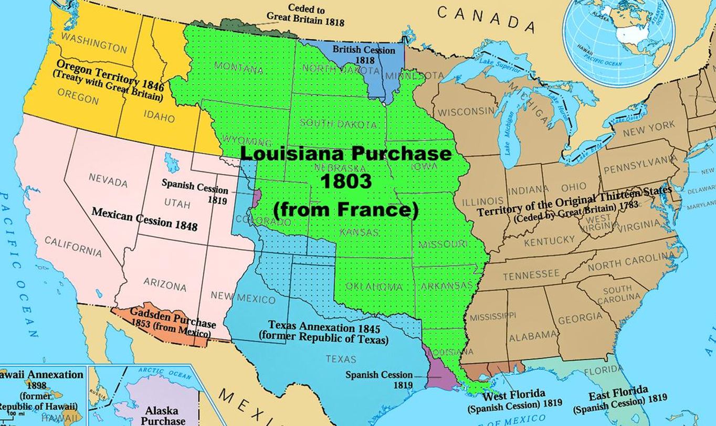
Simplifying the Presidency
Jefferson filled many vacancies with D-R’s to balance the Federalist
Simple Government needed (drew down the military)
Louisiana Purchase:
Bought for 15 million dollars from France
Doubled the size of the United States
Made Jefferson “adjust” his view on the Constitution.

